Slide 1

Technology and Society
Notes:
Good afternoon everyone! Welcome to Collaborative Collision: Technology and Society! My name is Mike Mitchell, program manager for strategic initiatives and proposal development in the Office of Research Development and I’ll be your host this afternoon. Today is our 13th Collaborative Collision since 2016, and I’m excited to see nearly 40 Florida State researchers joining us to discuss their interests, expertise, and resources in the Technology and Society topic area. I’d also like to mention that this program is being recorded and will be posted to research.fsu.edu/CollaborativeCollision.

Slide 2

Technology and Society
Welcome | Dr. Gary K. Ostrander Vice President for Research | 3:00-3:05
NSF, Interdisciplinarity, & Collaboration | Dr. John Parker Program Officer, National Science Foundation | 3:05-3:30
Q&A with Dr. Parker | Moderated by Mike Mitchell Please submit questions via Zoom chat | 3:30-3:40
Event Overview | Mike Mitchell Program Manager, Office of Research Development | 3:40-3:45
Research Profile Presentations | Presenters | 3:45-5:45
Closing Remarks | Dr. Michelle Kazmer Associate Dean for Academic Affairs and Faculty Advancement, College of Communication and Information | 5:45-6:00
Please message Beth Hodges or Rachel Goff-Albritton for assistance during the program
Notes:
A quick overview of our program this afternoon:
In a moment we’ll welcome Dr. Gary Ostrander, Vice President for Research at FSU for some opening remarks about the importance and opportunities of collaborative research at FSU.
We’ll then be joined by this afternoon’s keynote speaker, Dr. John Parker, Program Director with the National Science Foundation’s Division of Social and Economic Sciences for a presentation on NSF, Interdisciplinarity, and Collaboration. I’ll then moderate a brief Q&A session, in which we invite you to submit questions via the Zoom chat.
After this I’ll then go over the event format, and we’ll begin your research profile presentations. Finally, Dr. Michelle Kazmer will talk a little about the upcoming Technology, Innovation, and Culture initiative at FSU.
If at any point this afternoon you have technical difficulties or need assistance, please message Beth Hodges or Rachel Goff-Albritton in the chat.
It’s now my pleasure to introduce Dr. Gary Ostrander, Vice President for Research.

Slide 3

Dr. Gary K. Ostrander
Vice President for Research and Professor of Medicine

Slide 4
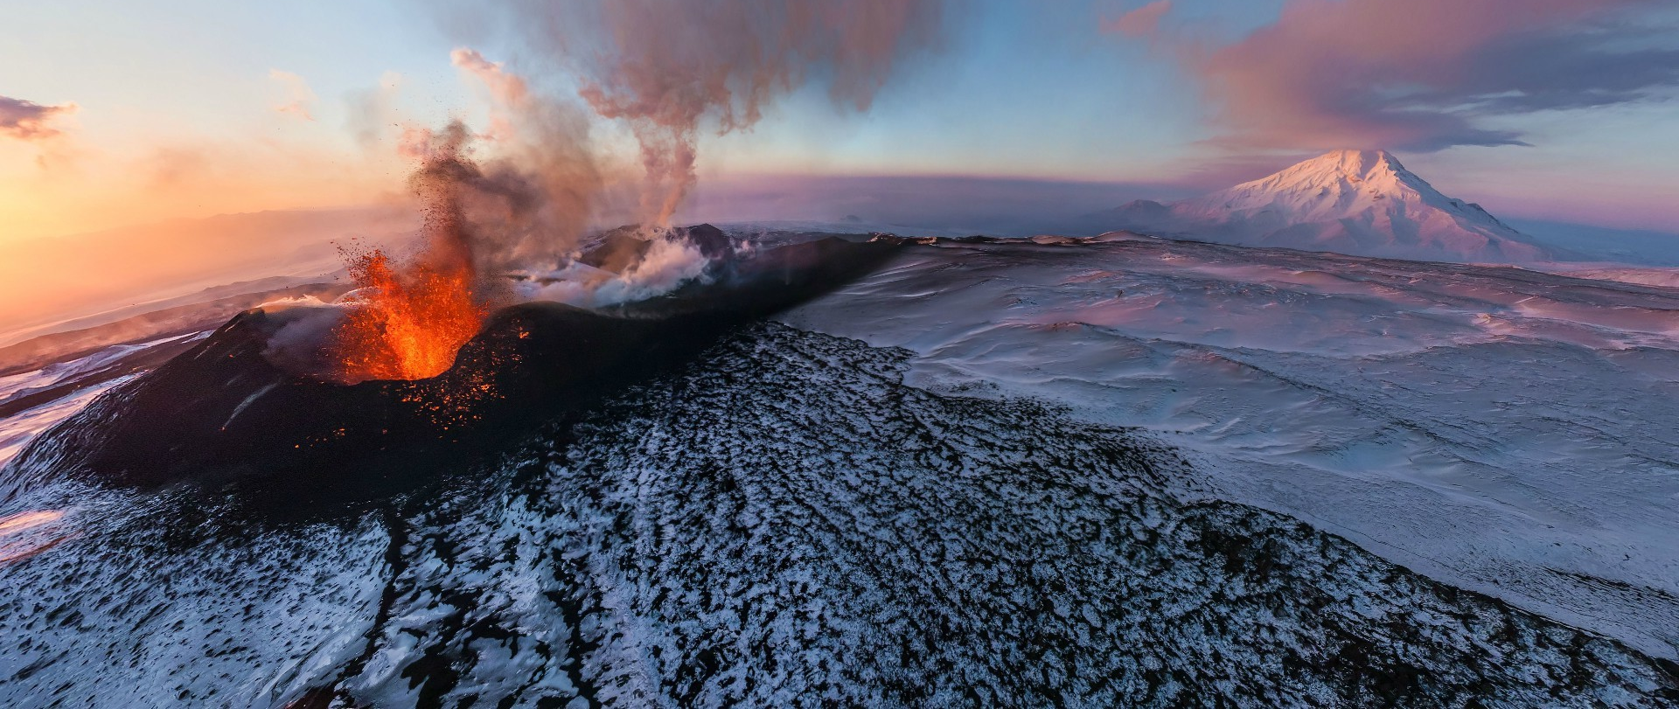

NSF, Interdisciplinarity, & Collaboration
John N. Parker

Slide 5

The Government of the United States
(the simple version)
The Constitution
Executive Branch
Legislative Branch
Judicial Branch
Department
of the Interior
Department
of Health &
Human
Services
Department
of Commerce
Department
of Defense
Many Other
Departments…
Notes:
NSF falls immediately under the Office of Science and Technology Policy (OSTP) – i.e. direct to White House…

Slide 6
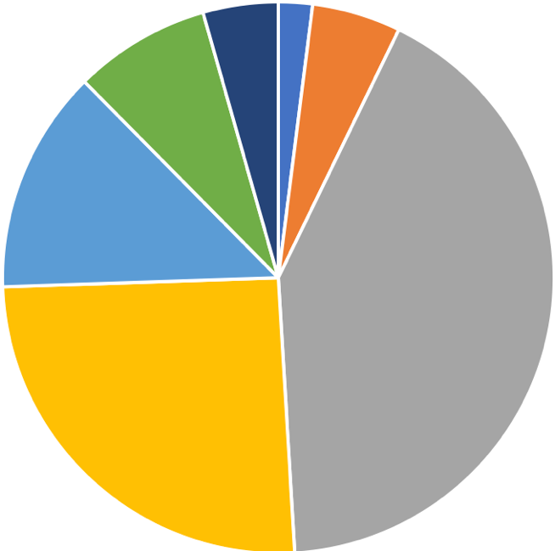
…with a big impact, due to low overhead
NSF is a very small agency…
NIH
25.4%
95% of our money goes out the door as grants
DOE
13.1%
DOD
41.8%
NASA
8.0%
NSF
4.0%
USDA
2.0%
Total R&D by Agency
FY 2018
Other
5.2%
Source: AAAS, NSF Budget Office
Notes:
Facilities construction, managing budgets, lawyers, our salaries and then allllll of this is research & related activities
Gray DOD 41.8
Yellow NIH 25.4
DOE 13.1
NASA 8
NSF 4
USDA 2
Other 5.2
R&D by agency, FY2018

Slide 7
NSF Structure
Eight Funding Directorates…
Geosciences
(GEO)
Biological Sciences (BIO)
Computer & Information Science & Engineering (CISE)
Engineering (ENG)
Education & Human Resources (EHR)
Mathematical & Physical Sciences (MPS)
Social, Behavioral & Economic Sciences (SBE)
Notes:
7 directorates
2 directorates represented here, 3 divisions, multiple programs
Fay from CISE
John from SBE, SES, STS
Jackie from SBE, BCS, GSS

Slide 8
Proposal Processing
NSF
Proposal
Generating
Document
Returned as Inappropriate/Withdrawn
Award via DGA
Organization
submits
via
FastLane
Minimum
of 3
Reviews
Required
Program
Officer
Analysis
&
Recom-
mendation
Proposal
Processing
Unit
Division
Director
Concur
Ad hoc
NSF Program Officer
*Panel
Decline
*Co-reviews with other panels
Organization
Research &
Education
Communities
Proposal received by NSF
Div. Dir. Concur
Award
4-5 months
30 days
Proposal Preparation Time
Review of Proposal P.O. Recommend
DGA Review &
Processing of Award

Slide 9

Merit Review Criteria
Intellectual Merit (IM):
the potential to advance knowledge
Broader Impacts (BI):
the potential to benefit society and
contribute to the achievement of
specific, desired societal outcomes

Slide 10
Types of Grants
  Doctoral Dissertation Research Improvement Grants
  Scholars Awards
  Standard Research Grants (can be collaborative)
  Conference and Workshop Awards
  Postdoctoral Awards
  CAREER
  Rapid Response Research (RAPID)
  Early Concept Grants for Exploratory Research (EAGER)
  Research Experiences for Undergraduates
  Research at Undergraduate Institutions

Slide 11
Science and Technology Studies (STS)
Examines science, engineering or technology, and their impacts on society.
Four core areas:
    Ethics and Values in Science (EVS)
    History and Philosophy of Science (HPS)
    Social Studies of Science (SSS)
    Studies of Policy in Science (SPS)

Slide 12
Ethical and Responsible Research (ER2)
  Factors promoting ethical STEM practices
  Techniques for cultivating cultures of ethical STEM
  Up to 5 years, $600,000

Slide 13
Research Advanced by Interdisciplinary Science and Engineering (RAISE)
• Bold, interdisciplinary projects
• Up to $1 million and five years
•Require the approval of two different programs of NSF
• Must address why suited for RAISE
• Internal review

Slide 14
Dynamics of Integrated Socio-Environmental Systems (DISES)
Basic scientific understanding of socio-environmental systems
True integration of social and environmental
DISES Research projects: 2-5 years, $1,600,000.
DISES RCN: 4-5 years, $500,000

Slide 15
Navigating the New Arctic (NNA)
Ice free Arctic Ocean
Convergent research on social, economic, & environmental implications
Social, natural, and built environment
Planning grants: up to 2 years, $300,000
Research grants: up to 5 years, $3,000,000
NNA Collaoratory grants: Up to 5 years, no budget limit

Slide 16
Highly Creative Teams…

Slide 17
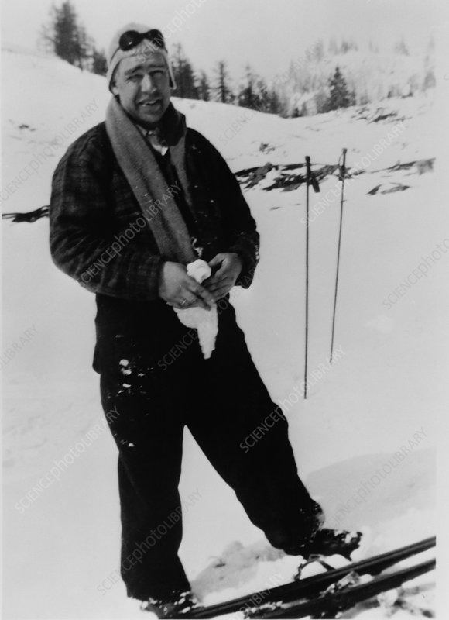
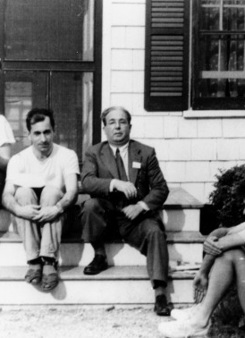
They Get Away:
Isolation & Insulation

Slide 18
Resources
Diverse expertise and skills
Diverse life experiences
$$$ to meet, organize, and work
Graduate students

Slide 19
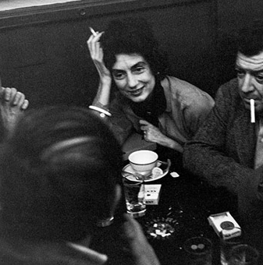
Culture of Trust & Reciprocity

Slide 20
Fun Facilitates Equality and Lower Social Barriers
1) Quantums: Ping pong
2) Phage: Camping
3) RA: Limericks & Secret Societies
Not ancillary, but crucial

Slide 21
A Few Tips…

Slide 22
Encourage Diverse Viewpoints
&
Avoid False Consensus

Slide 23
Manage Power Relations

Slide 24
Provide Incentives
&
Outcomes for All

Slide 25
Establish Clear Expectations (Early On)
Authorship
Data Sharing
Intellectual Property

Slide 26
Additional Questions?
John Parker joparker@nsf.gov
703-292-5034

Slide 27
Thanks!
John N. Parker
US National Science Foundation

Slide 28

The goal of Collaborative Collision is to foster interdisciplinary collaborations by providing an atmosphere to discuss researcher’s expertise, potential contributions to a research team, and partnerships to enhance their own research.
Interdisciplinary Networking
Convergent topics attract researchers from diverse areas across the research community.
Designed to maximize opportunity for participants to meet numerous FSU faculty.
Research Profiles
Focus on the individual's research background and interests.
Discuss expertise, and specific ways a participant can help, or be helped by, a collaborator.
Building Collaborations
Everyone will receive a copy of today’s presentations and video recording.
ORD provides team development, planning, and facilitation consulting
Collaborative Collision Seed Fund.
Notes:
Thank you, Dr. Parker! We very much appreciate you joining us this afternoon and look forward to potential opportunities to work with NSF in the future!
As I mentioned at the beginning of the program, today is our 13th Collaborative Collision; ORD has been organizing and hosting these events since 2016 on topics like Health, Environment, Disaster Resiliency, and Big Data among many others.
The goal of Collaborative Collision is to bring the Florida State research community together around a single, broadly defined topic and help our researchers expand their network of potential collaborators. We strive to choose topics that will attract participants from as many different Colleges and Departments as possible, to both recognize that many issues require broad disciplinary perspectives, and to maximize the number of potential connections.
ORD also supports the development of teams that form as a result of our collaborative collisions by providing all participants with a copy of the event materials, including contact information, as well as facilitating discussions, planning sessions, and eventually external proposal development resources and services.
You can find more about Collaborative Collision, including materials from past events, announcements of upcoming events, and information about the Collaborative Collision seed fund at research.fsu.edu/CollaborativeCollision.

Slide 29
The goal of Collaborative Collision is to foster interdisciplinary collaborations by providing an atmosphere to discuss researcher’s expertise, potential contributions to a research team, and partnerships to enhance their own research.
Interdisciplinary Networking
Convergent topics attract researchers from diverse areas across the research community.
Designed to maximize opportunity for participants to meet numerous FSU faculty.
Research Profiles
Focus on the individual's research background and interests.
Discuss expertise, and specific ways a participant can help, or be helped by, a collaborator.
Building Collaborations
Everyone will receive a copy of today’s presentations and video recording.
ORD provides team development, planning, and facilitation consulting
Collaborative Collision Seed Fund.
Notes:
Thank you, Dr. Parker! We very much appreciate you joining us this afternoon and look forward to potential opportunities to work with NSF in the future!
As I mentioned at the beginning of the program, today is our 13th Collaborative Collision; ORD has been organizing and hosting these events since 2016 on topics like Health, Environment, Disaster Resiliency, and Big Data among many others.
The goal of Collaborative Collision is to bring the Florida State research community together around a single, broadly defined topic and help our researchers expand their network of potential collaborators. We strive to choose topics that will attract participants from as many different Colleges and Departments as possible, to both recognize that many issues require broad disciplinary perspectives, and to maximize the number of potential connections.
ORD also supports the development of teams that form as a result of our collaborative collisions by providing all participants with a copy of the event materials, including contact information, as well as facilitating discussions, planning sessions, and eventually external proposal development resources and services.
You can find more about Collaborative Collision, including materials from past events, announcements of upcoming events, and information about the Collaborative Collision seed fund at research.fsu.edu/CollaborativeCollision.

Slide 30

Competition for up to $25,000 to promising new team(s) that form as a result of connections made at Collaborative Collision.
Catalyze team development and allow a new team to position themselves to seek external funding by demonstrating a history of successful collaboration.
Program Requirements
  At least two faculty from today's presentation, from different academic departments.
  Proposals must demonstrate new research projects, and new collaborative teams.
  All proposed projects must be related to the Collaborative Collision topic, or apply the topic to a new research area, and must explain the connection in the proposal.
  Faculty may serve as lead PI on only one proposal. There are no restrictions on the number of proposals on which they may be Co-PI.
Proposals due January 29th,2021
Notes:
Additionally, ORD manages the Collaborative Collision seed funding program. This provides up to $25k to catalyze new teams that form as a result of these events. An RFP for today’s event is currently posted to research.fsu.edu/collaborativecollision
Proposals for the Technology and Society round of funding are due January 29th 2021

Slide 31
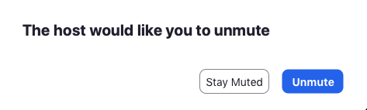
Presentation Overview
All participants are muted until it is their turn to present.
  Questions/Issues message: Beth Hodges or Rachel Goff-Albritton
Each presenter has three minutes to discuss their research profile.
  When the gold bar at bottom right disappears, your time is up, and the slide automatically advances.
  Presenters will be muted by the host to allow the next person to begin.
Between each profile there is a five (5) second transition slide displaying the next presenter’s name (also shown at bottom right of each profile slide).
  Host will send an unmute request to each presenter when it is their turn.
  You must still unmute yourself after receiving the request.
  Please ensure your Zoom ID is your first and last name.
Roxanne Hughes
Notes:
Before we begin, I’d like to briefly explain the event’s format.
Read slide.

Slide 32
Presentation Order
Roxanne Hughes
Lara Perez-Felkner
Xiaonan Zhang
Tyler McCreary
Yan-Yan Hu
Zhe He
Meegan Kennedy Hanson
Renaine Julian
Shuyuan Mary Ho
Arienne Ferchaud
Kassie Ernst
Hongyuan Cao
Russell Clayton
Horacio Rousseau
Meredith Thomas
Camille Thomas
Lorri Mon
Maximilian M. Etschmaier
Ebrahim Ahmadisharaf​
Patrick Merle
​Aimée Boutin​
Guangzhi Shang​
Andy Opel ​
​Paul Marty​
Aline Kalbian​
Kerry Fang​
Jeff Whalen​
Daniel L. Fay​
Zina Ward​
Laurelin Haas​
Cynthia Yang​
Tra Bouscaren​
Jonathan Stewart​
Rob Schoen​
Crystal Taylor​
Caroline Stratton​
Vanessa Dennen​
Laura Hart​
​Beth Hodges
​Michelle Kazmer
Roxanne Hughes
Notes:
Before we begin, I’d like to briefly explain the event’s format.
Read slide.

Slide 33
Roxanne Hughes

Slide 34
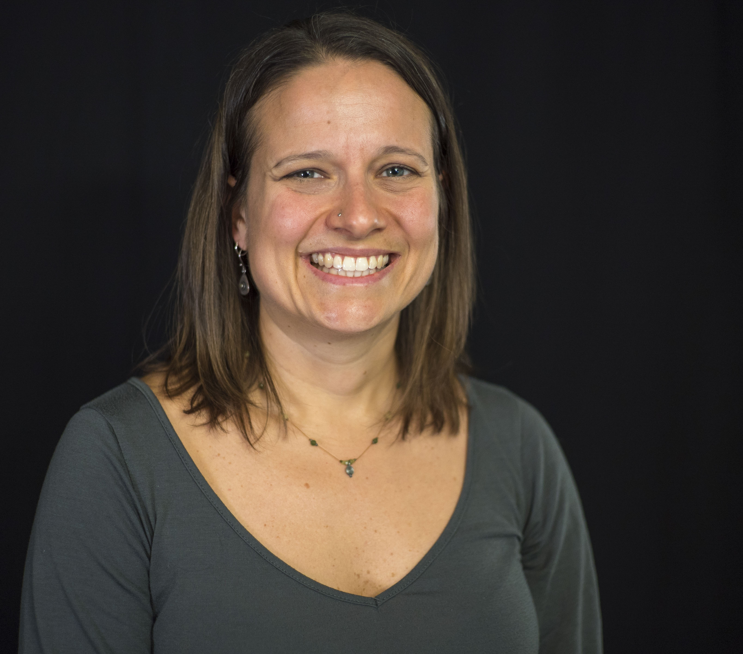
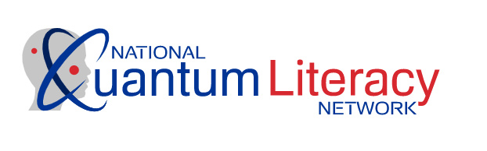
Identifying ways to make STEM disciplines more equitable to individuals from marginalized populations so that these fields can benefit all members of society
Studying the impact of programs on scientific literacy within society, particularly K-16 students and teachers.
Empowering young people to change STEM disciplines by empowering their voices, concerns, and passions to drive the work
I am currently working with a team led by Morgan State University that is developing a quantum literacy curriculum to build a more diverse quantum workforce and to inform society of the benefits of quantum technologies.
This is part of the NSF Convergence Accelerator program.
Roxanne Hughes
National High Magnetic Field Laboratory/FSU College of Education
hughes@magnet.fsu.edu
orcid.org/0000-0002-6383-1341
Qualitative Research
Coding Identity – one’s sense of belonging and future success
Building the STEM workforce
Qualitative research expertise
Opportunities to collaborate in studies of middle school, high school, college and early career STEM programs aimed to influence coding identity
I am looking for folks who are interested in providing advice on a quantum literacy initiative that will broaden participation of individuals who have been historically marginalized in STEM and quantum
Recent Proposals/Publications:
National Quantum Literacy Network
The Role of Recognition in Disciplinary Identity for Girls
SciGirls CONNECT2
Lara Perez-Felkner

Slide 35
Lara Perez-Felkner

Slide 36
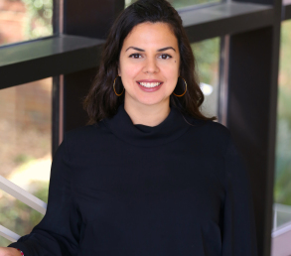
Gender and Racial/Ethnic Disparities in STEM Postsecondary Experiences, Outcomes, and Careers
Inequality in H.S. & College Students’ Pathways Socioeconomic, Educational, and Health (including Food and Housing Insecurity) Outcomes
Enhancing BIPoC & Latinx Communities and Experiences in STEM Higher Education
RESET – Research on Equity in Science, Engineering, and Technology projects focus on how ability beliefs, active learning, mentoring and research opportunities, and supportive social contexts influence persistence toward STEM research careers, with a focus on broadening participation in science, engineering, and technology in higher education and postsecondary careers.
HEPP – Higher Education Persistence Pathways initiatives investigate the structures and supports which can foster postsecondary student success among underrepresented students, especially women, Black and Latino students, and low-income students who may also be the first-generation in their family to go to college. This research draws on sociological and life course frameworks to understand constraints and opportunities which can contribute to longer-term outcomes.
See also: https://perezfelkner.com/
Lara Perez-Felkner
Associate Professor of Higher Education
lperezfelkner@fsu.edu
https://orcid.org/0000-0002-3451-8524
Race-, class- and gender-based disparities in pathways to postsecondary education and careers
Gender inequality in STEM
Sociology of education, Human Development
Experimental, survey, and mixed methods study design
Research design for projects involving RCT experiments, mixed methods integration, and/or surveys
Evaluation and educational research partnership on STEM and other equity- and opportunity-expansion projects
Data analysis and collaborative interdisciplinary writing
Collaborate on research projects using experiments and surveys, and as a qualitative partner for mixed methods research
Interdisciplinary partnerships around high school, community college, and community partner interventions
Collegiality & funding opportunities
Xiaonan Zhang

Slide 37
Xiaonan Zhang

Slide 38
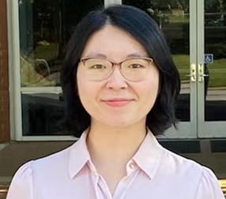
My research interests span over general areas of wireless network, Internet of Things (IoT), and wireless security, with emphasis on architecture design, algorithm optimization, and system implementation. For IoT, I focus on achieving efficient, reliable and secure wireless communication and networks for large-scale heterogenous IoT systems. For wireless security, I put my research emphasis on identifying new attacks in emerging wireless communication and networks as well as finding related strategies together with their implementation in the real world. Additionally, I am interested in conducting research on applying machine learning techniques to security problems in wireless communication and networks such as machine learning-based signal detection. For more details, please visit my webpage https://www.cs.fsu.edu/~xzhang/.
My current research focuses on achieving efficient, reliable and secure data transmission in heterogenous Internet of Things environment.
Sample publications are listed below:
Yu, Sihan, et al. "AuthCTC: Defending Against Waveform Emulation Attack in Heterogeneous IoT Environments." Proceedings of the 15th ACM Asia Conference on Computer and Communications Security. 2020.
Zhang, Xiaonan, et al. "Hide and seek: Waveform emulation attack and defense in cross-technology communication." 2019 IEEE 39th International Conference on Distributed Computing Systems (ICDCS). IEEE, 2019.
Zhang, Xiaonan, et al. "Incentivizing relay participation for securing IoT communication." IEEE INFOCOM 2019-IEEE Conference on Computer Communications. IEEE, 2019.
Xiaonan Zhang
Computer Science
xzhang@cs.fsu.edu
Wireless networking
Wireless security
Internet of Things
Cyber Physical System
Expertise in wireless transmission and wireless networking
Expertise in lower layers in Internet of Things
Experience in design, implementation, and evaluation of real-world experiment
Knowledge of machine learning
Willing to collaborate on interesting research problems, particularly in the areas of Internet of Things.
Identifying interesting and significant applications in Internet of Things
Exploring interdisciplinary research and joint funding opportunities
Tyler McCreary

Slide 39
Tyler McCreary

Slide 40
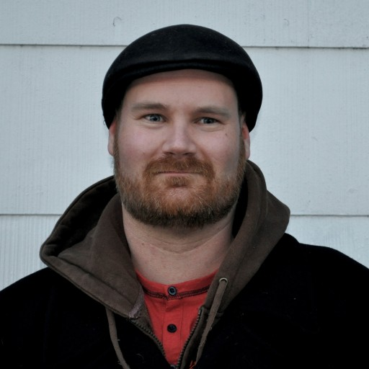
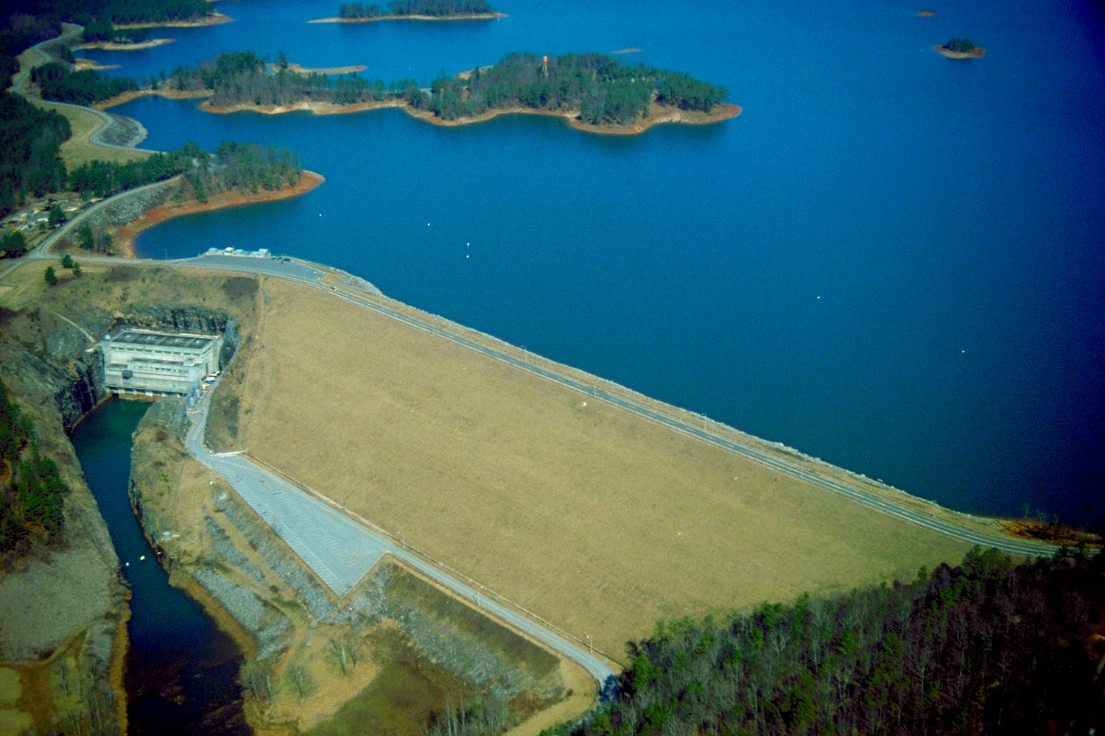
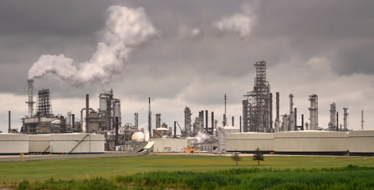
Hello there! Thanks for registering for Collaborative Collision: Technology and Society. This is the template slide for the event; all participants must use this format for continuity.
I’ve included my own slide here as an example, along with descriptions of what we hope to see in each field (more examples of past slides can be found here). The second slide is a blank template for you to use to create your own Collaborative Collision research profile.
When you are done please save as a PowerPoint file with the title LastName_FirstName_CC_T&SProfile.ppt (filling in your name of course) and email the file to me at mike.mitchell@fsu.edu as soon as possible, but no later than November 23rd, 2020
A professional headshot or other photo helps put a face with the name! We also accept organization/lab logos.
Tell us a little bit about your interest in this Collaborative Collision topic. What is your background in the area, what are you hoping to learn, what are the opportunities you see for collaboration, etc.
Examining the differential impacts of sociotechnical transitions in North American labor markets
Interrogating the ways that emerging scientific understandings of the environment intersect with Black and Indigenous environmental justice movements
Interrogating how energy and water infrastructure developments relate to processes of displacement, dispossession, and exclusion
Exploring how new smart cities governance technologies interface with the historic marginalization of Indigenous and Black families living in urban environments
Your Name
Organizational Affiliation
Email address
Link to an online profile*
*We recommend either your ORCID profile, LinkedIn profile, or a dedicated webpage
I am engaged exploring relationships between the water crisis, infrastructure, environmental governance, and race in Atlanta and the wider Apalachicola-Chattahoochee-Flint basin.
Tyler McCreary
Department of Geography
tmccreary@fsu.edu
https://orcid.org/0000-0001-6305-6325
This section is totally up to you! Many people put photos, diagrams, figures, etc. to help describe their research. We’ve also seen data tables/graphs, links to additional content, and lists of publications.
Environmental Justice
Settler Colonialism
Race and Technology
Political Ecology
Critical Infrastructure Studies
Community-based research and engagement capacity
Developing research examining relations between technological development and social inequalities
Critical qualitative methods
Experience collaborating with diverse interdisciplinary teams
Collaborate in grant proposals
Assist with survey-design and quantitative data analysis in mixed-methods projects
Direct promising, critical-thinking students towards my classes
I conduct research on Indigenous peoples’ relationships to unconventional hydrocarbon developments and their environmental effects.
3-4 keywords to describe your areas of expertise, research interests, or project interests
Recent Proposals/Publications:
Between the Commodity and the Gift: The Coastal GasLink Pipeline and the Contested Temporalities of Canadian and Witsuwit’en Law
Beyond Jobs vs Environment
From Precarious Work to Obsolete Labour?
Lands and Resources for Jobs
Yan-Yan Hu
Bullet points describing your skills and expertise that potential collaborators might find useful. Could include skills, disciplinary background, methodology experience, etc
Bullet points describing how a collaborator could help your project. Might include needed skills, disciplinary backgrounds, methodologies, etc.

Slide 41
Yan-Yan Hu

Slide 42
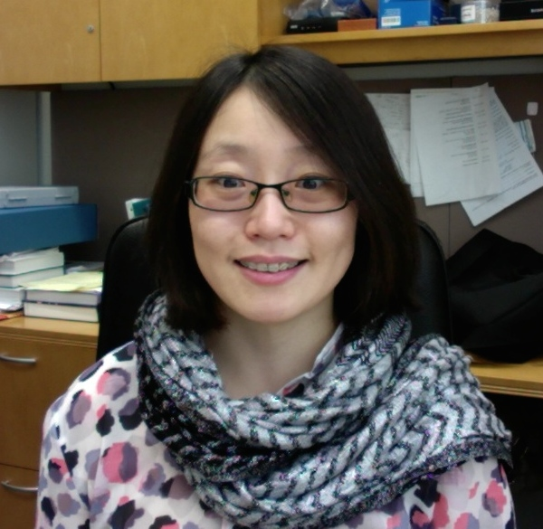
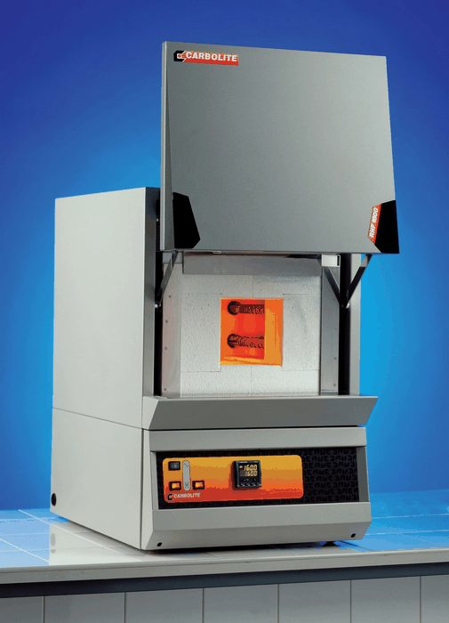
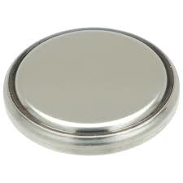
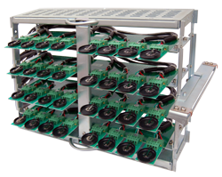
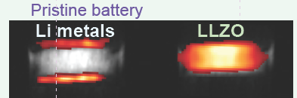
Developing new materials for energy conversion and storage.
Integrating functional materials to develop high-performance devices.
Designing and implementing In situ/operando characterization techniques to determine how devices work and why they fail
Commercializing technologies in partnership with industry.
Materials
Synthesis
Yan-Yan Hu
Department of Chemistry & Biochemistry
yhu@fsu.edu
orcid.org/0000-0003-0677-5897
Device fabrication,
and
performance testing
Material synthesis
Characterization
Electrochemical device testing
In situ/operando testing
Computational modeling
Large-scale reproducible fabrication
Complementary characterization techniques
New and exciting projects
Allow me to help you!
Energy Storage Materials
Device Fabrication
NMR/MRI
Electrochemistry
In situ/operando
characterization
Zhe He

Slide 43
Zhe He

Slide 44
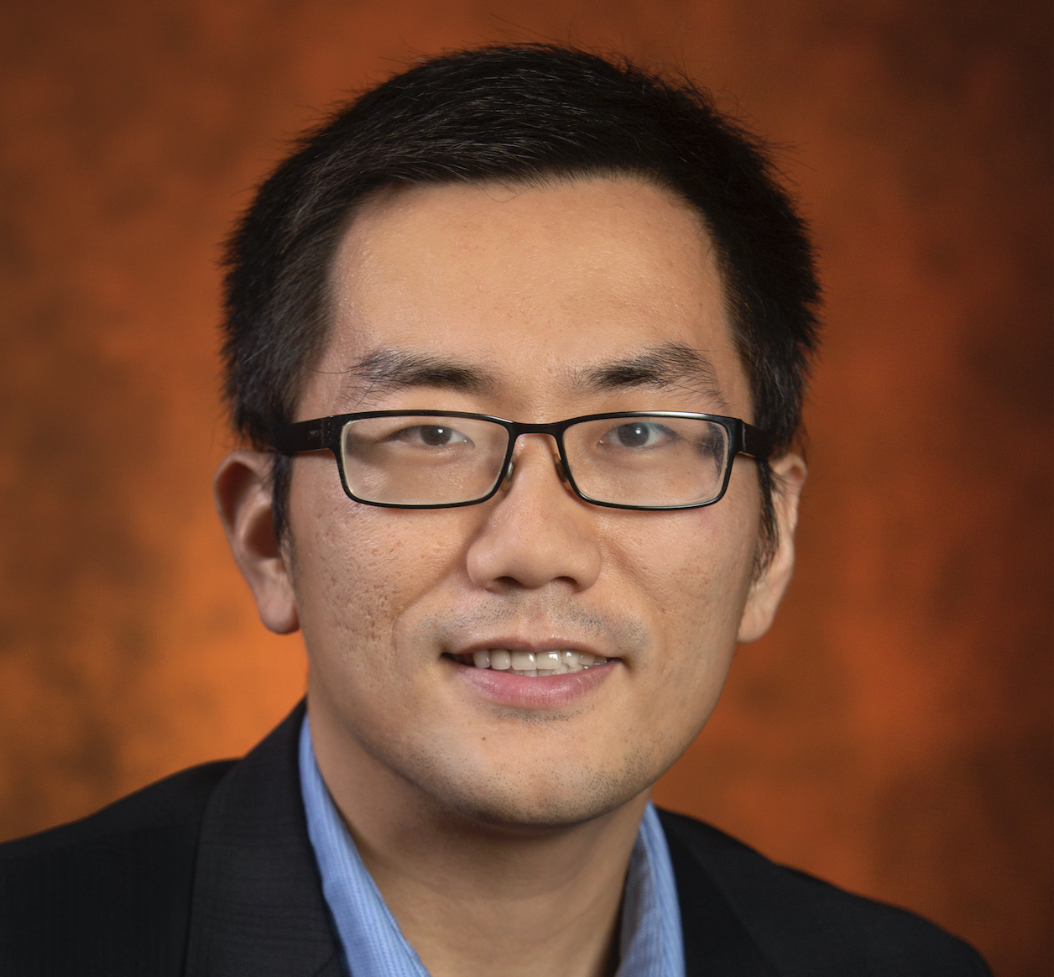
Artificial intelligence
Data mining and machine learning
Human aspect of Health IT
Health informatics
Access to a large clinical data warehouse – OneFlorida Data Trust (longitudinal clinical data for over 20 million patients)
Informatics approaches for grant proposals
Optimizing Alzheimer's Disease Clinical Trial Generalizability (R21AG061431-02S1, 2019-2021)
The Adherence Promotion with Person-centered Technology (APPT) Project: Promoting Adherence to Enhance the Early Detection and Treatment of Cognitive Decline (R01AG064529, 2019-2024) PI: Walter Boot
Systematic Analysis of Clinical Study Generalizability Assessment Methods with Informatics (R21AG061431, 2019-2021) PI: Zhe He
Posttransplant Health Outcomes in Pediatrics Organ Transplantation (NCATS CTSA 2019 – 2020) MPI: Michael Killian and Zhe He
Zhe He
Associate Professor
School of Information
Team Lead, UF-FSU CTSA BERD
Big Data Analytics
Data Mining
Machine Learning
Health Informatics
Natural Language Processing
Health data access
Natural language processing
Grant writing
Connect to multidisciplinary researchers in FSU
Analysis of COVID-19 clinical trials on ClinicalTrials.gov
Statistical modeling of complex datasets
Longitudinal data analysis
Implementation science
Software development
Meegan Kennedy Hanson

Slide 45
Meegan Kennedy Hanson

Slide 46
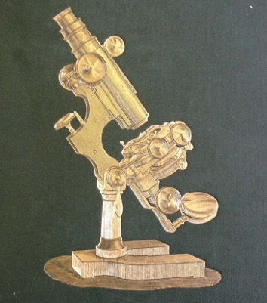
I study the development of disciplinary identity in Britain (and to some extent America), c17-present
I look at how conventions and communities of practice develop around particular forms of writing and with different forms of technology
I’m especially interested in how observation is made and how it is recorded
My current book project examines a culture of the “skeptical sublime” that emerged around c19 microscopy
Beautiful Mechanism, book MS on Victorian microscopy. Funded by NEH, Huntington, Wellcome, etc.
Recent essay on the oxyhydrogen microscope and cinema history in Victorian Studies
Co-editor (with John Holmes) of c19 Routledge Historical Resources: Science, Technology, and Medicine
First book, Revising the Clinic, on the c19 medical case history
LIT3438, a large lecture course on literature and medicine (LIT3438).
Meegan Kennedy Hanson
orcid.org/0000-0001-9789-6605
History of microscopy
Victorian science
Victorian medicine and public health
History of science writing
History of popular science
Historical perspective on debates in science, bioethics, environment...
Historical perspective on technology development and debates
Archival research experience
Writing about the interrelations of science, technology, and society
”Translating” scientific ideas for non-scientific audiences
Interested in working on projects that cross STEM and humanities
Need people interested in editing a focused set of c19 primary texts for the RHR:STM project – your topic
Always need fresh “expert interviews” on topics in medicine, bioethics, etc. for LIT3438 – 5 minute videos
What beautiful or curious thing have you seen in your own work recently?
Renaine Julian

Slide 47
Renaine Julian

Slide 48
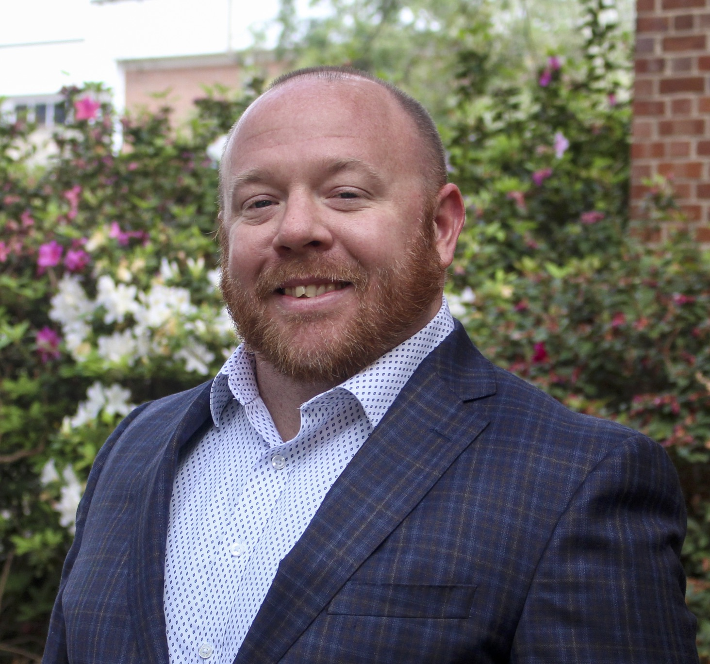
Leveraging technology to reduce barriers of access to scientific information
Connecting and collaborating with others who are passionate about open science and open access
Providing education and advocacy around the societal benefits of advancing open science and increasing access to scientific information
Exploring public benefits of open scientific data
Assessing faculty perceptions of the sustainability of scientific information
Renaine Julian
Director of STEM Libraries
FSU Libraries
https://orcid.org/0000-0001-6236-4756
Research Data Management
Open Science
Academic Publishing
Finding and evaluating ways to increase visibility and impact around your data and scholarship
Creating and evaluating the effectiveness of research data management plans (DMPs)
Collaborate with me to help me learn how to incentivize participation in open science initiatives
Allow me talk to you, your colleagues, and your students about the societal benefits of open science
Allow me to help you with open science and data management things!
Shuyuan Mary Ho

Slide 49
Shuyuan Mary Ho

Slide 50
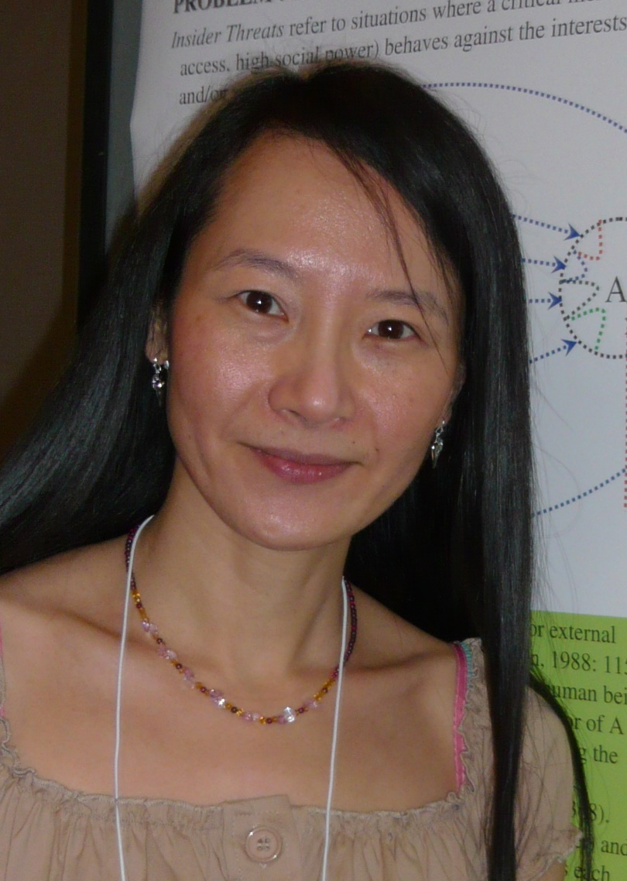
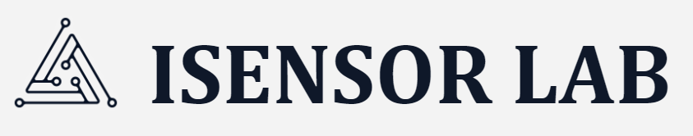
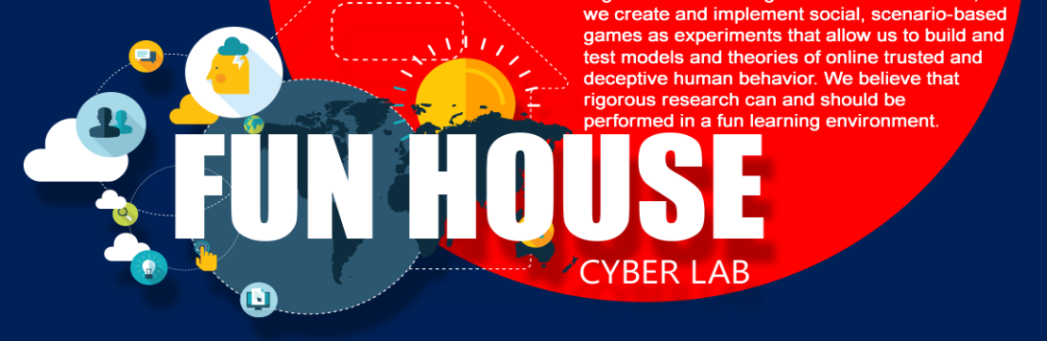
[Who am I?] a behavioral scientist for information systems and information science research, working on trusted human computer interaction.
Care deeply about societal issues that are related to technology.
Meet research collaborators to explore the societal issues that are mediated by technology so we can discover nuances, approaches to address the identified problems, and create knowledge.
Identify industry partners so my research can be translated to viable products and make societal impact.
I founded the iSensor Lab in 2010 to conduct sociotechnical research related to human factors in cyberspace. Experiments are conducted in live and virtual environments using online games. Research data is collected through confined resources. Real-world problems are simulated through interactive scenarios. Problems are conceptualized
and theorized through
innovative technology
design and development.
Shuyuan Mary Ho
School of Information
smho@fsu.edu
orcid.org/0000-0002-4790-1821
Societal issues e.g., public health, cyberbullying, disinformation, fake news, sociotechnical cybersecurity
Trusted human computer interaction
Gamification design
Behavioral experiments
Scenario-based behavioral experiment design
User-centered interactive system design
Behavioral computational modeling based on social factors and predictor variables
Social media research
Bring your biggest problems for analysis
Access to big datasets and government authorities Machine learning, artificial intelligence
Statistical analysis and modeling
Coding and programming
iSensor Lab:
https://isensoranalytics.com
Recent works:
CV19 Self Defense:
Situational Awareness
in a Pandemic through
mHealth Intervention
Arienne Ferchaud

Slide 51
Arienne Ferchaud

Slide 52
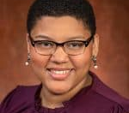
The ways in which people use technology for entertainment
Exploring ways to use new media entertainment for social good
Connecting with others examining new media technologies, specifically video games as social interventions
I explore the intersection of emerging media technologies and entertainment media. I’ve done work on:
  Social media
  Binge watching
  Video Games
Recent Publication Topics:
  YouTube and Parasocial Relationships
  Video Games and Mental Health
  Antecedents and Consequences of Binge Watching Behavior
Arienne Ferchaud
School of Communication
aferchaud@fsu.edu
https://orcid.org/0000-0002-3376-0503
Experimental research methods
Media Psychology
Emerging Media Entertainment
Statistics
Assist with study design
Statistical analysis, including structural equation modeling
Proposal editing
Experience managing research teams
Collaborative grant opportunities
Grant writing
Inter-department coalition-building
Kassie Ernst

Slide 53
Kassie Ernst

Slide 54
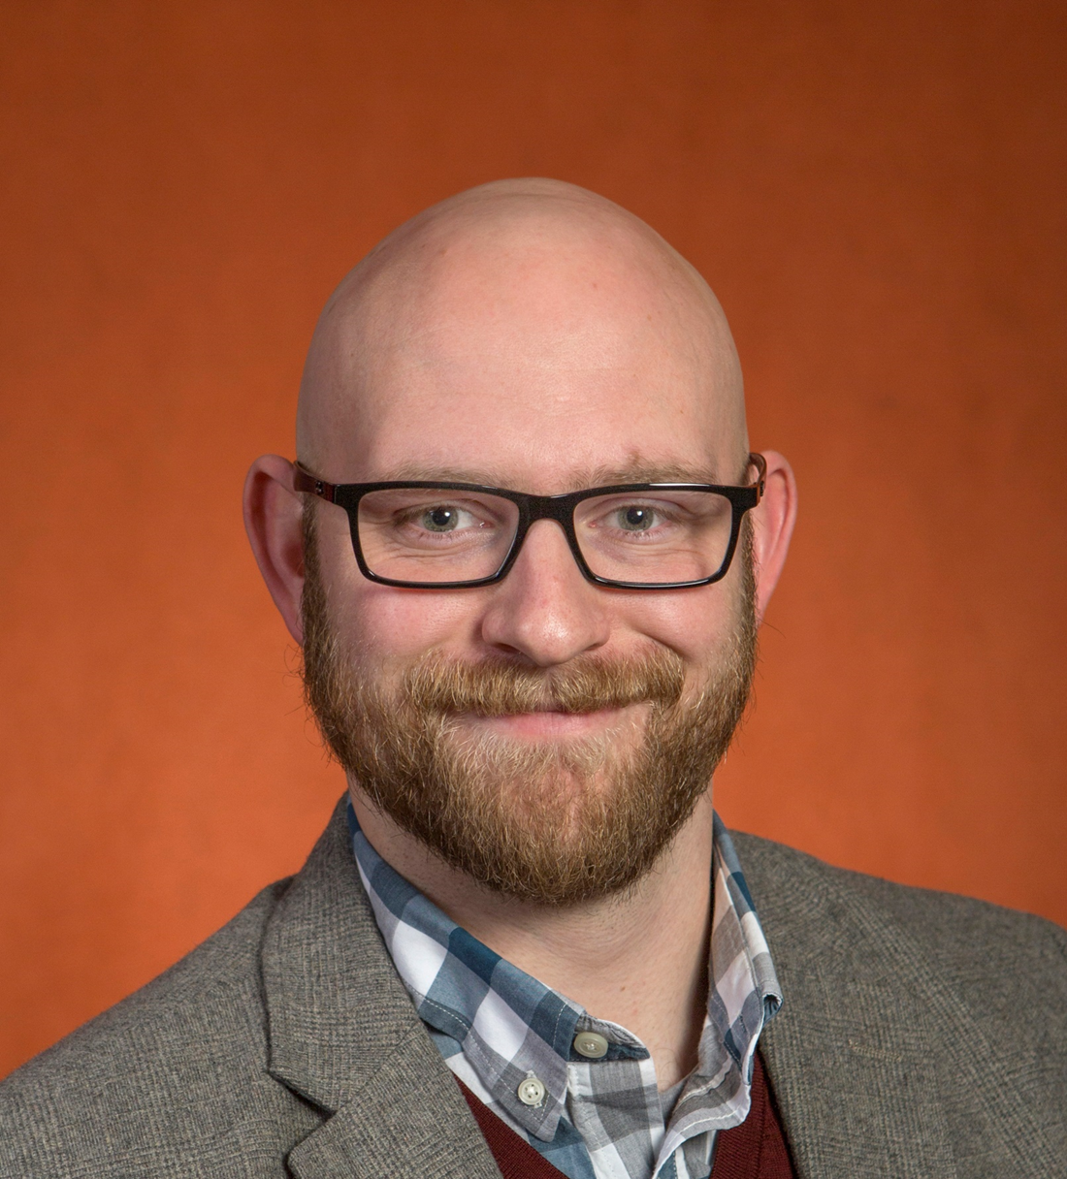
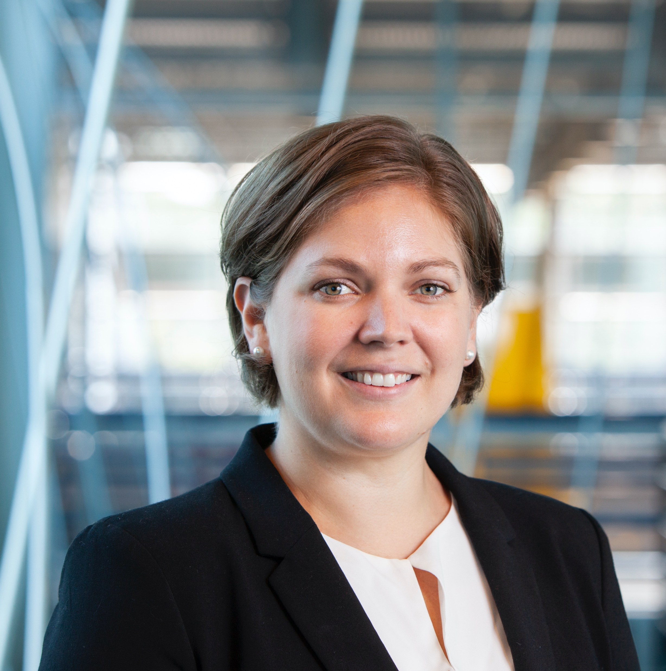
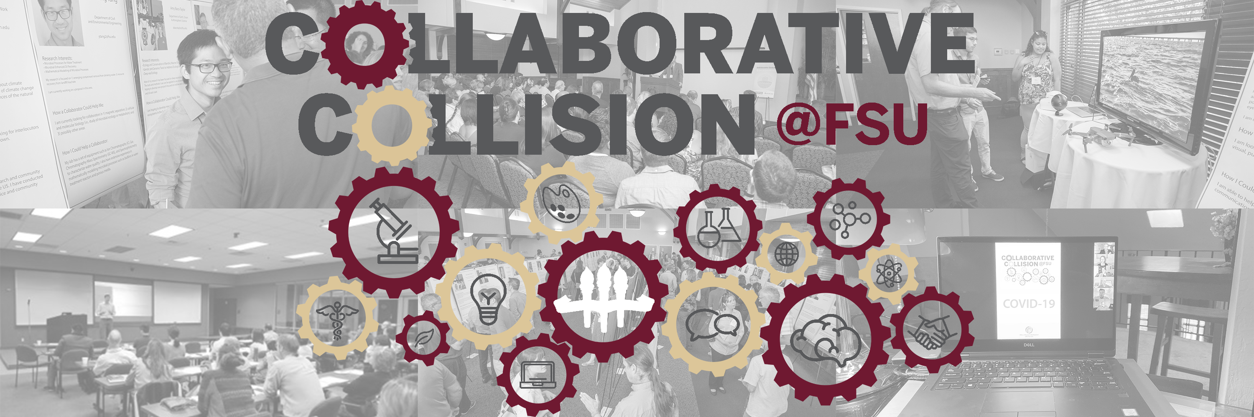
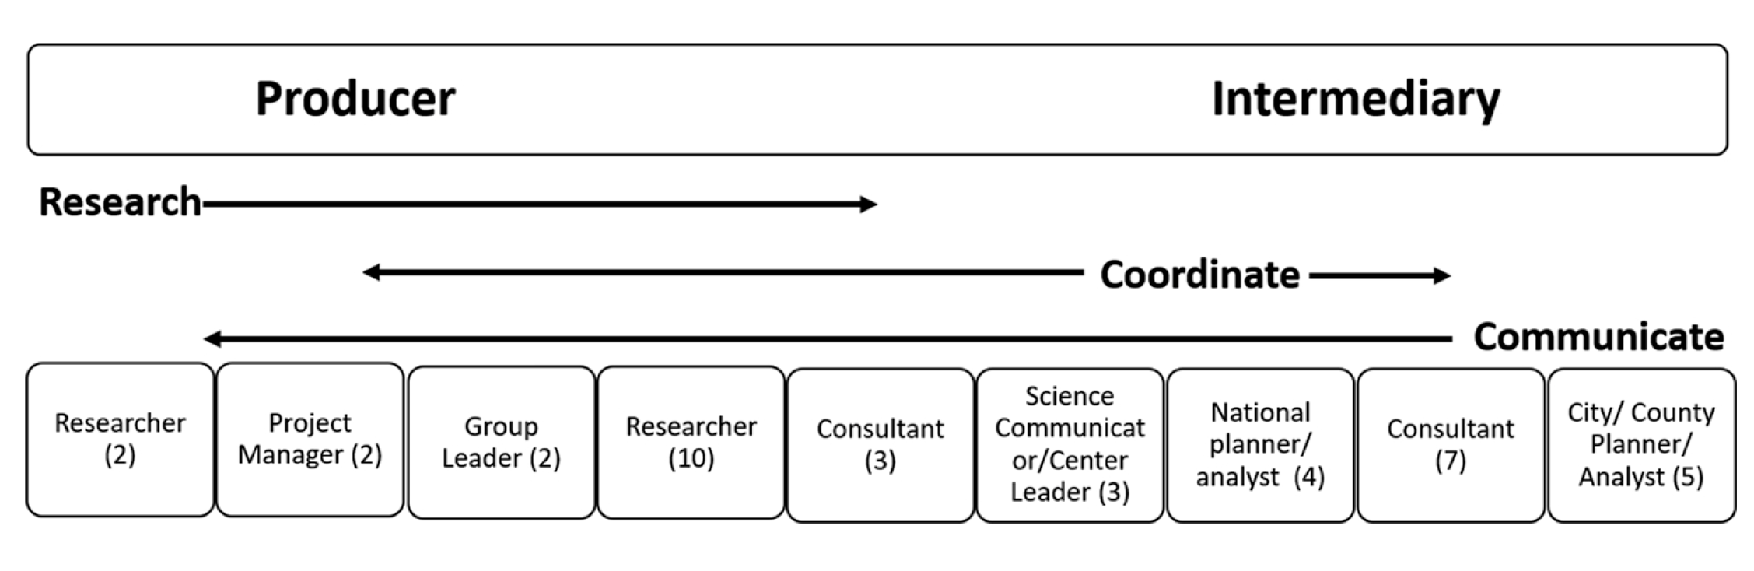
Hello there! Thanks for registering for Collaborative Collision: Technology and Society. This is the template slide for the event; all participants must use this format for continuity.
I’ve included my own slide here as an example, along with descriptions of what we hope to see in each field (more examples of past slides can be found here). The second slide is a blank template for you to use to create your own Collaborative Collision research profile.
When you are done please save as a PowerPoint file with the title LastName_FirstName_CC_T&SProfile.ppt (filling in your name of course) and email the file to me at mike.mitchell@fsu.edu as soon as possible, but no later than November 23rd, 2020
A professional headshot or other photo helps put a face with the name! We also accept organization/lab logos.
Tell us a little bit about your interest in this Collaborative Collision topic. What is your background in the area, what are you hoping to learn, what are the opportunities you see for collaboration, etc.
Identifying actionable information for climate change response that is science-informed, just, and effective
Scaling-up science-informed climate change action beyond single case studies
Understanding barriers and constraints to creating actionable climate change information that is both useful and used by decision-makers
Connecting decision-makers and scientists in useful partnerships and researching the effectiveness/outcomes of these partnerships
Your Name
Organizational Affiliation
Email address
Link to an online profile*
*We recommend either your ORCID profile, LinkedIn profile, or a dedicated webpage
I manage the Collaborative Collision program at FSU to connect faculty with shared research interests, and build new interdisciplinary teams
Kassie Ernst
College of Engineering, Grand Challenges Scholar Program Director, Pre-Engineering
kernst@fsu.edu,
orcid.org/0000-0002-4726-0331
This section is totally up to you! Many people put photos, diagrams, figures, etc. to help describe their research. We’ve also seen data tables/graphs, links to additional content, and lists of publications.
Recent Publications:
2020. Applying the Knowledge Product Evaluation (KnoPE) Framework to two urban resilience cases in the United States. Environmental Science & Policy, 107, 7-22
2019. Identifying climate service production constraints to adaptation decision-making in Sweden. Environmental Science & Policy
2019. Towards urban water sustainability: Analyzing management transitions in Miami, Las Vegas, and Los Angeles. Global Environmental Change, 58, 101967
Climate change decision-making
Climate change adaptation
Energy-Water Nexus
Resilience
Actionable information
Co-production
Synthesis
Human-subjects research
Coupled human and natural systems
Boundary runner (link between science and decision-makers)
Research Collaboration
Grant Collaboration
Sharing climate change knowledge products
Reviewing survey instruments
3-4 keywords to describe your areas of expertise, research interests, or project interests
Hongyuan Cao
Bullet points describing your skills and expertise that potential collaborators might find useful. Could include skills, disciplinary background, methodology experience, etc
Bullet points describing how a collaborator could help your project. Might include needed skills, disciplinary backgrounds, methodologies, etc.

Slide 55
Hongyuan Cao

Slide 56
Advancement in science and technology brings a variety of new data and interesting scientific problems. To decipher useful information in the vast data, principled statistical analysis is indispensable.
The knowledge we gain from scientific studies can be translated into public policy, medical practice, and eventually to improve the well-being of the whole society.
Integrative analysis of omics data exploring pleiotropy effect and causal mechanism of the genetic component on the phenotype.
Epidemiological causal analysis of treatment effect with survival outcome.
Analysis of survival outcome with intermittently observed longitudinal covariates
Time varying effects of covariate on the survival outcome
Mendelian randomization and causal mediation analysis
Hongyuan Cao
Department of Statistics
hcao@fsu.edu
Causal inference
Statistical and computational methods in omics data integration
Longitudinal data analysis
Survival analysis
Analytical perspective
Advanced statistical modeling
Experience publishing in top journals
Experience in grant proposal writing
Experience in serving on the review panel
Access to population/dataset
Interdisciplinary approach
Domain knowledge of the scientific problem
Explore challenges in the field
Interesting study design
Russell Clayton

Slide 57
Russell Clayton

Slide 58
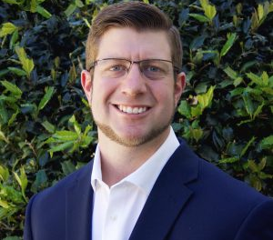

Examining how people cognitively and emotionally respond to and interact with all forms of technology and media.
Improving the design of mass media messages (campaigns) to improve population health and well-being.
Employing psychophysiological measures in the evaluation of audiences’ cognitive and emotional responses to mass media messages and technology.
Collaborations in the area of mediated-communication, mass communication, public health, and psychology.
https://cel.cci.fsu.edu/presentations-and-publications/
Our research examines how people cognitively and emotionally respond to and interact with media. Projects:
Evaluation of freedom-threatening anti-vaping PSAs.
Biological roots of psychological reactance.
Responses to mediated polysubstance images.
Mind wandering during media usage.
The psychological effects of technology separation.
Russell Clayton, Ph.D.
School of Communication
Director, Cognition and Emotion Lab
https://orcid.org/0000-0002-0471-1585
Media Psychology
Health Communication
Psychophysiology
Experiments
The implementation of psychophysiological, behavioral, and self-report measures to evaluate cognitive and emotional responses.
Experimental design of mass communication campaigns.
Expertise in media psychology research.
Collaborations on grant writing and proposals.
Collaboration with others interested in health promotion.
Consultation on multi-level modeling and time series analysis.
Horacio Rousseau

Slide 59
Horacio Rousseau

Slide 60
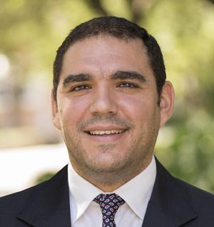
Identifying other scholars interested in developments around the nuclear power industry
Exploring the role of Creativity in technology-driven sustainable development
Connecting with others interested in how technology might help rebuild our communities
ASSESSING THE EVOLUTION AND IMPACT OF THE GLOBAL NUCLEAR POWER INDUSTRY
My goal is to understand the nuclear power industry’s evolution (emergence, (de)growth, and viability), and its impact worldwide. Regarding the evolution of the nuclear power industry, we ask: What determines that some countries embrace nuclear power while others do not? Why does this industry flourishes in some places but faces significant opposition in others? What determines the viability of the nuclear power industry once countries embrace it? Moreover, I aim to develop a deep understanding of the nuclear power industry’s impact on countries’ sustainability.
Horacio Rousseau
Assistant Professor of Management
Sustainability
Organizational strategy
Creativity and Innovation
Quantitative Data Analysis
Provide a management perspective on issues surrounding Tech and Society
Quantitative data analysis
Focused writer. I’ve published in the most important management journals including Organization Science and The Academy of Management Journal.
Provide access to data/experts in the field of sustainable innovation and nuclear power
Provide insight on the technology side of innovation
Meredith Thomas

Slide 61
Meredith Thomas

Slide 62
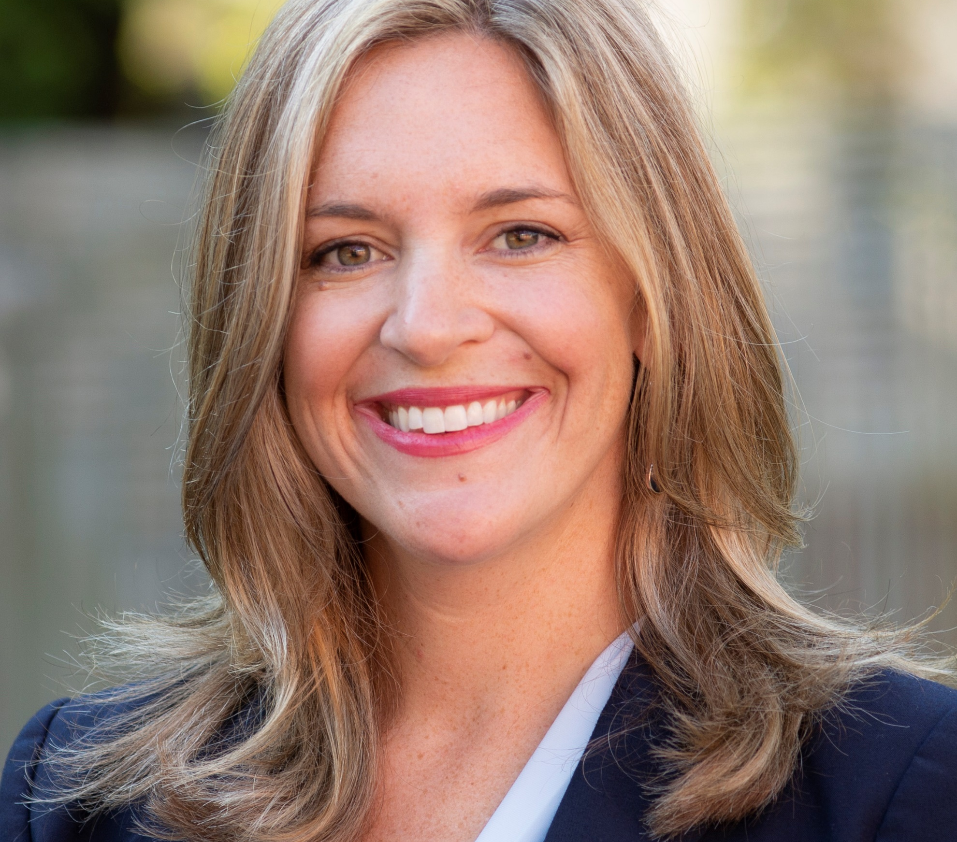
A current stream of research explores the unique challenges local businesses are facing and the constellation of actions taken to respond to recent disruptive events. In particular, this work examines how business owners make sense of their role in creating and rebuilding community in the face of the Covid-19 pandemic. Using digital resources including online commercial platforms and social media outlets, this research explores narratives of trauma and resilience, as well as innovative approaches to reaching consumers, connecting with other local businesses, and rebuilding and sustaining the local economy and community.
Meredith Thomas
Assistant Professor of Marketing
Mthomas@business.fsu.edu
Consumer behavior and community
Local community economic development,
Urban planning, housing and consumption
Understanding community development and planning
Social services ecosystem perspective
Urban planning, local public policy and consumer behavior.
Learn about adjacent research across disciplines
Access to interesting data
Gain exposure to tech platforms and resources that are being used to support and sustain local communities.
Camille Thomas

Slide 63
Camille Thomas

Slide 64
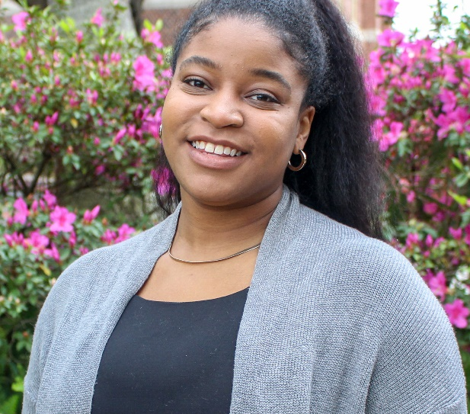


Conduct research on academic publishing, recently presented to National Academies of Sciences, Engineering and Medicine
Connecting with other individuals at FSU who are interested in open science and public scholarship
Exploring ways to translate research and technology into societal impact
I lead the Libraries’ initiatives on scholarly communication, conduct outreach and manage our funding initiatives for OA and OER.
Camille Thomas
Recent Proposals/Publications:
Perspectives of BIPOC Faculty on OA
First Gen & Low Income Students and OER
Increasing Discovery of Open Resources
Office of Digital Research and Scholarship
University Libraries
cthomas5@fsu.edu
orcid.org/0000-0002-0363-0126
Copyright education for academic publishing and teaching
Library as Publisher
Diversity, Equity, Inclusion and Anti-Racism
Funding for Open Access Journal fees
Explore new impact metrics and research outputs
Make research and teaching materials available at no cost
Review or negotiate publication contracts
Looking for existing research teams interested in open science/OA
Share your experiences with teaching and research
Allow me to help you!
The Open Scholars Project is an informal forum to learn about and discuss interdisciplinary developments in open access. It is action-oriented and supportive in bringing faculty, post-docs and graduate students together. The group will meet virtually every 4th Friday in Spring 2021 at 1pm from late January to late April.
Lorri Mon

Slide 65
Lorri Mon

Slide 66
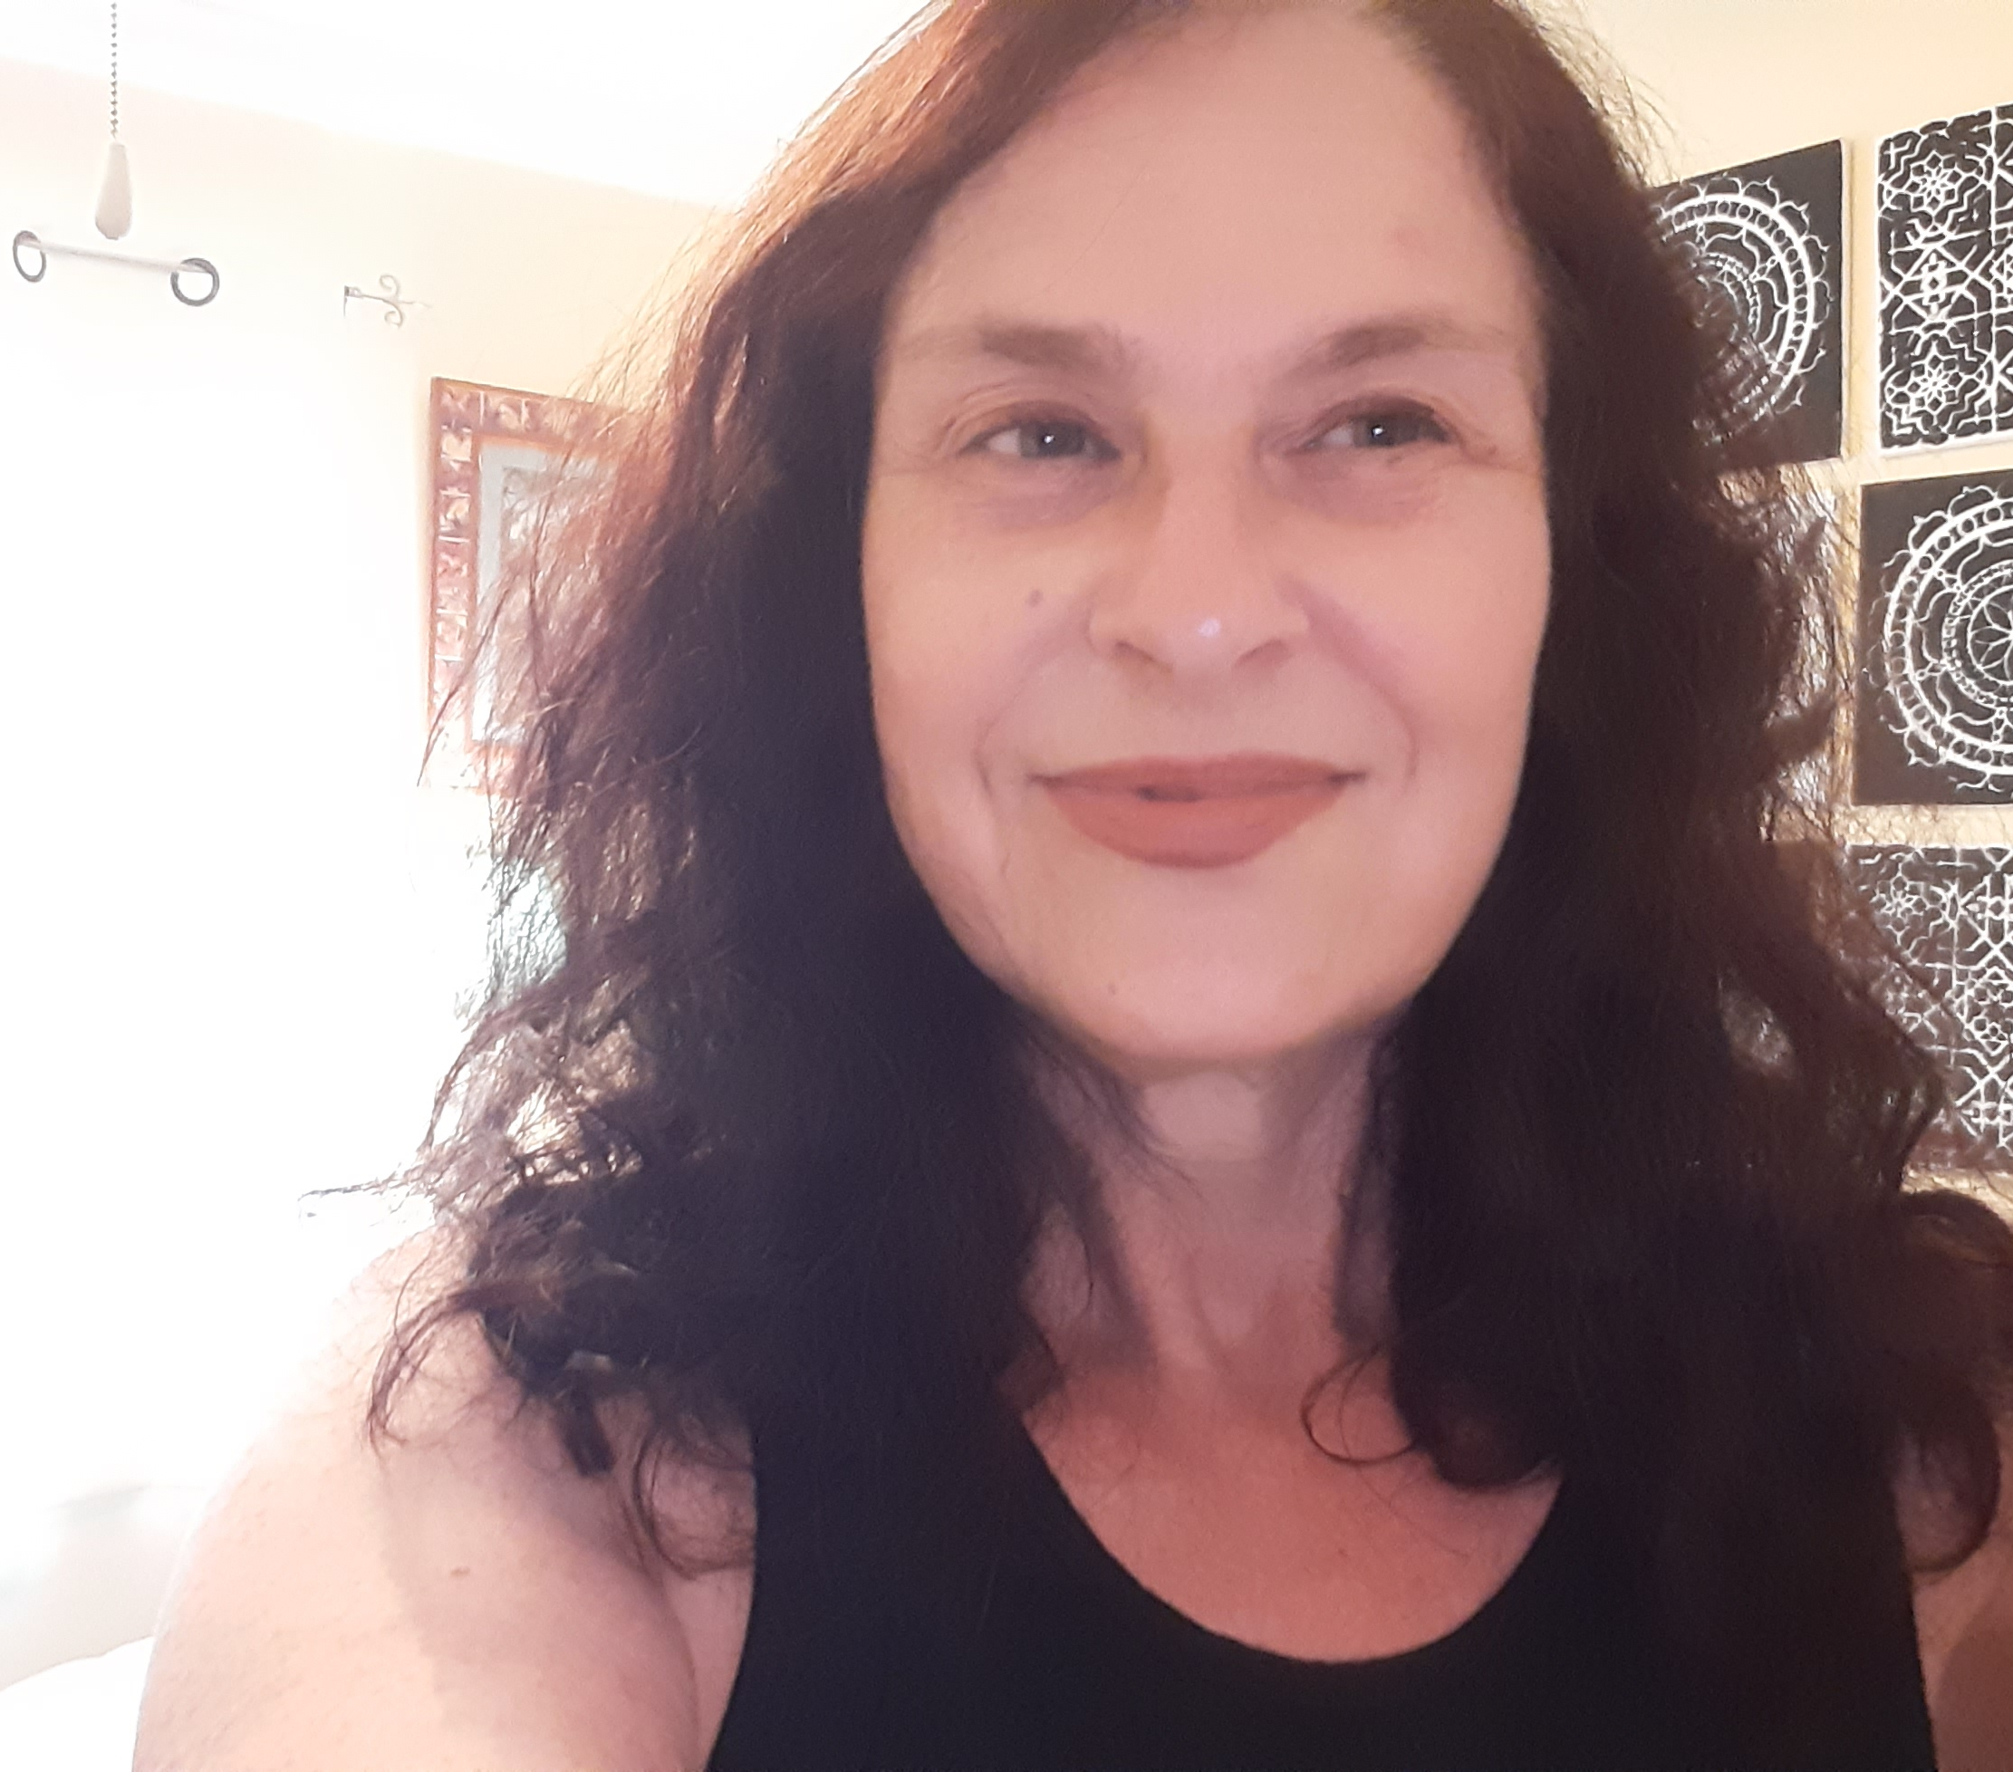
Libraries as the last free place in our society for accessing technology, information and education for all people – can we leverage public libraries in research that makes a difference for those needing help in our society?
Many libraries offer makerspaces and STEM/STEAM learning – can we improve the ability of these programs to help us increase technology skills among a more diverse population in our society?
Many elderly people and others with low technology literacy seek help through public libraries – can we improve technology literacy of seniors by innovating in libraries?
December 2020 publication of Marketing & Social Media: A Management Guide for Libraries, Archives, and Museums. Second Edition. Rowman & Littlefield.
Taught first online Makerspace Management class with experiential learning in connection with FSU’s Innovation Hub;
Conducted research on social media policy, and on education in virtual worlds;
Researching education offered in libraries and impact of pandemic on educational offerings;
Participated in recent 100 Plus Change universitywide MacArthur grant application “Disrupting the Cycle of Incarceration in the U.S.,” seeking to use technology, personal storytelling, and mass media to achieve reform and prepare formerly incarcerated individuals for success.
Leon County Public Library’s Board member, and serving on FSU Libraries faculty advisory board
Lorri Mon
Associate Professor, FSU CCI,
School of Information
lmon@fsu.edu
Social Media & Technology
Online Education
Libraries in Innovation & Education
Makerspaces/Fab Labs
Government Information
Collaborating in grant-seeking and research for supporting online education & tech literacy education;
Collaborating in grant-seeking and research for government information/civics literacy
Collaborating in grant-seeking and research on libraries, social media, and makerspaces
Partnering on grants and research for areas including:
social media
technology education
makerspaces/fab labs
improving civics literacy
online education
Maximilian Etschmaier

Slide 67
Maximilian M. Etschmaier

Slide 68
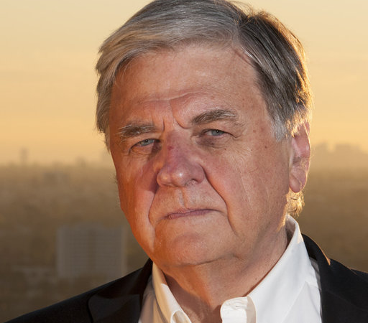
Theory and application of purposeful systems (Systems that integrate material, logical, and human elements)
Applications to industrial and business systems, society
Holistic solution to global equitable sustainability integrating humanity and the environment and using the Globally Equitable Burden Added Tax (GEBAT)
Development of a book on “Elements of Sustainability” that presents sustainability as universal concept that recognizes the key role of human introspection and ethical norms.
Maximilian M. Etschmaier
metschmaier@fsu.edu
Design, analysis and operation of ethical systems that recognize the process of evolution and integrate humans and material and logical elements
Provide advice and support on innovative work in analysis, design and operation of ethical systems that integrate humans and material and logical elements
Join interdisciplinary discussion related to sustainability or any other application of purposeful systems
Suggest beneficial professional connections
Provide support for research and publication
Ebrahim Ahmadisharaf

Slide 69
Ebrahim Ahmadisharaf

Slide 70
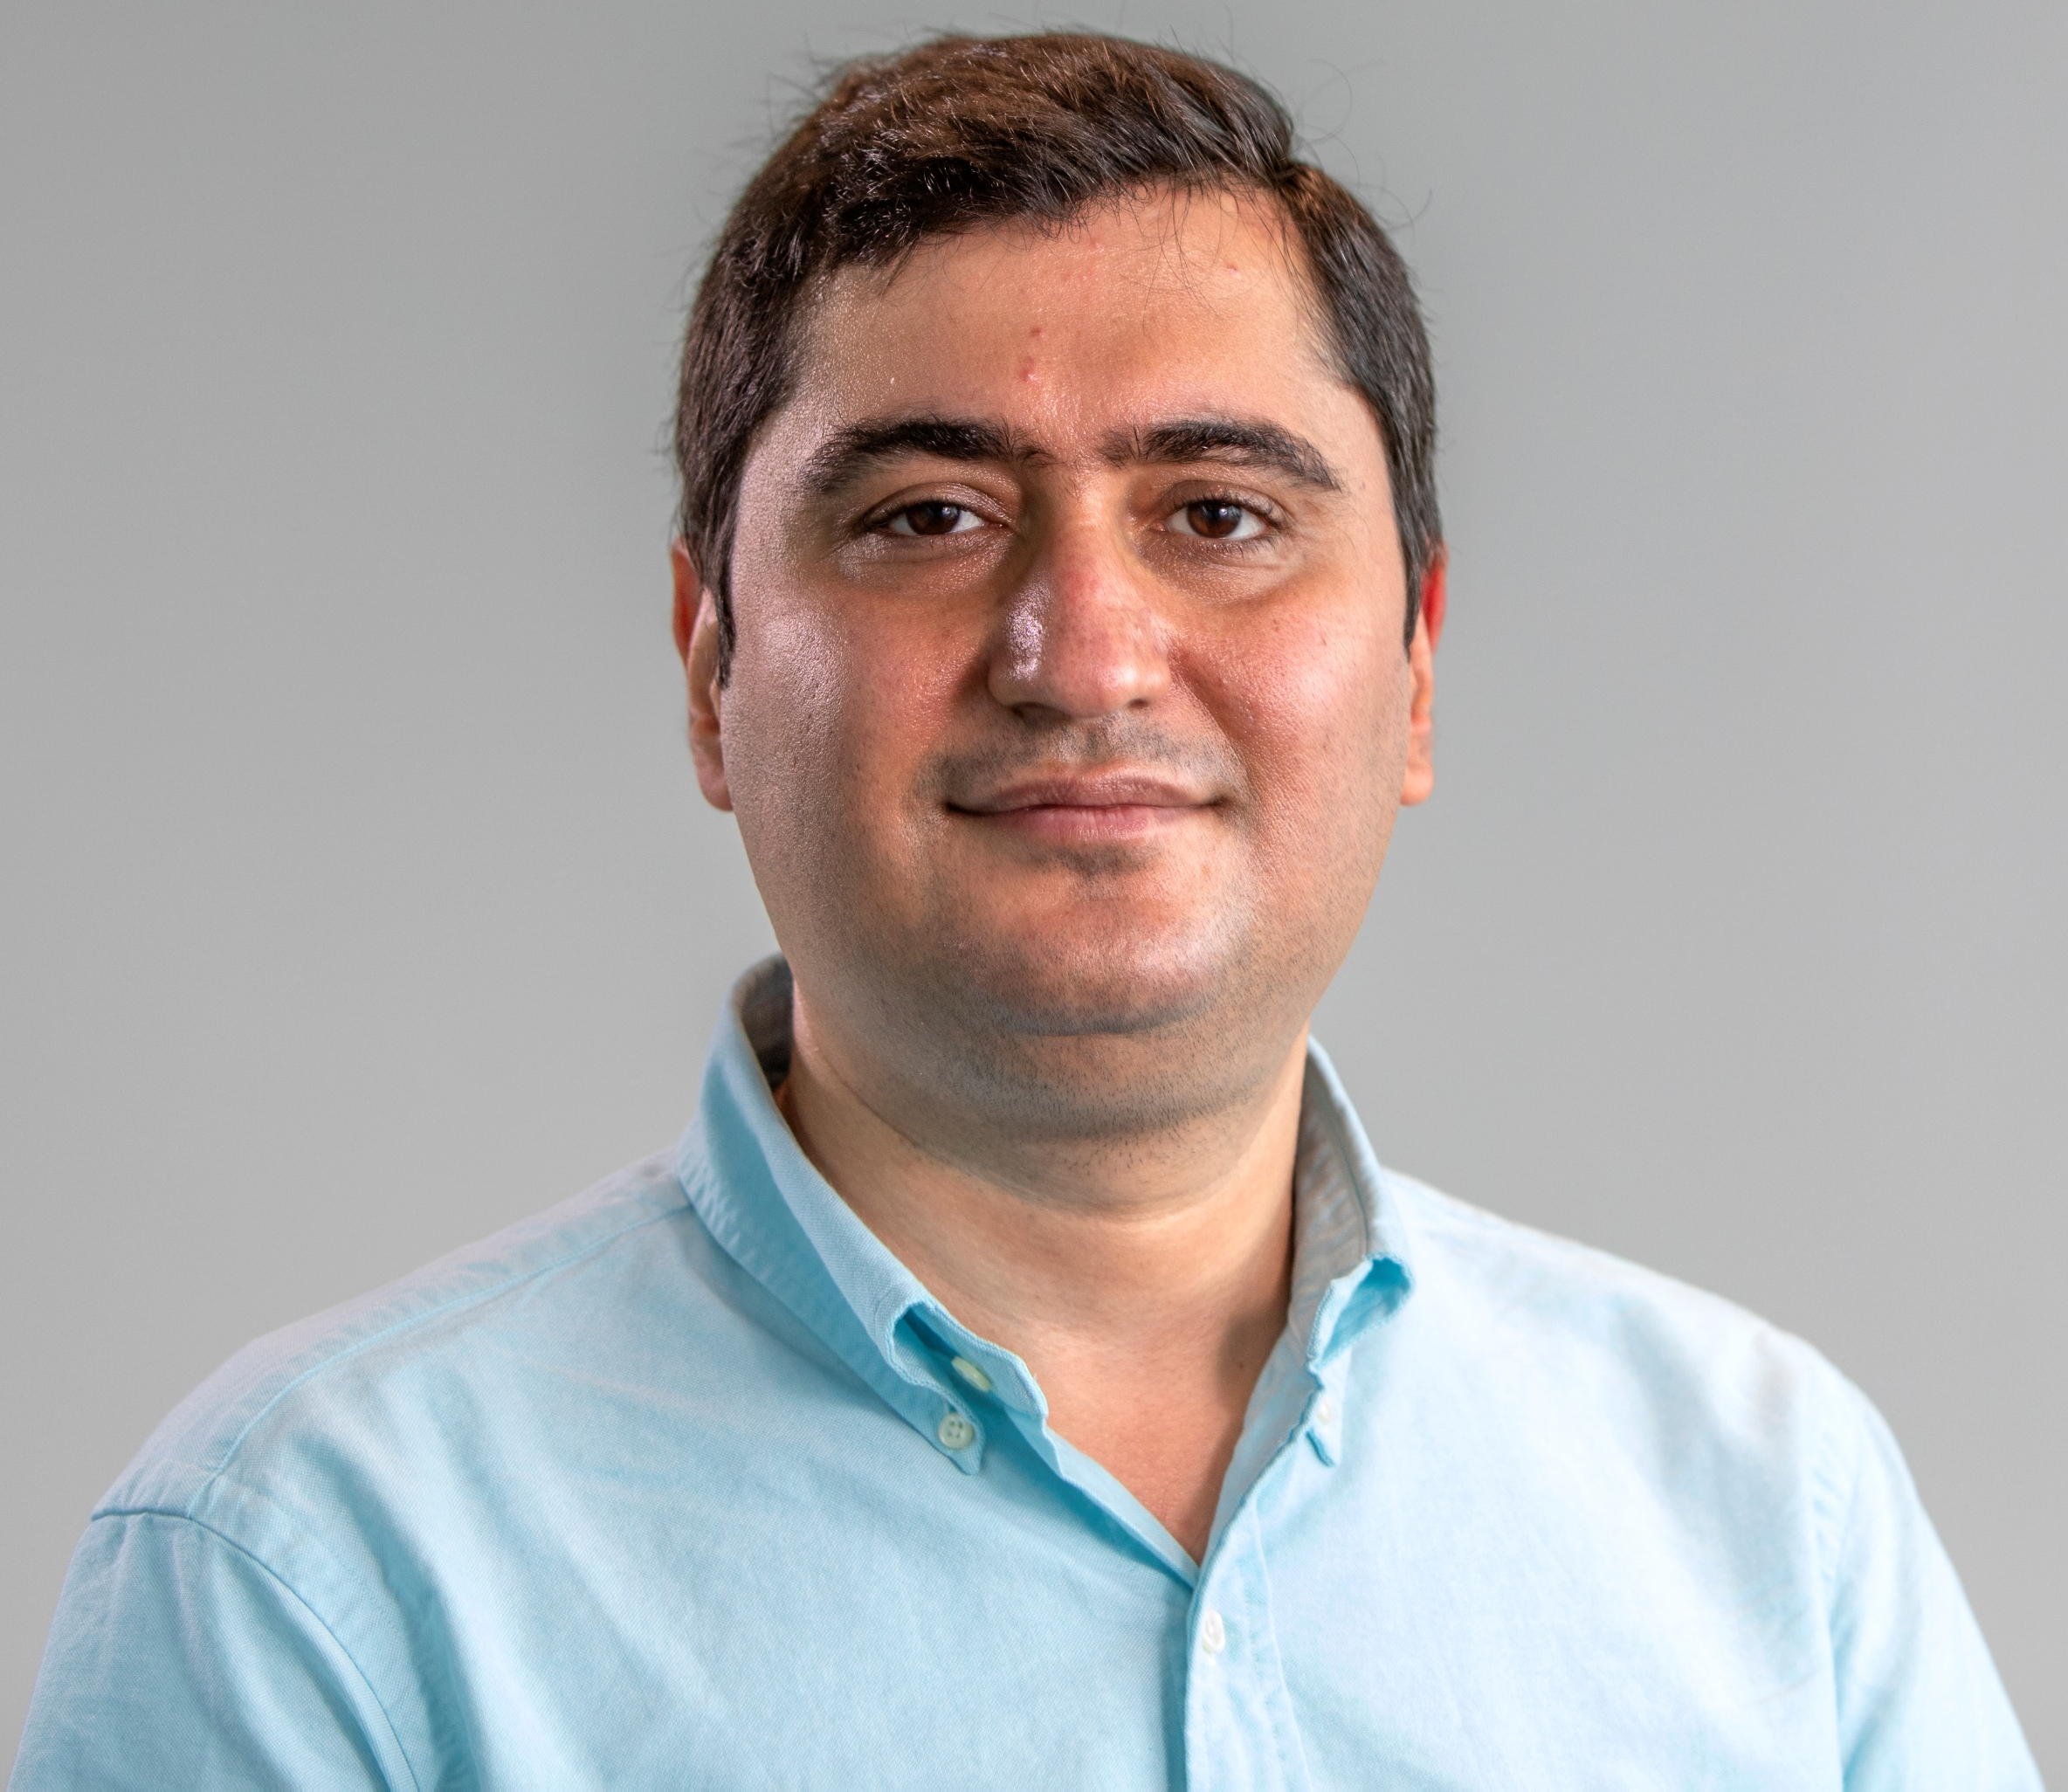
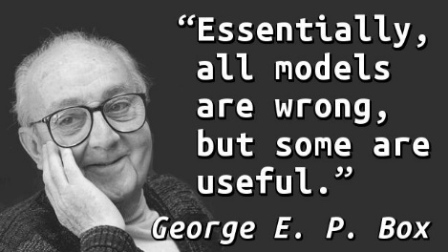
Using best available technology and information to help minimize the impact of natural and man-made disasters on the society
Advancing the understanding of the long-term and indirect impact of these disasters on the society
Helping our communities to understand the impact of our today’s decisions on ecosystems
Exploring approaches to communicate complex numerical analyzes, particularly the uncertainties, with the public stakeholders and decision makers
I am interested in interdisciplinary research that uses best available technology to support decisions related to the impact of natural and man-made hazards on our communities
Ebrahim Ahmadisharaf
Civil & Environmental Engineering
eahmadisharaf@eng.famu.fsu.edu
https://orcid.org/0000-0002-9452-7975
Predicting river streamflows, flood dynamics and impacts on the society, economy and environment
Predicting surface water pollution in rivers
Quantifying uncertainties in numerical model via Bayesian analysis
Collaborate on:
Effective methods for communication of complex analyzes with the public stakeholders
Field work, data collection and lab analysis related to my research
Developing research projects related to floods and surface water pollution
I perform numerical analyzes to develop simulation-optimization frameworks that support decision making under deep uncertainty.
Floods
Surface water pollution
Dam break
Urban stormwater
Land use change impact
Extremes
Recent Projects:
Risk and reliability in reducing bacterial pollution in the rivers
Predicting plausible scenarios of a dam failure and quantifying the impact downstream
Quantifying the uncertainty in flood hazard zones (e.g., 100-yr flood)
Projecting the impact of land use change on river pollution
Patrick F. Merle
Bullet points describing your skills and expertise that potential collaborators might find useful. Could include skills, disciplinary background, methodology experience, etc
Bullet points describing how a collaborator could help your project. Might include needed skills, disciplinary backgrounds, methodologies, etc.

Slide 71
Patrick F. Merle

Slide 72
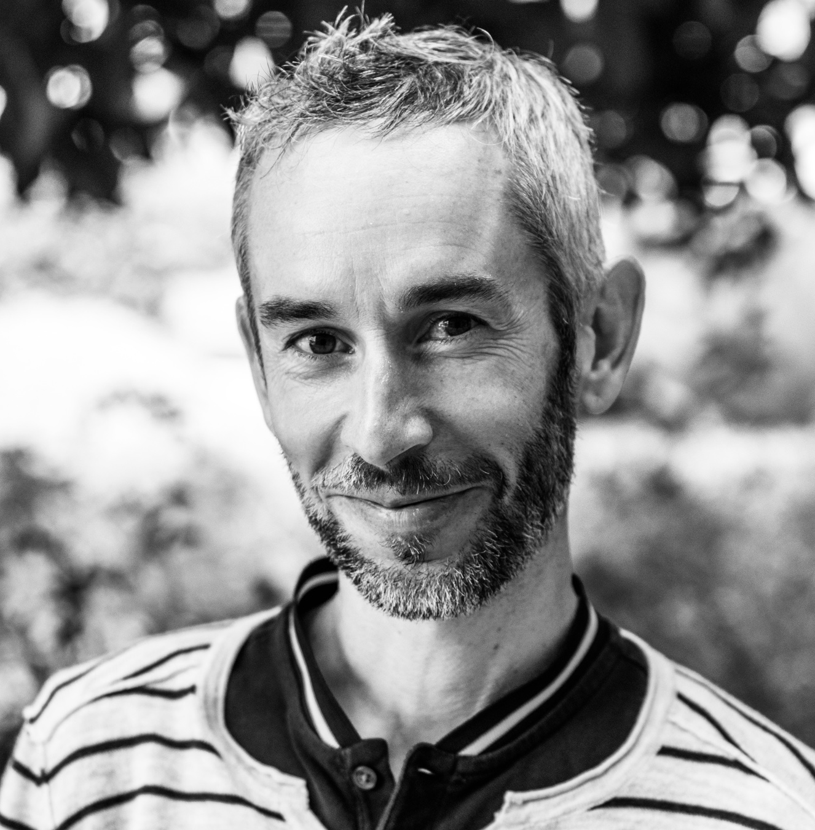
Finding co-authors for research on technology and civic engagement
Developing collaboration for projects on technology and risk prevention (urban planning, climate change…)
Projects on Terror Management Theory and Conservative Bias
Projects on misinformation and behavior
Projects on credibility and civic engagement
Patrick F. Merle - pmerle@fsu.edu
Crisis Communication
Risk Communication
Political Communication
Terror Management Theory
Message testing
Adding communication elements
International (French) angle
Integrating
Grant development
Consideration of a communication component
Aimée Boutin

Slide 73
Aimée Boutin

Slide 74
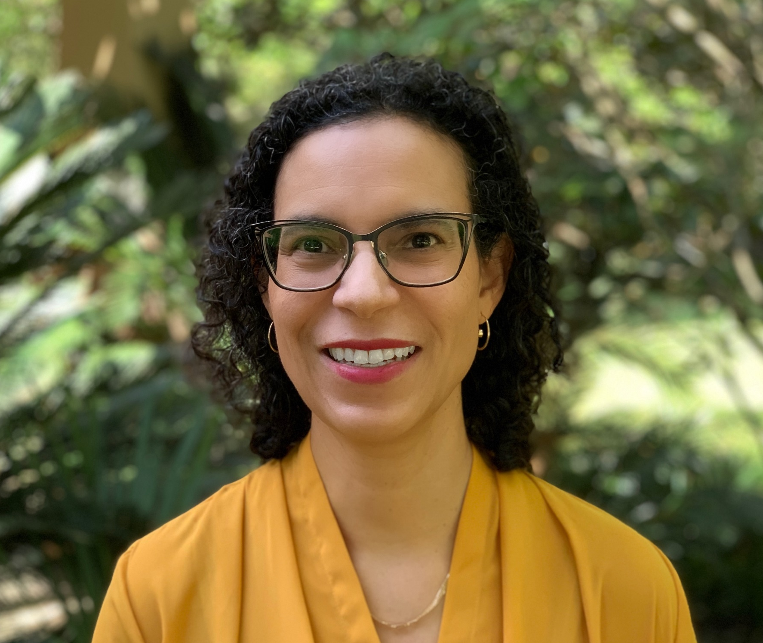
Technologies of mobility (railway, cars…): historical + cultural perspectives
Gender, mobility and technology: do all people move the same ways? for same purposes? with same outcomes?
Noise and technology: how noise levels impact social behaviors, health, cognition, creativity.
Gender and synthesized voice in technological applications and virtual assistants (why is it that Siri, Alexa… are all compliant female voices?)
I work on nineteenth-century French literature, arts and culture. While I primarily study texts, my interests have expanded to include social practices, interdisciplinarity, and sensory experience, especially hearing/listening.
My current project examines women and the railway in 19th-century France; I consider how the railway expanded freedom of movement while imposing and exposing gendered norms on female travelers. How did French women writers respond to dialectics of escape and confinement or new configurations of space-time that locomotion enabled?
Aimée Boutin
Modern Languages and Linguistics
aboutin@fsu.edu
French studies
Sound Studies
Urban Studies
Gender
Interdisciplinary perspectives
I can bring a humanistic perspective to research into technologies’ social impact
Expertise in sensory studies
Interdisciplinary background
Excellent writing, organization
I am interested in collaborating with colleagues in STEM and social sciences to learn how the humanities can better contribute to these areas.
I seek opportunities to apply my expertise to practical, policy or design issues.
Guangzhi Shang

Slide 75
Guangzhi Shang

Slide 76
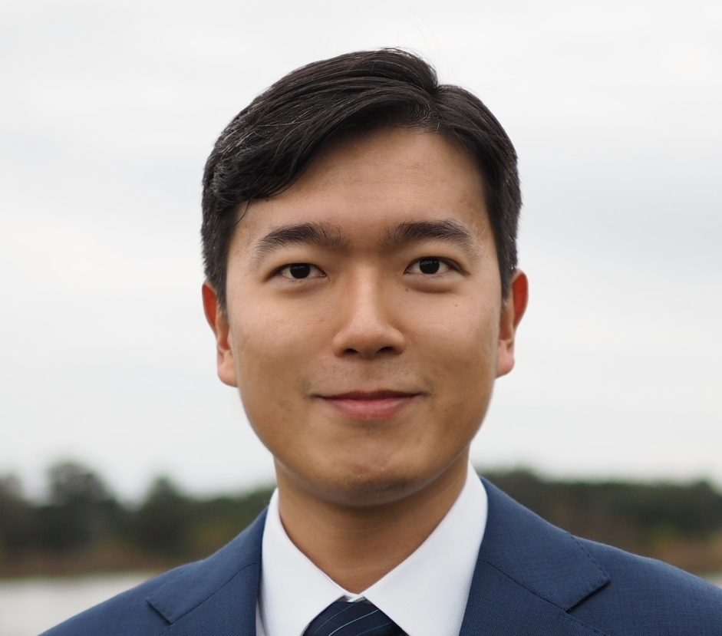
How are crowdfunding-based innovation worker’s productivity affected by COVID19?
This supply-side effect may differ based on the category of a project. For example, the productivity of creators of art projects may increase because they are able to do arts at home and they have more time to initiate the projects. In contrast, the productivity of creators of pot projects may decrease because they face more difficulties in the supply chain process.
Customers become more supportive of these workers?
There are should be two sides of impact: (1) Income: the decrease of people’s income due to COVID-19 leads to smaller number of backers and reduced pledge per backer. (2) Sympathy: COVID increase people’s sense of sympathy, which can lead to the increased number of backers and pledge per backer. For example, backers from the area without COVID-19 may increase their support to the project initiated by the creators from the area with COVID-19.
Ilk, N., Shang, G., Fan, S., and Zhao, L. J. (2020) Stability of Transaction Fees in Bitcoin: A Supply and Demand Perspective. MIS Quarterly, forthcoming.
Ilk, N., Shang, G., and Goes, P. (2020) Improving Customer Routing in Contact Centers: An Automated Triage Design based on Text Analytics. Journal of Operations Management, 66(5).
Shang, G., McKie, E.C., Ferguson, M.E., and Galbreth M.R. (2020) Using Transactions Data to Improve Consumer Returns Forecasting. Journal of Operations Management, 66(3).
Lu, G. and Shang, G. (2017) Impact of Supply Base Structural Complexity on Financial Performance: Roles of Visible and Not-So-Visible Characteristics. Journal of Operations Management, 53-56.
Shang, G., Pekgun, P., Ferguson, M.E., and Galbreth M.R. (2017) How Much Do Online Consumers Really Value Free Returns? Journal of Operations Management, 53-56.
Shang, G., Ghosh, B.P., and Galbreth, M.R. (2017) Optimal Retail Return Policies with Consumer Opportunism. Production and Operations Management, 26(7).
Guangzhi Shang
Department of Business Analytics, Information System, & Supply Chain
gshang@business.fsu.edu
Platform business models
Labor productivity in services
Retail management
Cryptocurrency economics
Proficient in data manipulation
Econometrics
Statistics
Math modeling
Economic and management theory
Social impact of this reserach
Expertise that’s not overlapping with mine
Andy Opel

Slide 77
Andy Opel

Slide 78
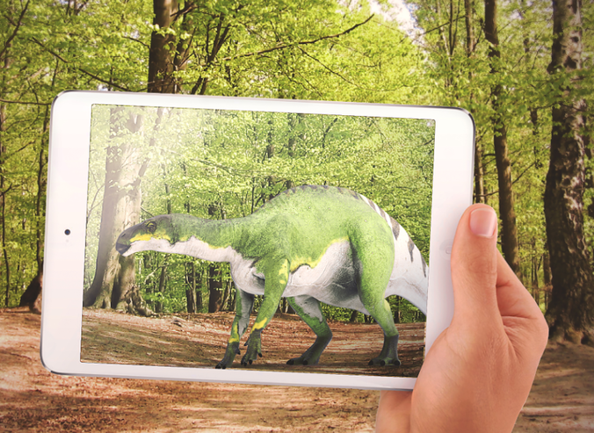
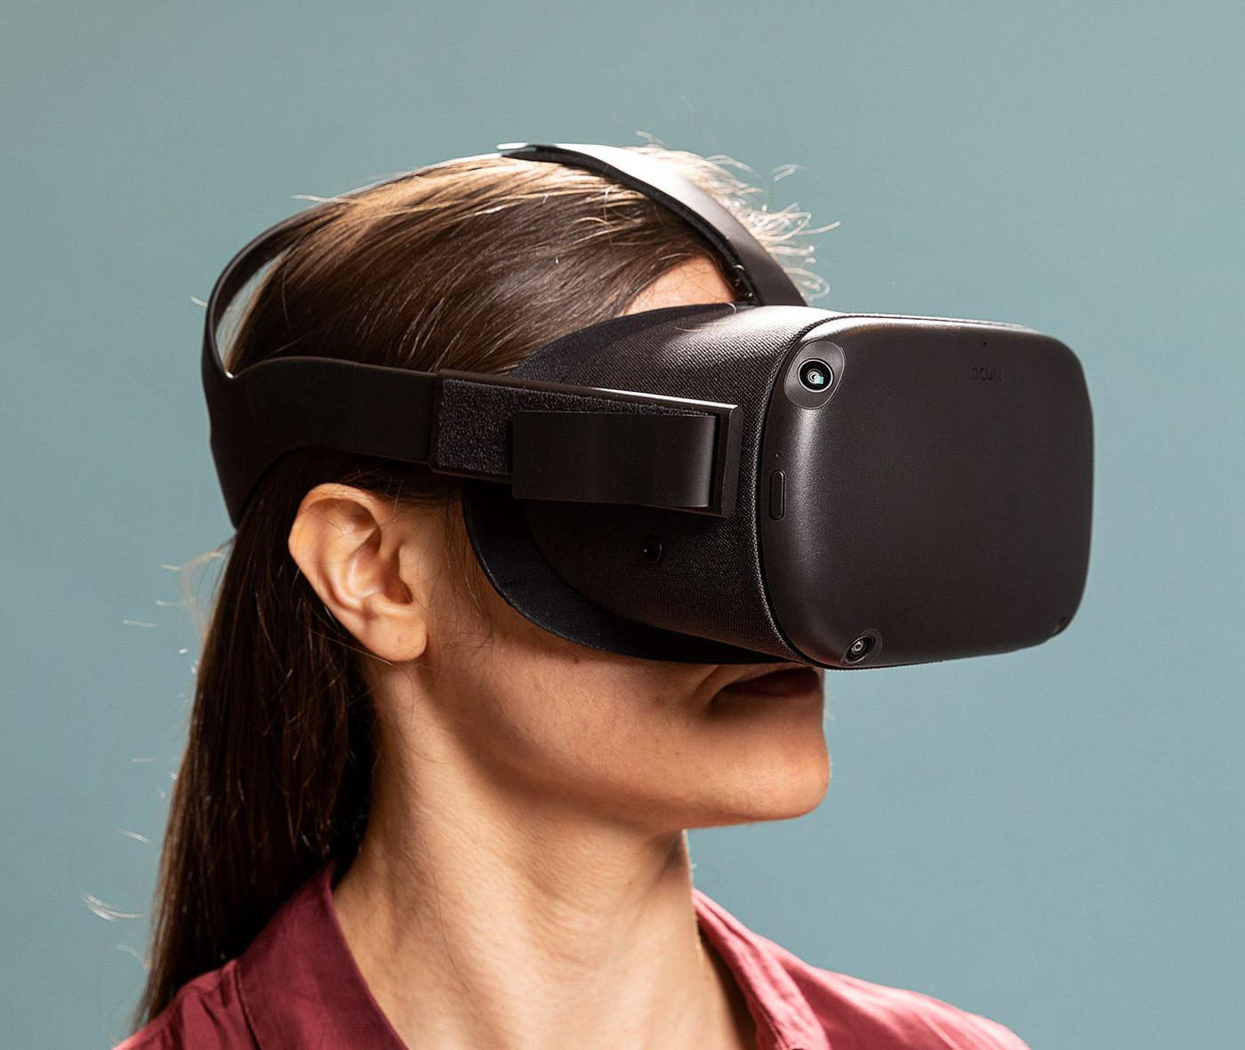

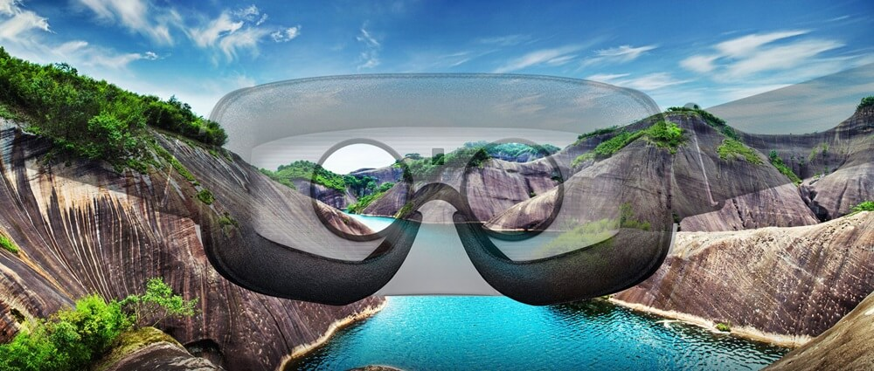
Andy Opel
School of Communication
Looking for VR/AR collaborators to develop and test
immersive environmental experiences
aopel@fsu.edu
Paul Marty

Slide 79
Paul Marty

Slide 80
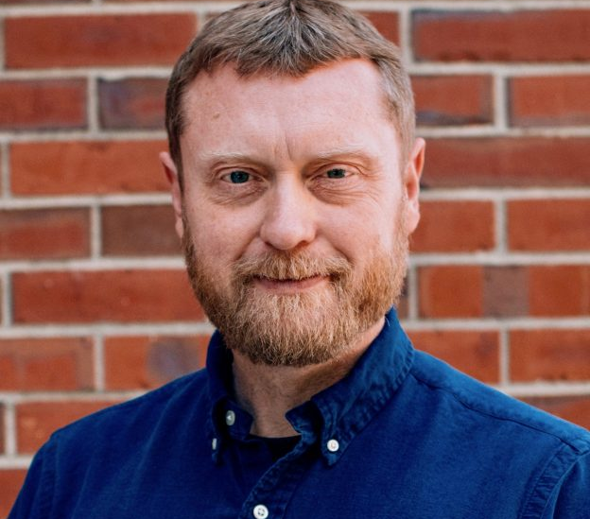
Studying the Sociotechnical Interactions that take place between People, Information, and Technology in Museums and other Cultural Institutions
Building a Culture of Innovation and Digital Literacy in Undergraduate Education
Career Driven Innovation and Leadership through Information Technology
Let's talk about the future of Information Literacy, Data Literacy, and Digital Citizenship on campus!
Recent Publications
Marty, P.F. & Kim, U. (2020). Trending MCN: Fifty Years of Museum Computing Conferences and Community. Curator: The Museum Journal 63(2), 193-215.
Marty, P.F., Saludo, R., & Kim, U. (2020). Innovation Centers and the Information Schools: The Influence of LIS Faculty. Journal of Education for Library and Information Science. 61(4).
Current Projects
Assessing the Contributions of the Museum Technology Sector during Times of Crisis such as COVID-19
Invisible Work in Museums: An Oral History of Museum Computing
Gen Z vs. Google: The Unintended Consequences of Information Technology in the Information Society
Paul Marty
School of Information
marty@fsu.edu
orcid.org/0000-0002-5948-5730
Museum Informatics
Technology and Culture
Innovation and Design
Information and Society
The Innovation Hub Steering Committee is designing an Innovative Scholars program to recognize the University's innovative, creative, and engaged student learners — let’s talk about that!
marty@fsu.edu
We’re developing an interdisciplinary minor in Technology and Society to encourage undergraduate students to explore the social, ethical, and/or cultural implications of technology — let’s talk about that!
marty@fsu.edu
Aline Kalbian

Slide 81
Aline Kalbian

Slide 82
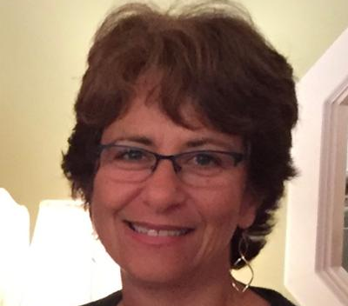
To develop collaborations across units at FSU.
To integrate new material into my teaching and research.
To learn more about technology’s impact on society through the lens of other disciplines.
Sex, Violence, Justice: Contraception and the Catholic Church, Georgetown University Press, 2014.
Sexing the Church: Gender, Power, and Ethics in Contemporary Catholicism, Indiana University Press, 2005.
”Community, Complicity, and Critique: Christian Concepts in Secular Bioethics,” (with Courtney S. Campbell & James F. Childress), The American Journal of Bioethics, 20:12 (2020): 37-39.
“Both Familiar and New: Reimagining Catholic Sexual Ethics,” Journal of Religious Ethics, 46.4 (2018): 603-610.
“Moral Traces and Relational Autonomy,” Soundings, 96.3 (2013); 280-296.
“Sexuality in Religions,” in Hugh LaFollette, ed., International Encyclopedia of Ethics, Wiley-Blackwell, 2012.
“Catholic and Contraception since 1968: Has Anything Really Changed?” Louvain Studies 36.1 (2012): 22–45.
“Considering the Risks to Economically Disadvantaged Egg Donors,” American Journal of Bioethics 11.7 (September 2011): 22–30.
Aline Kalbian
Professor and Chair
Department of Religion
Florida State University
I am a scholar of religious ethics.
I study religious communities and their ethical views about medicine, health, sexuality, and gender.
I am interested in reproductive and genetic technologies.
My research focuses on Catholicism in the US.
My approach is broadly feminist.
Expertise in ethics.
Knowledge of religious traditions and communities.
Previous interdisciplinary work.
Long-time editor of journal in my field.
To expand my research and thinking about technology.
To think about how to integrate science and humanities through the study of ethics.
Kerry Fang

Slide 83
Kerry Fang

Slide 84
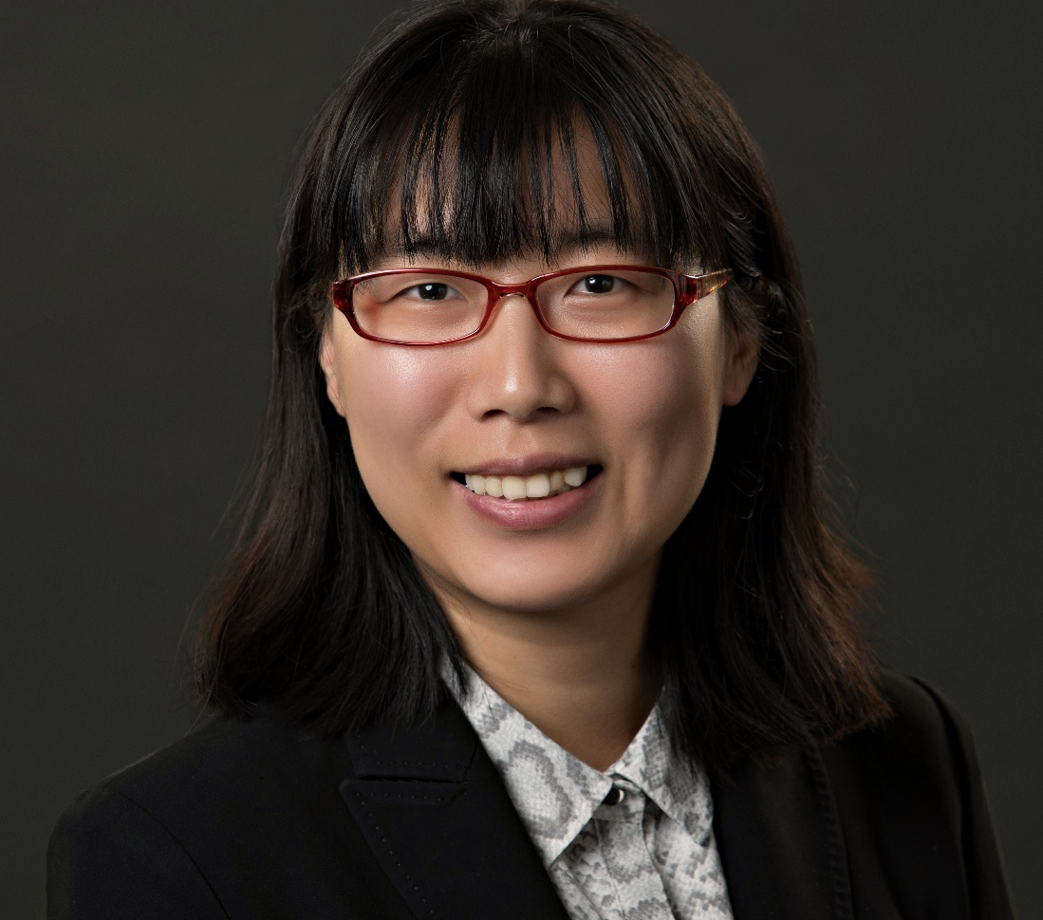
I’m looking for collaborators on the project studying AI’s implications on the future of work. Given my own expertise in labor market analysis and policy analysis, I’m looking for collaborators either (1) have expertise in AI, or (2) have access to unique dataset for analyzing skill requirements in different occupations.
My research has focused on examining the effectiveness of policy tools to advance technology and innovation, as well as using policies to address the potential problems coming out of the adoption of new technology.
I typically use a combination of statistical, computational and scenario development methods to study these issues. One of my current projects studies the labor market impact and policy preparation for autonomous vehicles across the US.
Kerry Fang
Urban and Regional Planning
lfang3@fsu.edu
Technology & Innovation policy
Economic development
Deep understanding in urban policies, planning and political process
Mixed-method research design
Extensive relationships with collaborators in and outside of academia
Advanced statistical, spatial and data science analysis
Rich experience in cross-country comparative studies
Access to new dataset
Interdisciplinary approach
A research team of students and postdocs that can efficiently move projects forward
Familiarity with the development of new technology (such as AI and AV)
Jeff Whalen

Slide 85
Jeff Whalen

Slide 86
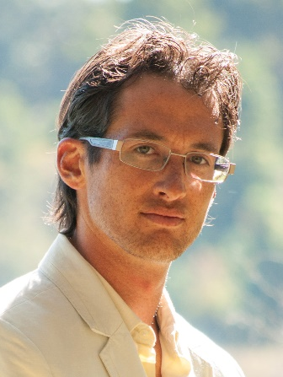
The intersections of STEM and entrepreneurship in both education and practice
Growth and expansion of STEM acceptance, influence and appreciation in society
Collaborative grant seeking for STEM-enabled research and venture creation
Curriculum and course development in STEM entrepreneurship
Past work at MagLab:
DOE, Crystal growth and characterization
DOD, Development of a system for removal of magnets from metal plates
Current work at JMC:
FSU, undergraduate and graduate programs in STEM Entrepreneurship
NSF, Florida I-Corps
Jeff Whalen
STEM Entrepreneur in Residence
The Jim Moran College of Entrepreneurship
Florida State University
Phone: 850-644-7142
jwhalen@fsu.edu
-Science commercialization startups, fundraising & business modeling
-Intellectual property, core innovation & technology transfer
-Entrepreneurship education curriculums and program development
-Crystalline materials growth and processing
-X-ray diffraction systems
-Novel process control systems
-Solid state physicochemical properties characterization
-Applied magnetism and new magnetic device development
-Cross-disciplinary collaborative research spanning chemistry, materials science, physics, engineering, education, business & entrepreneurship
-Federal, state and locally funded laboratory-based grant seeking, project execution & reporting
-Setup and management of new and/or customized laboratories
Fundraising
Product development pathways
Resource and asset sharing
Increasing awareness of STEM entrepreneurship programs and culture at FSU
Collaborations on relevant research projects and grant seeking
Daniel L. Fay

Slide 87
Daniel L. Fay

Slide 88
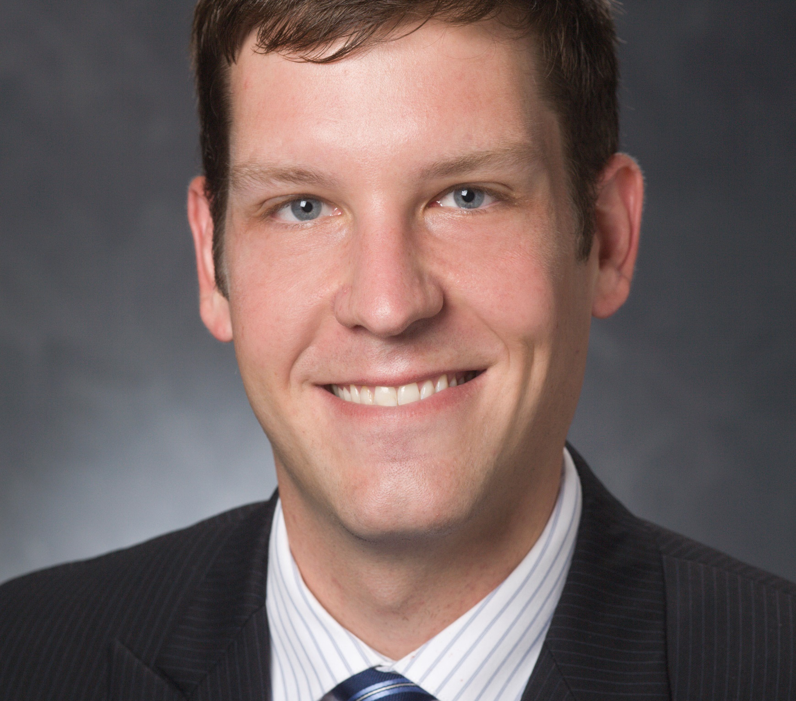
Diffusion and innovation of technology policy across governments
Public/Private partnerships in technology policy
Research collaboration among academic scientists, universities, government, and private industry
Organizational structures that foster technological developments and innovations
E-governance
Research collaboration in universities and academic entrepreneurship: the-state-of-the-art. The Journal of Technology Transfer
Power to do...What? Department heads' decision and strategic priorities. Research in Higher Education
Revisit the drivers and barriers to e-governance in the mobile age: A case study on the adoption of city management mobile apps for smart urban governance. Journal of Urban Affairs
The Political Structure of Policy Diffusion. Policy Studies Journal
Move and Countermoves: Countermovement Diffusion of State Constitutional Amendments. Policy Studies Journal
Contracting, Ethics, and Policy Adoption: The Case of Florida Municipalities. Public Integrity
Planning for a Payout: Effectiveness of Special Purpose Entities as State Lottery Administrations. The American Review of Public Administration
Daniel L. Fay
dfay@fsu.edu
Askew School of
Public Administration & Policy
https://orcid.org/0000-0002-2812-6110
Academic research Collaboration
Public Management
Public Policy
Higher Education
Gender equity
Quantitative empirical analysis
Social network analysis
Data management
Grant proposal development
Survey-design
Background in public policy, management, and higher education
Qualitative methodology
Disciplinary background in communication, technology, and physical sciences.
Zina Ward

Slide 89
Zina Ward

Slide 90
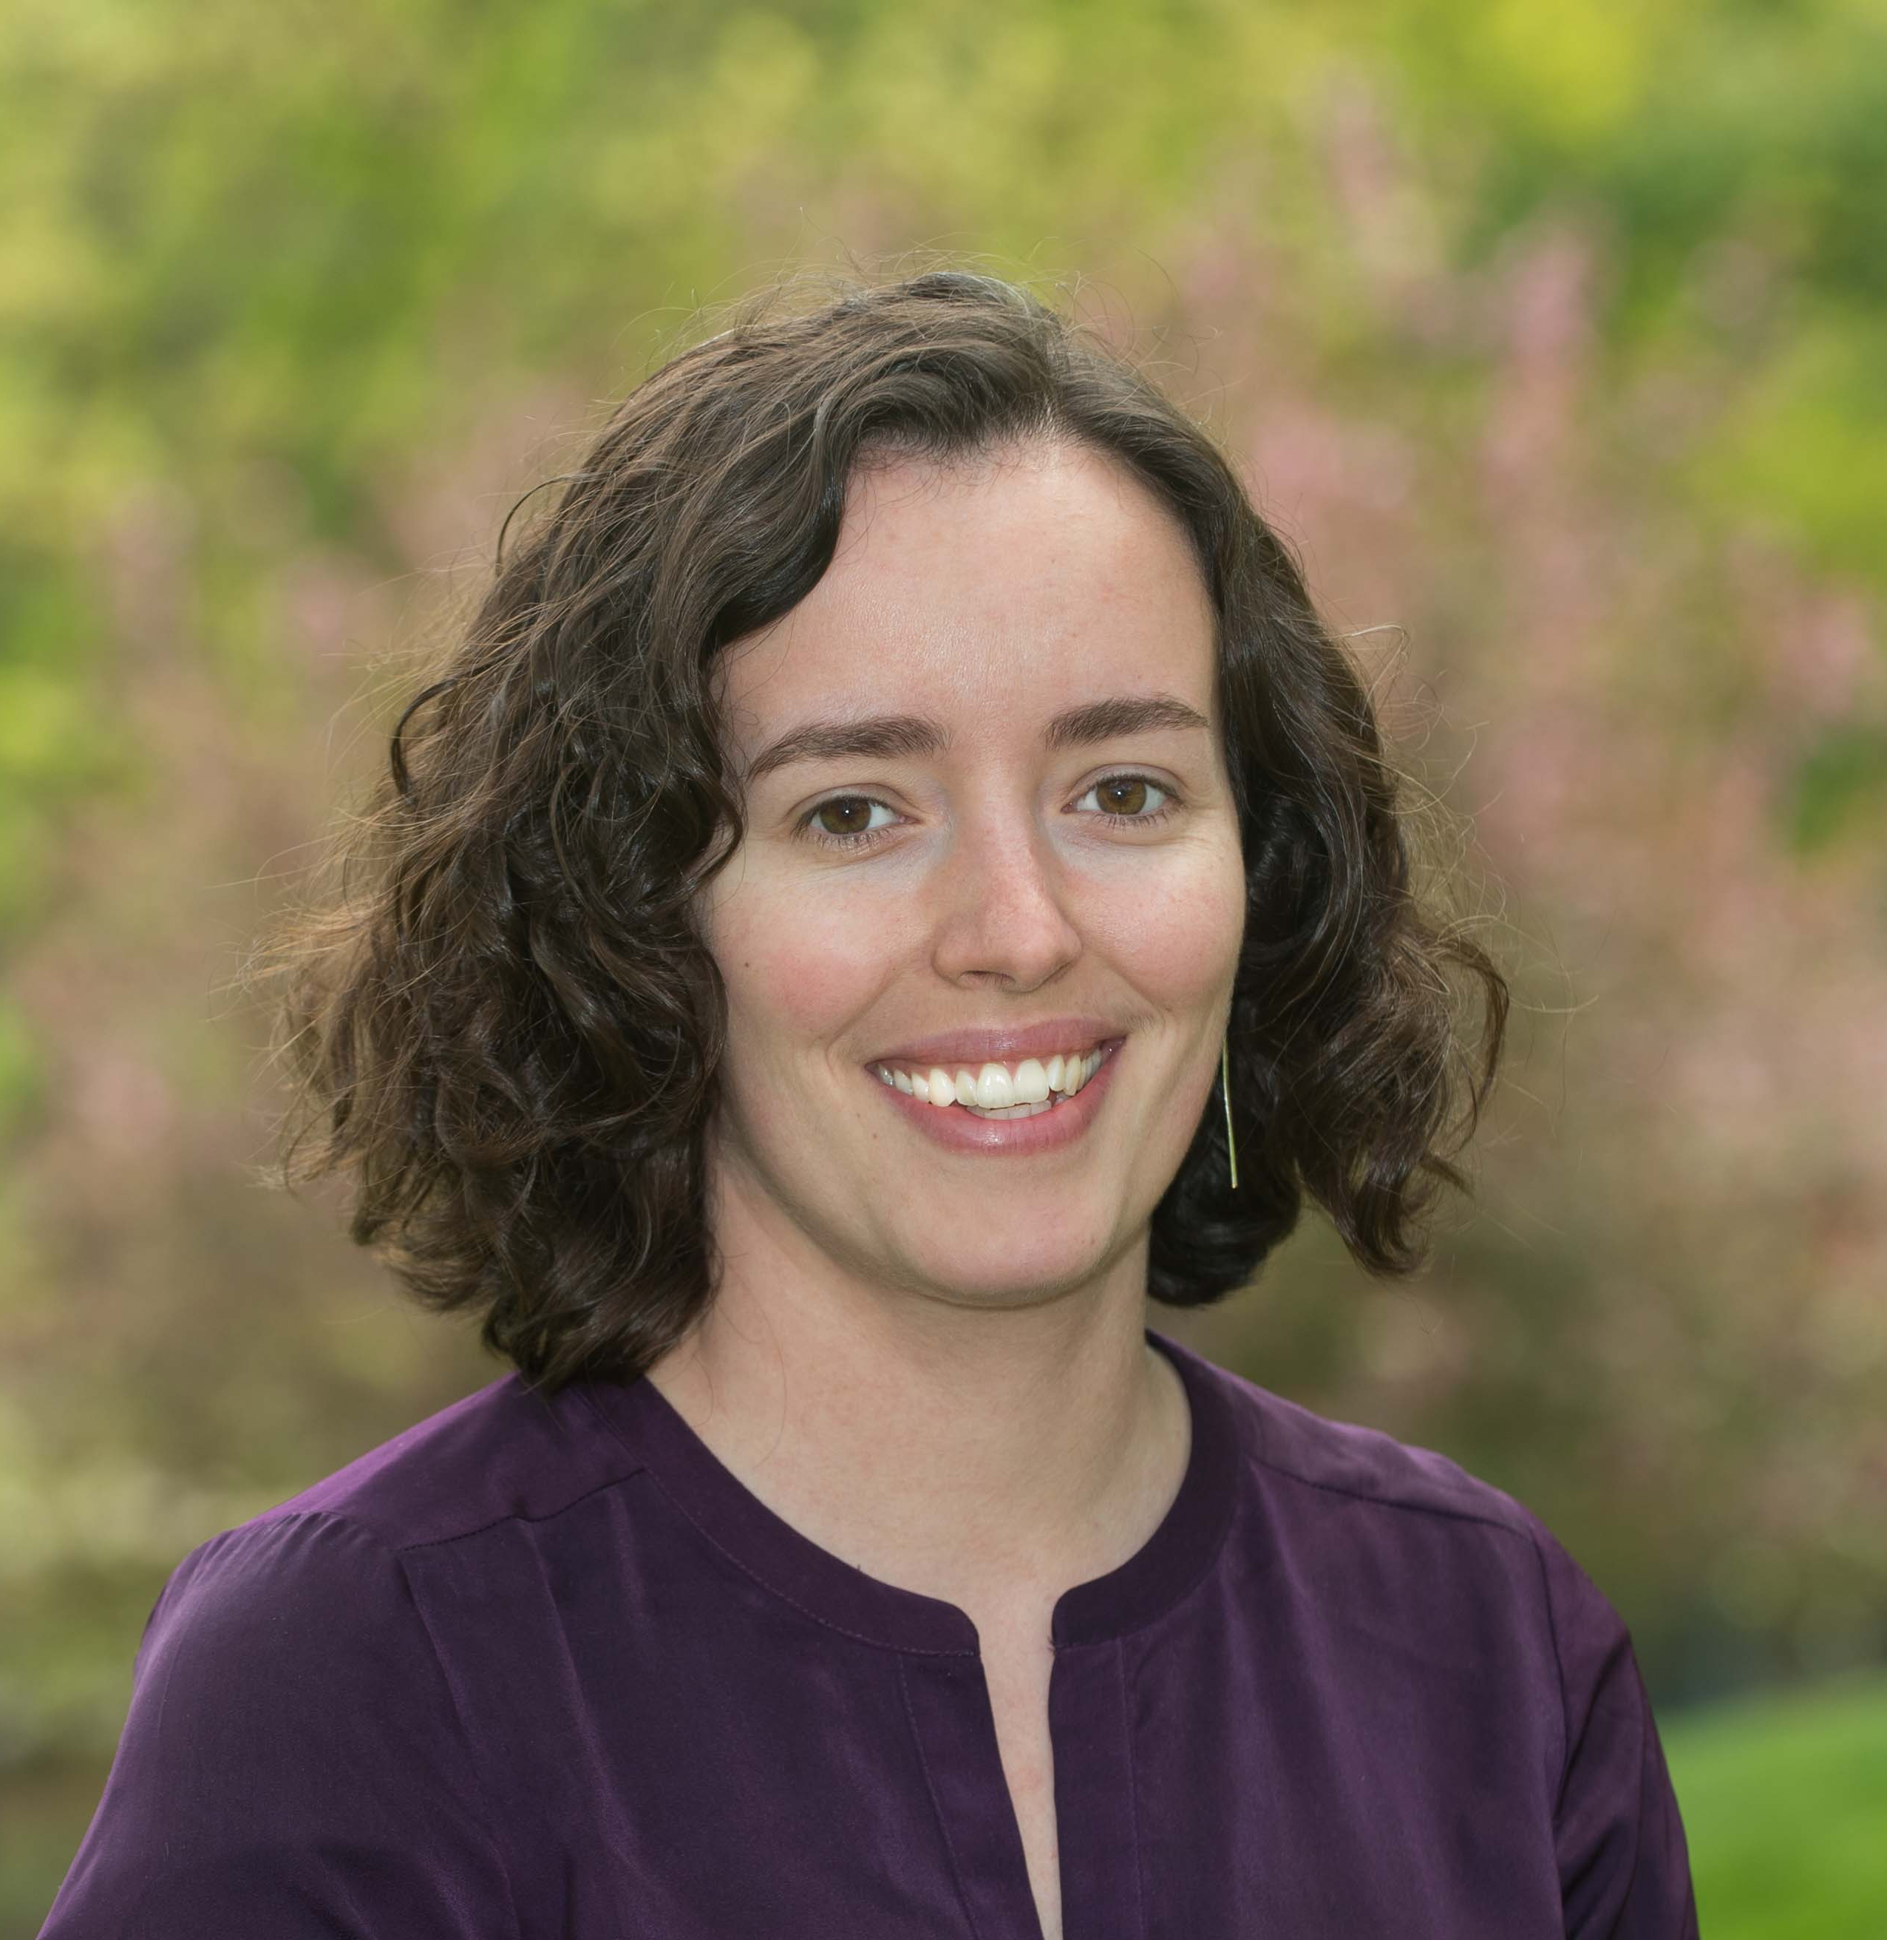
As a philosopher of science, I’m broadly interested in how social currents shape scientific research and vice versa.
values: what role do non-epistemic values play in science? how do distinguish between legitimate and illegitimate value influence?
data ethics: what ethical principles should guide the use of machine learning and other big data methods in science, medicine, and industry? (I’ll be teaching the Data Ethics course in FSU’s new Master’s in Data Science next spring.)
science and policy: how to best structure the interface between science and public policy?
values in science: The philosophical literature on values in science focuses on the choices of individual scientists; in future work I intend to consider how values come into play in groups (e.g., collaborative teams) and institutions (e.g., funding bodies).
history of neuroscience: I’m currently working on a project on the mid-20th century debate about whether muscles or movements are represented in motor cortex.
clustering and natural kinds: I’m starting a new project exploring how and why we use clustering (i.e., low within-category variability and high between-category variability) as a marker of genuine scientific and social kinds.
Recent publications:
Ward (forthcoming), “On value-laden science,” Studies in History and Philosophy of Science
Ward (forthcoming), “Registration pluralism the cartographic approach to data aggregation across brains,” British Journal for the Philosophy of Science
Zina Ward
Department of Philosophy
zward@fsu.edu
www.zinabward.com
philosophy of science
history and philosophy of cognitive science
the role of (social, political) values in science
nascent: data ethics
background in philosophy, history, & sociology of science
expertise in the history of neuroscience (1870-present)
familiarity with data ethics, research ethics
help develop interdisciplinary grant proposals
statistical expertise, experience with clustering methods (see right panel)
interesting ethical question/issue that has arisen in your research
I’ve just joined FSU this semester; open to ideas!
Laurelin Haas

Slide 91
Laurelin Haas

Slide 92
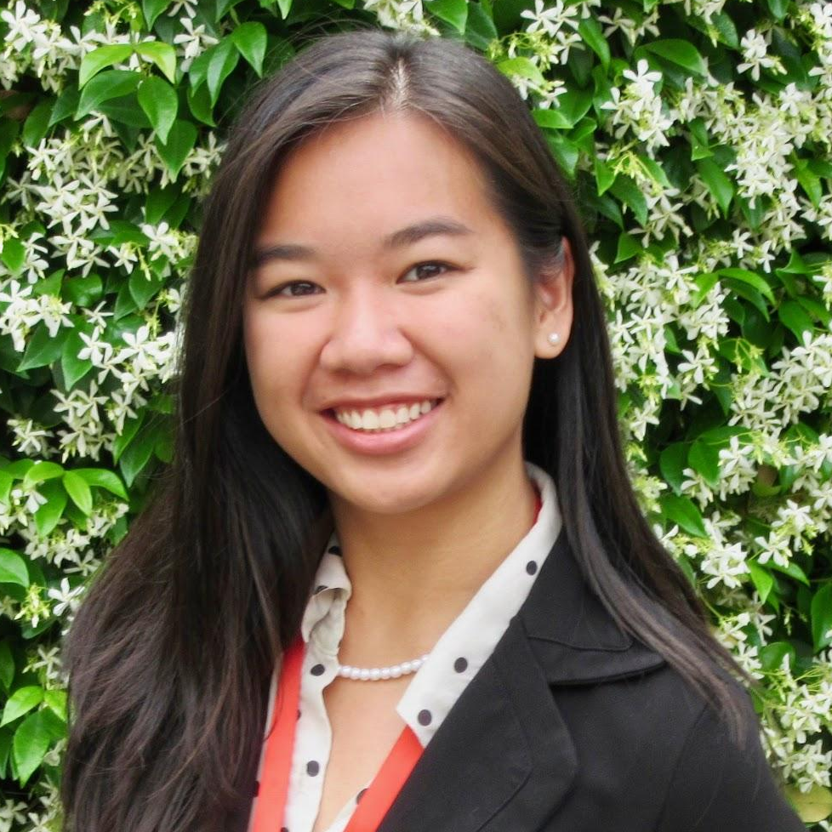


Exploring connections between campus and community related to sustainable technology implementation
Facilitating partnerships related to green business initiatives and/or data ethics
Supporting research, outreach, and applied projects related to the social impact of sustainability innovations (renewable energy, EVs, plant-based meats)
I manage the Green Fund program at FSU, which provides small grants to FSU students, staff, and faculty pursuing sustainability projects that benefit the FSU community.
Laurelin Haas
Academics & Partnerships Coordinator
Sustainable Campus
lhaas@fsu.edu | 850-645-7818
Community Outreach
Broader Impacts
Connecting to Sustainability Challenges
Grant funding for sustainability-related projects
Connection to local sustainability-related nonprofit and government organizations
Connection to FSU Facilities department
Share details of your work for STARS reporting
Join our network of sustainability faculty & researchers
Allow me to help you!
I connect faculty with campus and community partners through Campus as a Living Lab for applied sustainability research projects.
Recent Collaborations:
Dr. Jaejin Lee and FSU Food for Thought Food Pantry
Dr. Tisha Holmes and St. Marks Wildlife Refuge
Dr. Will Butler and Second Harvest of the Big Bend
Cynthia Yang

Slide 93
Cynthia Yang

Slide 94

Connecting with other colleagues at FSU who are interested in the economic and social impact of technology advancement.
Productivity gain/loss from remote work and collaboration.
Economic impact of new supply chain technology.
Adoption of digital technology and Covid-19.
Technology diffusion across time and space.
I am open to other ideas.
Selected publications/projects
Econometric analysis of production networks with dominant units
Common factors and spatial dependence: An application to US house prices
Matching theory and evidence on Covid-19 using a stochastic network SIR model
The effects of single-family rentals on home values and neighborhood racial integration
Binary choice panel data models with endogeneity
Cynthia Yang
Department of Economics
cynthia.yang@fsu.edu
https://sites.google.com/site/cynthiafanyang/home
Applied and theoretical Econometrics
Cross-section dependence: spatial econometrics, factor models, networks
Urban and regional economics
Econometric and statistical methods
Large heterogeneous panel data models and spatial-temporal models
Time series analysis
Econometrics of program evaluation
Access to interesting datasets
Interdisciplinary approaches
Grant finding and writing tips
Tra Bouscaren

Slide 95
Tra Bouscaren

Slide 96

I am a post-disciplinary installation artist focused on American spectacle. Site-responsively, my process begins with salvaging local materials that resonate indexically with waste culture and the surveillance state. Aggregating these waste materials into networks of sculpture, I weave surveillance equipment into the sculpture such that it looks out at people as they approach the work. The video feeds are combined algorithmically and re-deployed through in a multichannel projector array, submerging the installation in a distorted vision of surveillance of the people in the exhibition space. By projection-mapping live video mashups of exhibition viewers back onto the waste-based physical structure, the work serves to implicate spectators back into what they have arrived to judge.
I Co-Direct the Expanded Cinema Lab (ExCineLab), an experimental/new genres exhibition and performance platform. We have Faculty Affiliates from FSU Departments of Dance, Theatre, Film, Communications, Music as well as the FSU Innovation Hub. Our home base is a 5,000 sf space gifted to us by the TCC Center for Innovation. We offer an artist-in-residence program, lectures, new media workshops, and social outreach. We are founding a New Media Festival here in Tallahassee and want to work with you.
My work has been featured nationally and internationally at venues including the Berlin Museum für Naturkunde, Victor I Fils Gallery (Madrid), the National Museum of Art (Addis Ababa), Centre de Cultura Contemporània de Barcelona, Czong Institute for Contemporary Art (Seoul), Palácio da Cultura Ildo Lobo (Praia), The Wrong Biennial, The Wiregrass Biennial, Greenleaf Gallery (Los Angeles), Fort Mason Center for Art and Culture (San Francisco), Annenberg Center for the Performing Arts (Philadelphia), Santa Cruz Museum of Art and History, San Diego Art Institute, MOCA Tucson, Hallwalls (Buffalo), Lincoln Center (New York), Mattress Factory Museum of Contemporary Art, alongside permanent installations by Yayoi Kusama and James Turrell. My upcoming installation "Camo Ammo" will be featured at the Orlando Museum of Art, in competition for the Florida Prize in 2021.
Tra Bouscaren
Assistant Professor of Critical Art Practices
Co-Director of the Expanded Cinema Lab
https://www.instagram.com/fieldtripprojects/
abouscaren@fsu.edu
Practice-Based Art Research
Installation Art
Video Art
Media Ontology
Aesthetics
I am looking to connect with FSU Professors from other disciplines to explore collaborative possibilities.
I don't know yet, because I don't know you.
Jonathan Stewart

Slide 97
Jonathan Stewart

Slide 98


One of my primary research interests is social network analysis. Technology has fundamentally changed our society, from how people interact with one another and communicate, to how we engage in financial transactions, and more.
I am interested in developing new statistical methodology and theory which helps us better understand how technology affects the ways in which we interact with and relate to each other.
My research ranges from foundational theory in mathematical statistics, to applied work in social network analysis.
Research highlights:
Theoretical guarantees for estimators of high-dimensional models for network data.
Methodological developments for multilevel social networks.
Statistical software for networks
Jonathan Stewart
Assistant Professor
Department of Statistics
jrstewart@fsu.edu
Statistical network analysis
Modeling dependent data with complex structures
Applications in sociology and economics
I have expertise in modeling data with complex structures, with emphasis on applications in the social sciences.
I have experience in developing custom statistical software and libraries.
I am interested in learning about important problems people are working on, and understanding the statistical needs.
Data: I am always interested in getting to analyze new data.
I am open to forming meaningful collaborations.
Rob Schoen

Slide 99
Rob Schoen

Slide 100

I do randomized controlled trials of educational interventions in mathematics. Data matters, and scientific rigor is important. But they don’t move people in ways that personal stories do. I want to gather teachers’ individual stories about their experiences with CGI and create a way to let their stories be shared.
My lab administers tens of thousands of mathematics tests in a paper-pencil format annually. It is time to convert them to an electronic platform. I have the content and the contacts in schools. Looking for a partner who has expertise and is willing to work on the technical side.
Replicating the CGI Experiment in Diverse Environments
Follow Up to the Replicating the CGI Experiment in Diverse Environments Study
FCR-STEMLearn: Foundations for Success in STEM
Foundations for Success: Developing Effective Mathematics Educators through Cognitively Guided Instruction
Rob Schoen
School of Teacher Education and Learning Systems Institute
rschoen@lsi.fsu.edu
www.schoenresearch.com
Mathematics Education
Cognition in Mathematics
Randomized Controlled Trials
Educational and Psychological Measurement
Access to thousands of teachers who have stories about professional transformation through CGI
Access to tens of thousands of students who will be taking mathematics tests annually
Gather stories and make them available to the public
Convert paper-pencil test to an electronic platform, establish access to platform in schools; automate scoring and reporting procedures
Crystal Taylor

Slide 101
Crystal Taylor

Slide 102



The DeVoe L. Moore Center hosts a government transparency website called FloridaOpenGov. My data analytics interns are engaged in data acquisition, cleaning, and website design. The FloridaOpenGov project just wrapped up the transition from QlikView to Tableau charts to improve aesthetics and decrease image load time for computers and smartphone users.
My public policy interns are interested in place-based and market-driven research. We’ve recently added a mapping component to our Center.
Government Transparency Project
FloridaOpenGov Tableau Visualization
Building a Property Value Geodatabase
Crystal Taylor
Director of Public Policy and Data Analytics Program
DeVoe L. Moore Center
Urban and regional planning
Built environment
Government transparency
Market-driven solutions
Our Center conducts public policy research focused on Florida. (Surveys)
My interns want experience creating Tableau visualizations.
We collect government transparency data and are starting to develop our geospatial data.
Connecting me with prospective student interns with GIS and data analytics skills.
Partnering on collaborative funding opportunities that has a student and tech educational component.
Collaborating on transparency research.
Caroline Stratton

Slide 103
Caroline Stratton

Slide 104

Social scientist with engineering background interested in interventions with technology for social good (organizational relationships, policy, outcomes and impacts)
Connect with potential collaborators and others with similar interests at FSU
Find collaborators interested in developing proposal to NSF Smart and Connected Communities program
Recent work
New paper on Google Fiber and connecting community anchor institutions in Austin, TX in Journal of Urban Affairs: https://doi.org/10.1080/07352166.2020.1820872
Currently writing up
Comparative critical discourse analysis of digital equity plans of four large US cities
Contradictions of technology policy and practices with educational technology in Bolivia
2021
Analyze data and write up multi-country study about ICT4D and social entrepreneurship
New project on rural electric cooperatives and broadband
Caroline Stratton
School of Information
cstratton2@fsu.edu
https://carolinestratton.github.io/
Digital inequality and organizations
Information and communication technologies (ICTs) for development
US telecom policy
Qualitative (including ethnographic) research methods
Relationships to digital inclusion and ICT4D practitioner communities
Technology and development policy in Latin America
Complementary research methods, including computational social science
Collaborate on interdisciplinary research about digital inequality in the US or abroad
Vanessa Dennen

Slide 105
Vanessa Dennen

Slide 106


I’m interested in how technology shapes identity, relationships, and learning processes, whether formal, non-formal, or informal.
Populations and contexts that interest me include teens, affinity groups, and professional development.
http://studentssocialmediaschools.com
Students, Social Media & Schools
I co-lead the Students, Social Media & Schools (SSMS) Research Group with Dr. Stacey Rutledge. Our work explores the teenage social media ecosystem and how social media fits into everyday life, contributes to informal learning, supports resilience, and intersects with schools as systems.
Networked Knowledge Activities
This research group explores how networked knowledge activities and personal learning networks are developed and used to support informal learning and professional development
Other projects:
Othering in online learning settings
Social media for active learning
Intersubjectivity in online communication
Vanessa Dennen
Professor
Educational Psychology & Learning Systems
vdennen@fsu.edu
Social media
Identity, community, and social networks
Informal learning
Knowledge management
Online learning and OER
Qualitative research skills, including discourse analysis, conversation analysis, content analysis, ethnography, activity systems analysis
Social network analysis
Emerging technologies and social media platforms
Instructional design & development
Let’s collaborate!
Laura Hart

Slide 107
Laura Hart

Slide 108
Working in support of local and state governments to produce quality, cost-effective solutions, especially in regards to emergency management and public safety.
Researching policy innovation and diffusion, and examining its relationship with the implementation of UAS in the public sector
Bridging the gap in between the private sector and public sector
I work as the UAS Program Coordinator for the EMHS Program, and I am a member of the CDRP.EMHS UAS Team. I instruct courses, conduct research, and follow legislative affairs. I also deploy as a member of a team upon request to emergencies and disasters, including missing persons investigations, Hurricane Michael, and the 2018 Kilauea volcanic eruption.
Laura Hart
Program Coordinator, Emergency Management and Homeland Security Program
lhart@fsu.edu
Unmanned Aircraft Systems (UAS) Implementation and Research
Emergency Management
Public Policy
UAS Implementation and Strategy
International Logistics and Projects
Identification of other portions of the public sector that could potentially benefit from implementation of UAS as a tool
Collaboration and Discussion!
Beth Hodges

Slide 109
Beth Hodges

Slide 110


Office of Research Development
Proposal management for large, multidisciplinary efforts
Funding opportunity identification
Collaborator Identification Events & Services
Professional Development (workshops, resources, funding training module coming soon)
Examples of successful proposals
Proposal Editing
Limited Submissions Oversight
The Council on Research & Creativity management
Early-Career Grantsmanship
Website: ORD.FSU.EDU
Email: ORD@FSU.EDU
Michelle Kazmer (Final)
Notes:
Research development encompasses a set of strategic, catalytic, and capacity-building activities that advance research, especially in higher education. As Research Development professionals, we help researchers become more successful communicators, grant writers, and advocates for their research. We help researchers bring new ideas to life!

Slide 111

Dr. Michelle Kazmer
Associate Dean for Academic Affairs and Faculty Advancement

Slide 112
Thank You!
Beth Hodges, ORD | Jonathan Nurse, FSU Federal Relations
Evangeline Ciupek, ORD | Michelle Kazmer, CCI
Rachel Goff-Albritton, ORD | John Parker, NSF
Grace Adkison, ORD | Laurel Fulkerson, Office of Research

