Slide 1


SBIR/STTR Funding
Michael Tentnowski, Director of Entrepreneurship Innovation Park of Tallahassee

Slide 2
SBIR/STTR History
Created by Roland Tibbetts at the NSF and signed in 1982 by Ronald Reagan
SBIR programs awarded ~$40 billion to research-intensive small businesses
450,000 engineers & scientists involved; largest STEM talent concentration
Meet Federal research and development needs
Private-sector commercialization of innovations from Federal research
Stimulate technological innovation
Foster and encourage participation in innovation and entrepreneurship by socially and economically disadvantaged persons

Slide 3
Program Basics
SBIR = Small Business Innovation Research
STTR = Small Business Technology Transfer
Nation’s largest source of early stage / high risk funding
Must be 51% American-owned, for-profit, and have <500 employees
Must want to commercialize a product
Retain the rights to intellectual property (in most cases)
Awards based on; small business status, NAICS* codes, degree of innovation, technical merit, and future market potential
* North American Industry Classification System

Slide 4
Three Phases & Rules
Phase I – Concept phase up to $225k, lasting 6-9 months (feasibility)
Phase II – After proof-of-concept up to $1.5M, and up to two years
Phase III – After Phase II to move from the lab to the marketplace, but must be private-sector funding…NOT SBIR/STTR funded
Principal Investigator (PI) – Primarily employed by the small business and has overall responsibility for the project
SBIR – Small business must do at least 67% of the work, while a subcontractor can do up to 33% of the research
STTR – Small business must do at least 40% of the work, a Research Institution must do at least 30%, while a subcontractor can do the rest

Slide 5
SBIR Requirements
You can include another company (large or small) and/or a university
Subcontracting to a university or lab must be 33% or less of the work
Investors may want SBIR rather than STTR because of University’s claims
Faculty sometimes prefer to participate as consultants, rather than as representatives of the University; know the Conflict of Interest policy
SBIR Phase I recipients can win STTR Phase II awards and vice versa
The SBIR program is slated to expire on Sept. 30, 2022

Slide 6

Agencies that Participate in the SBIR Program
Department of Agriculture
(USDA)
Department of Commerce
(DoC)
Department of Defense
(DoD)
Department of Education
(ED)
Department of Energy
(DOE)
Department of Health and Human Services
(HHS)
Department of Homeland Security
(DHS)
Department of Transportation
(DOT)
Environmental Protection Agency
(EPA)
National Aeronautics and Space Administration
(NASA)
National Science Foundation
(NSF)

Slide 7
STTR Requirements
Only 5 of the 11 participating federal agencies have STTR programs
Up to 60% of subcontracting can go to research institutions
Considered equal & collaborative partner status with universities/labs
Chance of winning is greater when partnering with top-tier allies
STTR Phase I recipients can win SBIR Phase II awards and vice versa
The STTR program is slated to expire on Sept. 30, 2022

Slide 8
Agencies that Participate in the STTR Program
Department of Defense
(DoD)
Department of Energy
(DOE)
Department of Health and Human Services
(HHS)
National Aeronautics and Space Administration
(NASA)
National Science Foundation
(NSF)

Slide 9
Agency Introductions:
Dept. of Education: Phase I = $200k/8 mo. & Phase II = $900k/24 mo.
Dept. of Energy: Phase I = $150k/9 mo. & Phase II = $1M/24 mo.
Dept. of Health & Human Services: Phase I = $150k/6 mo. Phase II = $1M/24 mo.
Dept. of Homeland Security: Phase I = $100k/6 mo. Phase II = $750k/24 mo.
NASA: Phase I = $105k/6 mo. & Phase II = $600k/24 mo. (Phase II-E)
NOAA: Phase I = $120k/6 mo. & Phase II = $400k/24 mo.
NSF: Phase I = $225k/6-12 mo. & Phase II = $750k/24 mo. (+)

Slide 10
Department of Defense (DoD)
  Army: Phase I = $100k/6 mo. & Phase II = $1M/24 mo.
    Communications, Electronics, Engineering Services are the most funded projects
  Airforce: Phase I = $150k/9 mo. & Phase II = $750k/18-27 mo.
    Battlespace, Electronics, Sensors, Materials, Space Platforms are the most funded
  Navy: Phase I = $150k/? mo. & Phase II = $1M/? mo. (plus DTA $75k / $500k)
    Communications, Command, Control, Computers, Intelligence are the most funded
  CBD: Phase I = $150k/6 mo. & Phase II = $1M/24 mo. (plus DTA)
    Detection, Mitigation, Modeling, Simulation, Treatments are the most funded
  DTRA: Phase I = $150k/7 mo. & Phase II = unspecified
    Medical, Countermeasures, Modeling, Simulation are the most funded projects
  USSOCOM: Phase I = $150k/6 mo. & Phase II = unspecified
    Reconnaissance, Counterterrorism, Unconventional Warfare are the most funded

Slide 11
Small Business Registration
Register with three databases right now (during the planning stage)
  D&B – Dunn & Bradstreet (5 min.) Need: Employer Identification Number
  SAM – System for Award Management (takes up to six weeks) Get: MPIN – Marketing Partner Identification Number for future reference
  Small Business Administration - Company Registration (10 min.)
FSU is already registered with these entities
Additional requirements by agency:
  NASA – Electronic Handbook
  HHS – Grants.gov
  DOE – Four additional systems
  NSF – Fastlane (interactive real-time system)
  DoD – Dept. of Defense Submission website

Slide 12
Required Registrations by Agency
 | NASA | HHS | NSF | DOE | DOD
DUNS | x | x | x | x | x
SAM | x | x | x | x | x
Company Registry (SBA.gov) | x | x | x | x | x
Electronic Handbook (EHB) | x
eRA Commons |  | x
Grants.gov |  | x |  | x
NSF FastLane |  |  | x
Portfolio Analysis and Management System (PAMS) |  |  |  | x
fedconnect.net |  |  |  | x
Funding Accountability and Transparency Act Sub-award Reporting System |  |  |  | x
DoD Submission Website |  |  |  |  | x

Slide 13
Winning Teams
The Small Business Principal Investigator (PI) is the most important
  Show achievements, credentials and highlight experience
Key Staff need bios, credentials and proven experience
Subcontractors (agencies encouraged you to use them)
  Elevates credibility/prestige
  May discourage potential IP infringers
  Considered “entities” by solicitors
Consultants
  May add experience, specialized talent, industry connections, etc.
  Considered “individuals” by solicitors

Slide 14
Solicitations; RFP, FOA, or Solicitation
Unsolicited proposals are not accepted
Usually between 30-200 pages (120 is typical)
Three sections:
  Proposal Preparation Instructions
  Application & Submission Guidelines
  Evaluation Criteria
Federal Fiscal Year is October 1st – September 30th
Cannot speak with topic authors after solicitation is released
  Can email authors on SITIS* but this will be made public
  There is a pre-release period (approx. one month prior) where you can communicate
  *SBIR Interactive Topic Information System

Slide 15
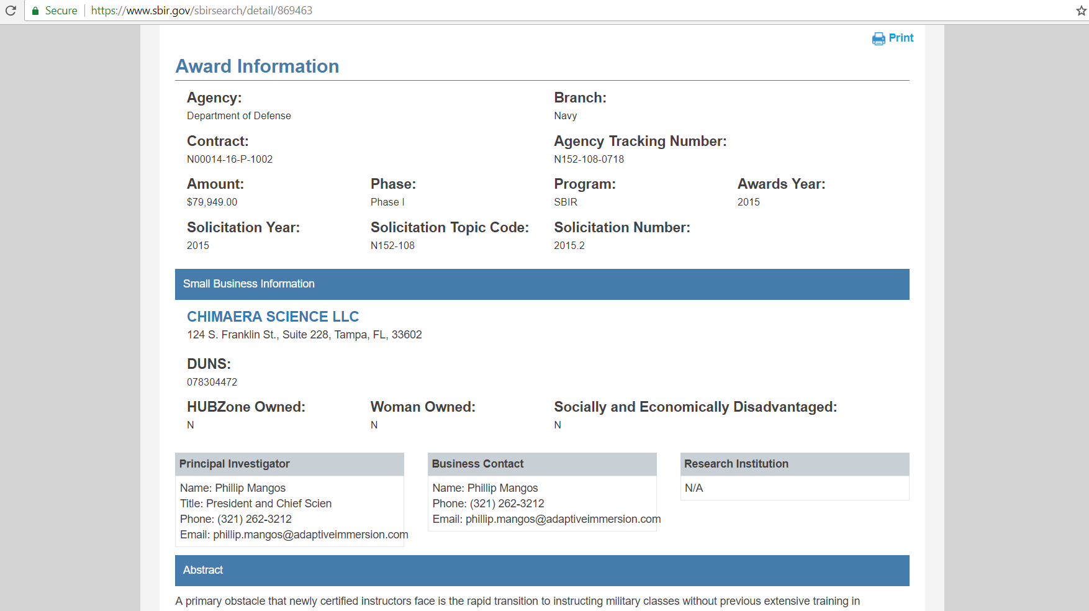

Slide 16
Release & Close Dates
Dept. of Agriculture – Release in June, Close in October
Dept. of Commerce:
  NIST – Release in January, Close in March
  NOAA – Release in October, Close in January
Dept. of Defense – Release: April/July/Dec., Close: June/Sept./March
Dept. of Education – Release in December, Close in January
Dept. of Energy – Release: July/Oct., Close: in Oct./February
HHS (NIH) – Release in June, Close in Sept./January/April (grants)
Dept. of Homeland Security – Release in December, Close in January
Dept. of Transportation – Release in October, Close in December
EPA – Release in August, Close in October
NASA – Release in Mid-November, Close in Mid-January
NSF – Release in March/Oct., Close in June/December

Slide 17
Proposals
Know the Evaluation Criterion
  Innovation – Different than the state-of-the-art that is already out there
  Experience, Qualifications, & Facilities – Team
  Commercialization – Potential and merit
Develop a Schedule
  Start now…on the release date of the solicitation
  Allow for 10 weeks of preparation
  Formulate questions for TA (if allowed)
  Determine the structure: number of sections, page limit, font size, etc.

Slide 18
Sample 10-Week Schedule
Week 1 – Review topics and narrow down to one or two that fit well
Week 2 – Reach out to Topic Authors to gain insight and line up the team and internal reviewers of draft proposal(s)
Week 3 – Register in all databases; D&B, SAM, SBA Company Registration, agency-specific ones and conduct literature reviews
Week 4 – Add subcontractors, consultants, employees, partners
Week 5 – Create the financials; ask PTAP, SBDC, SCORE for assistance
Week 6-8 – Flesh out the remaining sections of the proposal
Week 9 – Provide a draft to colleagues, mentors, partners
Week 10 – Do not miss the deadline: submit the proposal two days prior

Slide 19
Proposal Preparation
40% of Phase I proposals are successful
It takes between 40-60 hours to prepare a comprehensive proposal
Include a commercialization plan
Decision Timeline:
  1 month for the agency to review the proposal
  3 months for the scientific reviews (SMEs)
  3 months until the award is announced
Know your Technology Readiness Level (TRL 1-9)

Slide 20
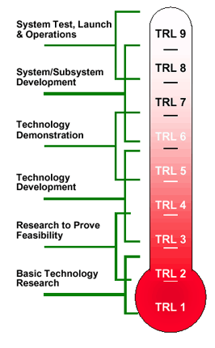

Slide 21
Grants vs. Contracts
Grants are flexible, so the PI has considerable latitude to deviate
  Applicants define the scope of work
  No legally-binding requirements to achieve results
  Payments are flexible; typically using a drawdown system
Contracts are demanding, so the PI has limited latitude to deviate
  Scope of work is defined and inflexible
  Binding agreement to deliver for compensation
  Payments are based on milestones and deliverables
  All classified work is done using Contracts

Slide 22
Finding Opportunities
Grants.gov – for Grants only, not Contracts
SBIR.gov and Zynsys.com are good for finding all solicitations
Four step review of opportunities:
  Make an honest assessment of the fit
  Review any literature cited or references used
  Establish a dialog with the Topic Author* to further explore fit
  Consider whether other aspects of the proposal appeals to the agency
  * Also known as Topic Managers, Technical POCs, or Contracting Officer’s Representative (COR)

Slide 23
Finding Small Business Partners
Conferences and events:
  Careful selection of events is critical
  Review previous and/or current attendee lists
  Add all contact info from business cards into tracking system
  Send LinkedIn invitations to interesting contacts
  Send a brief email to continue the interaction
Innovation Park is launching new programs:
  Ask for assistance in finding small business partners (Park network)
  Creating a database for matching-making small businesses with universities
  Hosting “speed dating” luncheons once a quarter

Slide 24
Conflict of Interest & Commitment
A conflict of interest on the part of the faculty may arise when the faculty member is the co-founder, owner, or officer of the small business applying for funding, and will also do research under a subcontract between the small business and FSU
Conflicts of commitment exist when individuals have difficulty balancing the effort necessary to perform their job duties while engaging in other activities that may or may not be job-related
This type of conflict can also occur when an individual's research or work output is affected due to a competing influence
Follow agency and institutional policies to manage, reduce, or eliminate such conflicts

Slide 25

Thank you!
Michael Tentnowski Director of Entrepreneurship
For a copy of the slides emailed to you:
mtentnowski@inn-park.com

Slide 26
ITAR & DCAA
International Traffic in Arms Regulations
  U.S. regulatory regime to restrict and control the export of defense and military related technologies to safeguard U.S. national security
  Information and material pertaining to defense and military related technologies may only be shared with U.S. persons unless authorization from the Department of State is received or a special exemption is issued
  Does not apply to information related to general scientific, mathematical or engineering principles that are commonly taught in schools and colleges or information that is in the public domain
Defense Contract Audit Agency
  Accounting systems are audited by DCAA
  Provides standardized contract audit services for the Dept. of Defense
  Accounting and financial advisory services regarding contracts and subcontracts

