Slide 1
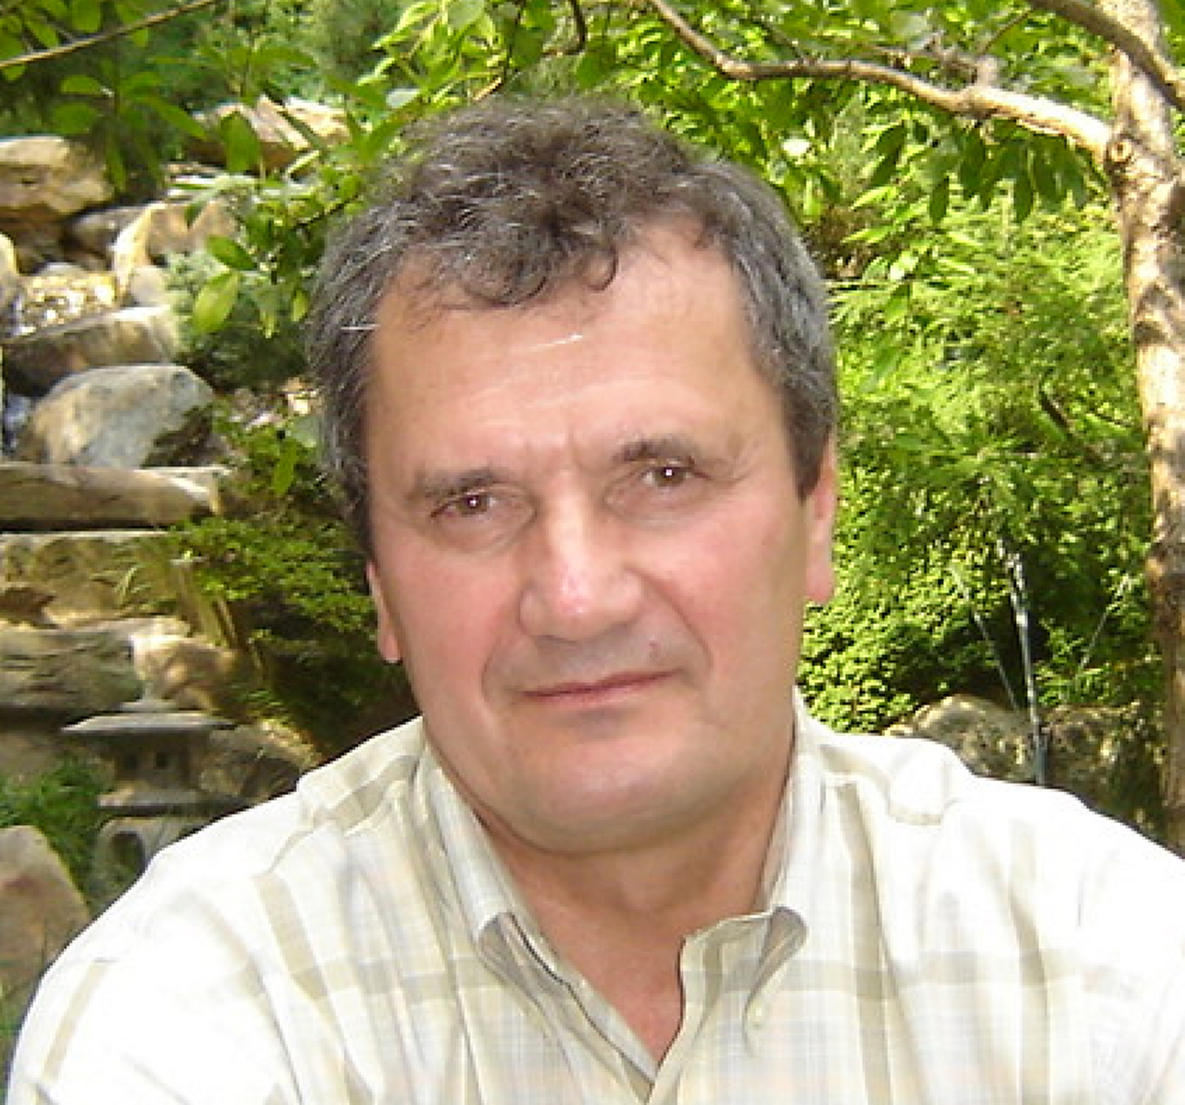
Victor Schepkin
National High Magnetic Field Laboratory
schepkin@magnet.fsu.edu
MR imaging of apoptosis. Development of non-invasive biomarkers for predicting and evaluating responses to cancer chemotherapy using sodium and proton diffusion MRI. Funded by NSF and the State of Florida.
Development of triple quantum MR methods for the non-invasive detection of in vivo ion homeostasis. Funded by NSF and the State of Florida.
Development of new biomedical MRI applications at ultra high magnetic fields.
By formal education, I am a physicist, but for a long time have worked in the field of NMR and MRI applications, particularly focused on biomedical problems and solutions.
The 21.1 T magnet is a unique part of ultra-high magnetic field MRI scanner located at the NHMFL/FSU. The magnet provides a capability to acquire in vivo MR images of sodium and other low-gamma nuclei, which otherwise difficult to obtain at low fields.

