Slide 1
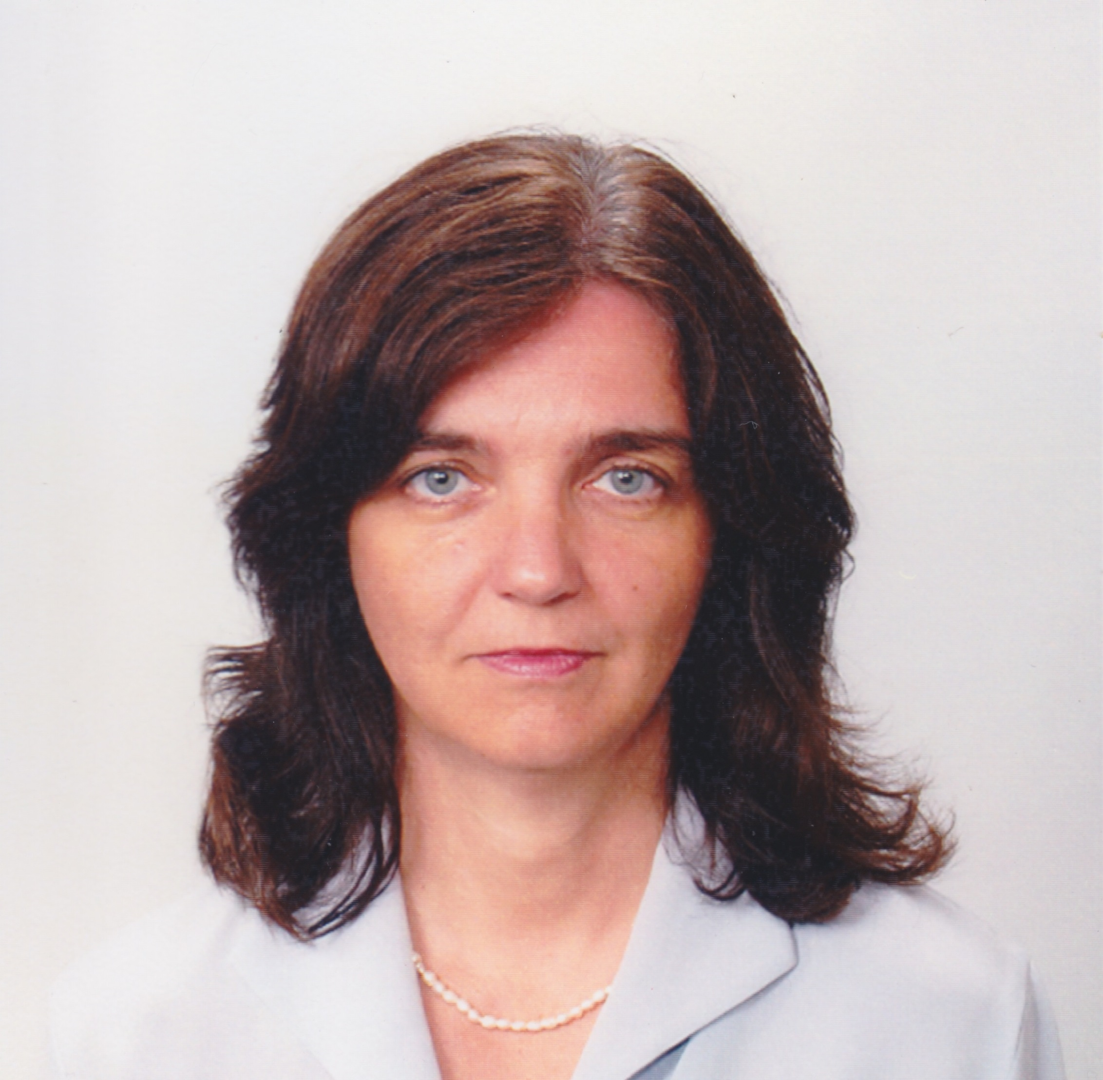
Svetla Slaveva-Griffin
Classics
sslavevagriffin@fsu.edu
Relation between medicine and philosophy in Late Antiquity (3rd–6th CE), funded by Alexander von Humboldt Fellowship (2013–2014)
The development of “the art of medicine” as a scientific discipline
The construction of the scientific method of medicine in Antiquity
Ancient and modern perspectives on “body,” “health,” and “disease”
Theories of embryology in Antiquity
History of science and medicine
My expertise in ancient science and medicine allows me to provide historical background and conceptual assessment to major topics such as “health,” “bodily constitution,” “disease,” “psychology,” “wellbeing,” Hippocratic and Galenic medicine, development of medicine in Byzantium and Late Antiquity, medical encyclopaedia, the status of the physician in Antiquity; the general social cons and pros of medicine.

