Slide 1
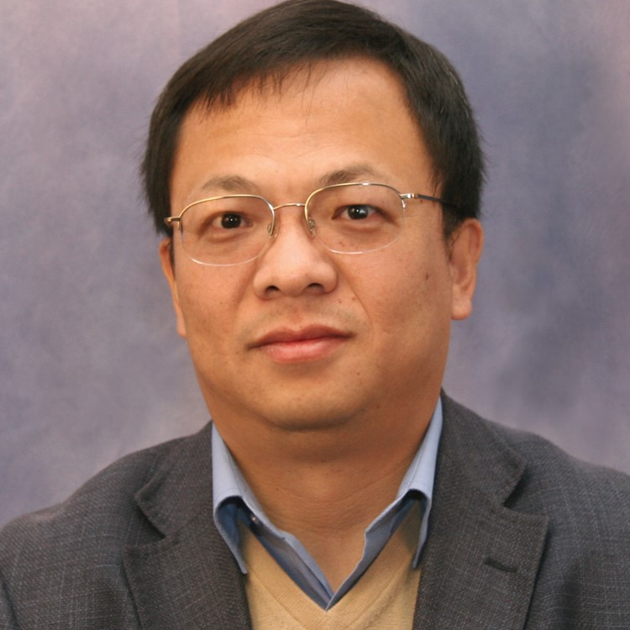
Richard Liang
High-Performance
Materials Institute
Dept. of Ind. and
Mfg. Engineering
zliang@fsu.edu
Manufacturing and Interface of Advanced Composites;
CNT Thin Film (Buckypaper) and Multifunctional Nanocomposites;
Scale-up Manufacturing of Nanomaterials and Nanocomposites;
3D Printed Sensors and Manufacturing
Funded by AFOSR, ONR, NSF, Florida State and Industries
Novel printed and affordable sensors for medical applications;
Bio-inspired high-performance materials
3D Printing and Advanced Manufacturing of custom-made medical devices using lightweight and multifunctional composites
Composite technology and manufacturing;
Printed and custom-made sensors;
3D printing and advanced manufacturing for medical devices;
Materials and microstructures characterization
Co-advising students in bio-inspired materials and structure research

