Slide 1
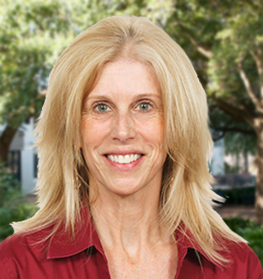
Pamela Perrewe
Management
pperrewe@fsu.edu
My research interests are focused on the psychological, behavioral, and physiological strain effects of organizational stressors.
I am particularly interested in the neutralizing or buffering effects of personal resources such as political skill, self-regulation, resiliency.
The role of occupational stress on employee well being.
As an organizational scientist, I have experience in both theoretical and applied research. I am the founding editor of the annual series, “Research in Occupational Stress and Well Being” which has given me the opportunity to work with stress researchers around the globe. My experiences have provided me with the ability to understand the important research questions that still need to be addressed.

