Slide 1
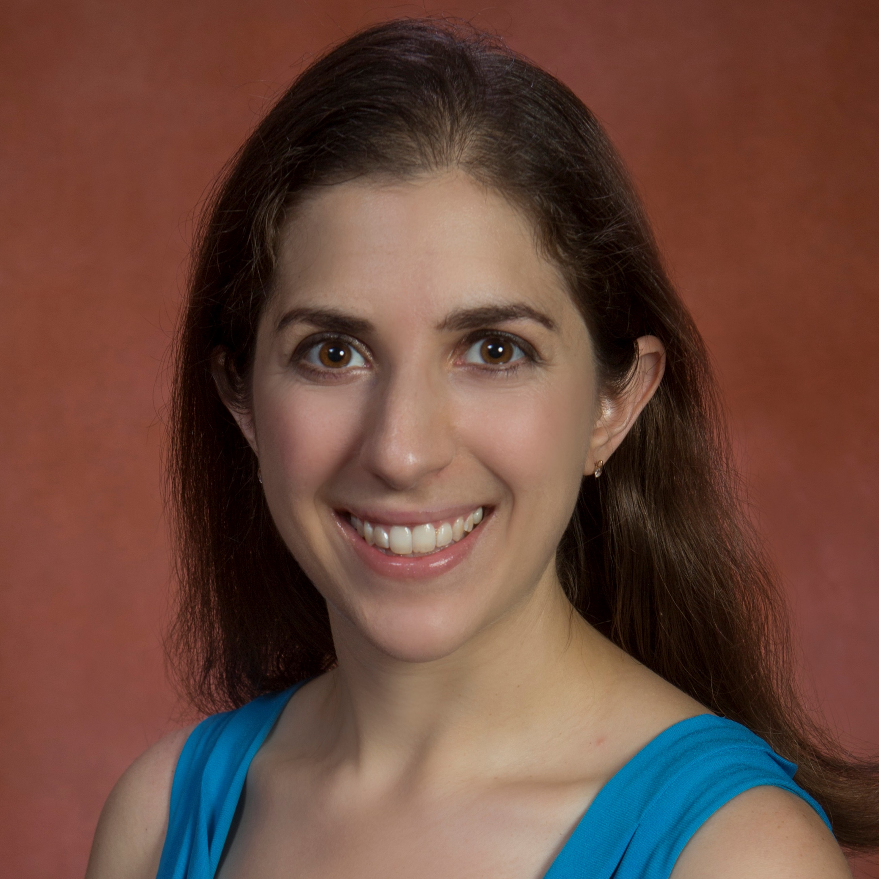
Naomi Brownstein
Behavioral Sciences and Social Medicine
naomi.brownstein@med.fsu.edu
Comparative effectiveness methods for perinatal mental health; grant proposal in development
E-cigarettes: physician knowledge and patient assessment; grant proposal in development
Quantifying uncertainty in proteomics; funded by NSF/state of FL
Medicaid therapy management (Meds-AD) and long-term care programs; funded by Florida AHCA
Applying statistics in public health, medicine, and science
As a biostatistician, I can collaborate on proposals for projects requiring statistical planning, analysis, and interpretation. I currently work on a variety of problems relating to development and application of statistical methods. My current application areas include pain, substance abuse, health disparities, genomics, and proteomics. I can help others with experimental design, power analyses, advice on appropriate statistical methodology, data analysis and interpretation.

