Slide 1
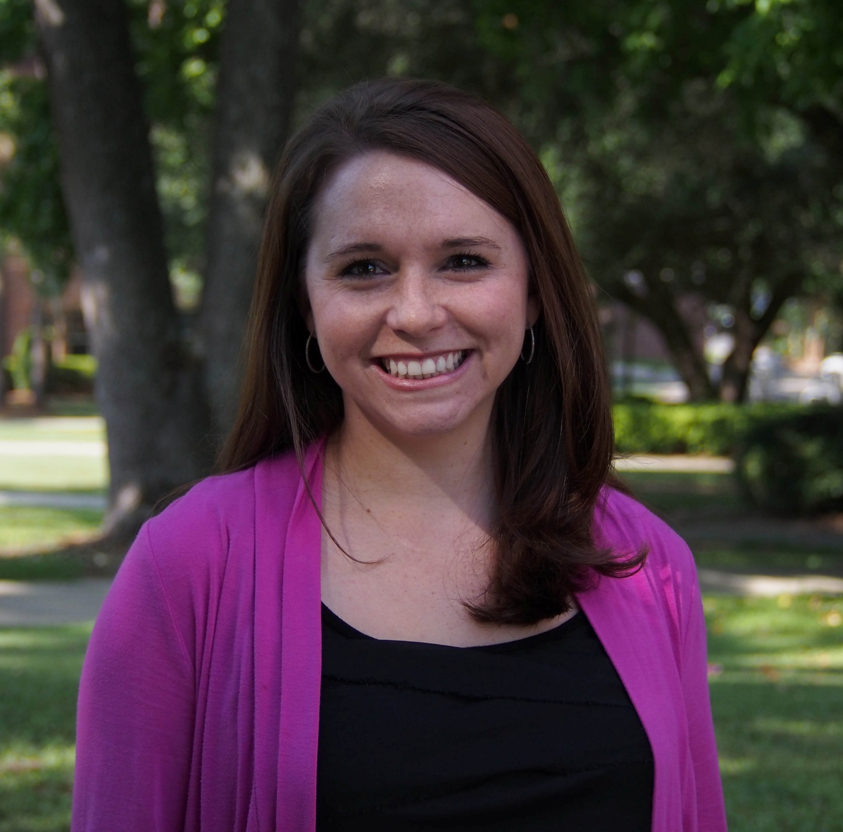
Mallory Lucier-Greer
Family and Child Sciences
mluciergreer@fsu.edu
Identifying family and community-level protective factors that promote resilience among military families
Military enlistment and longitudinal implications for reducing young adult economic and health inequalities
Examining the role of social relationships in promoting mental health and well-being among emerging adults
Identifying processes that promote resilience among vulnerable populations
As a marriage and family therapist, I have clinical training and an applied orientation to apply and translate research findings to be used by practitioners and families. I also have a strong background in research methodology and statistics. I am able to contribute in areas of proposal development, research design, work with at-risk human subjects, and dissemination.

