Slide 1
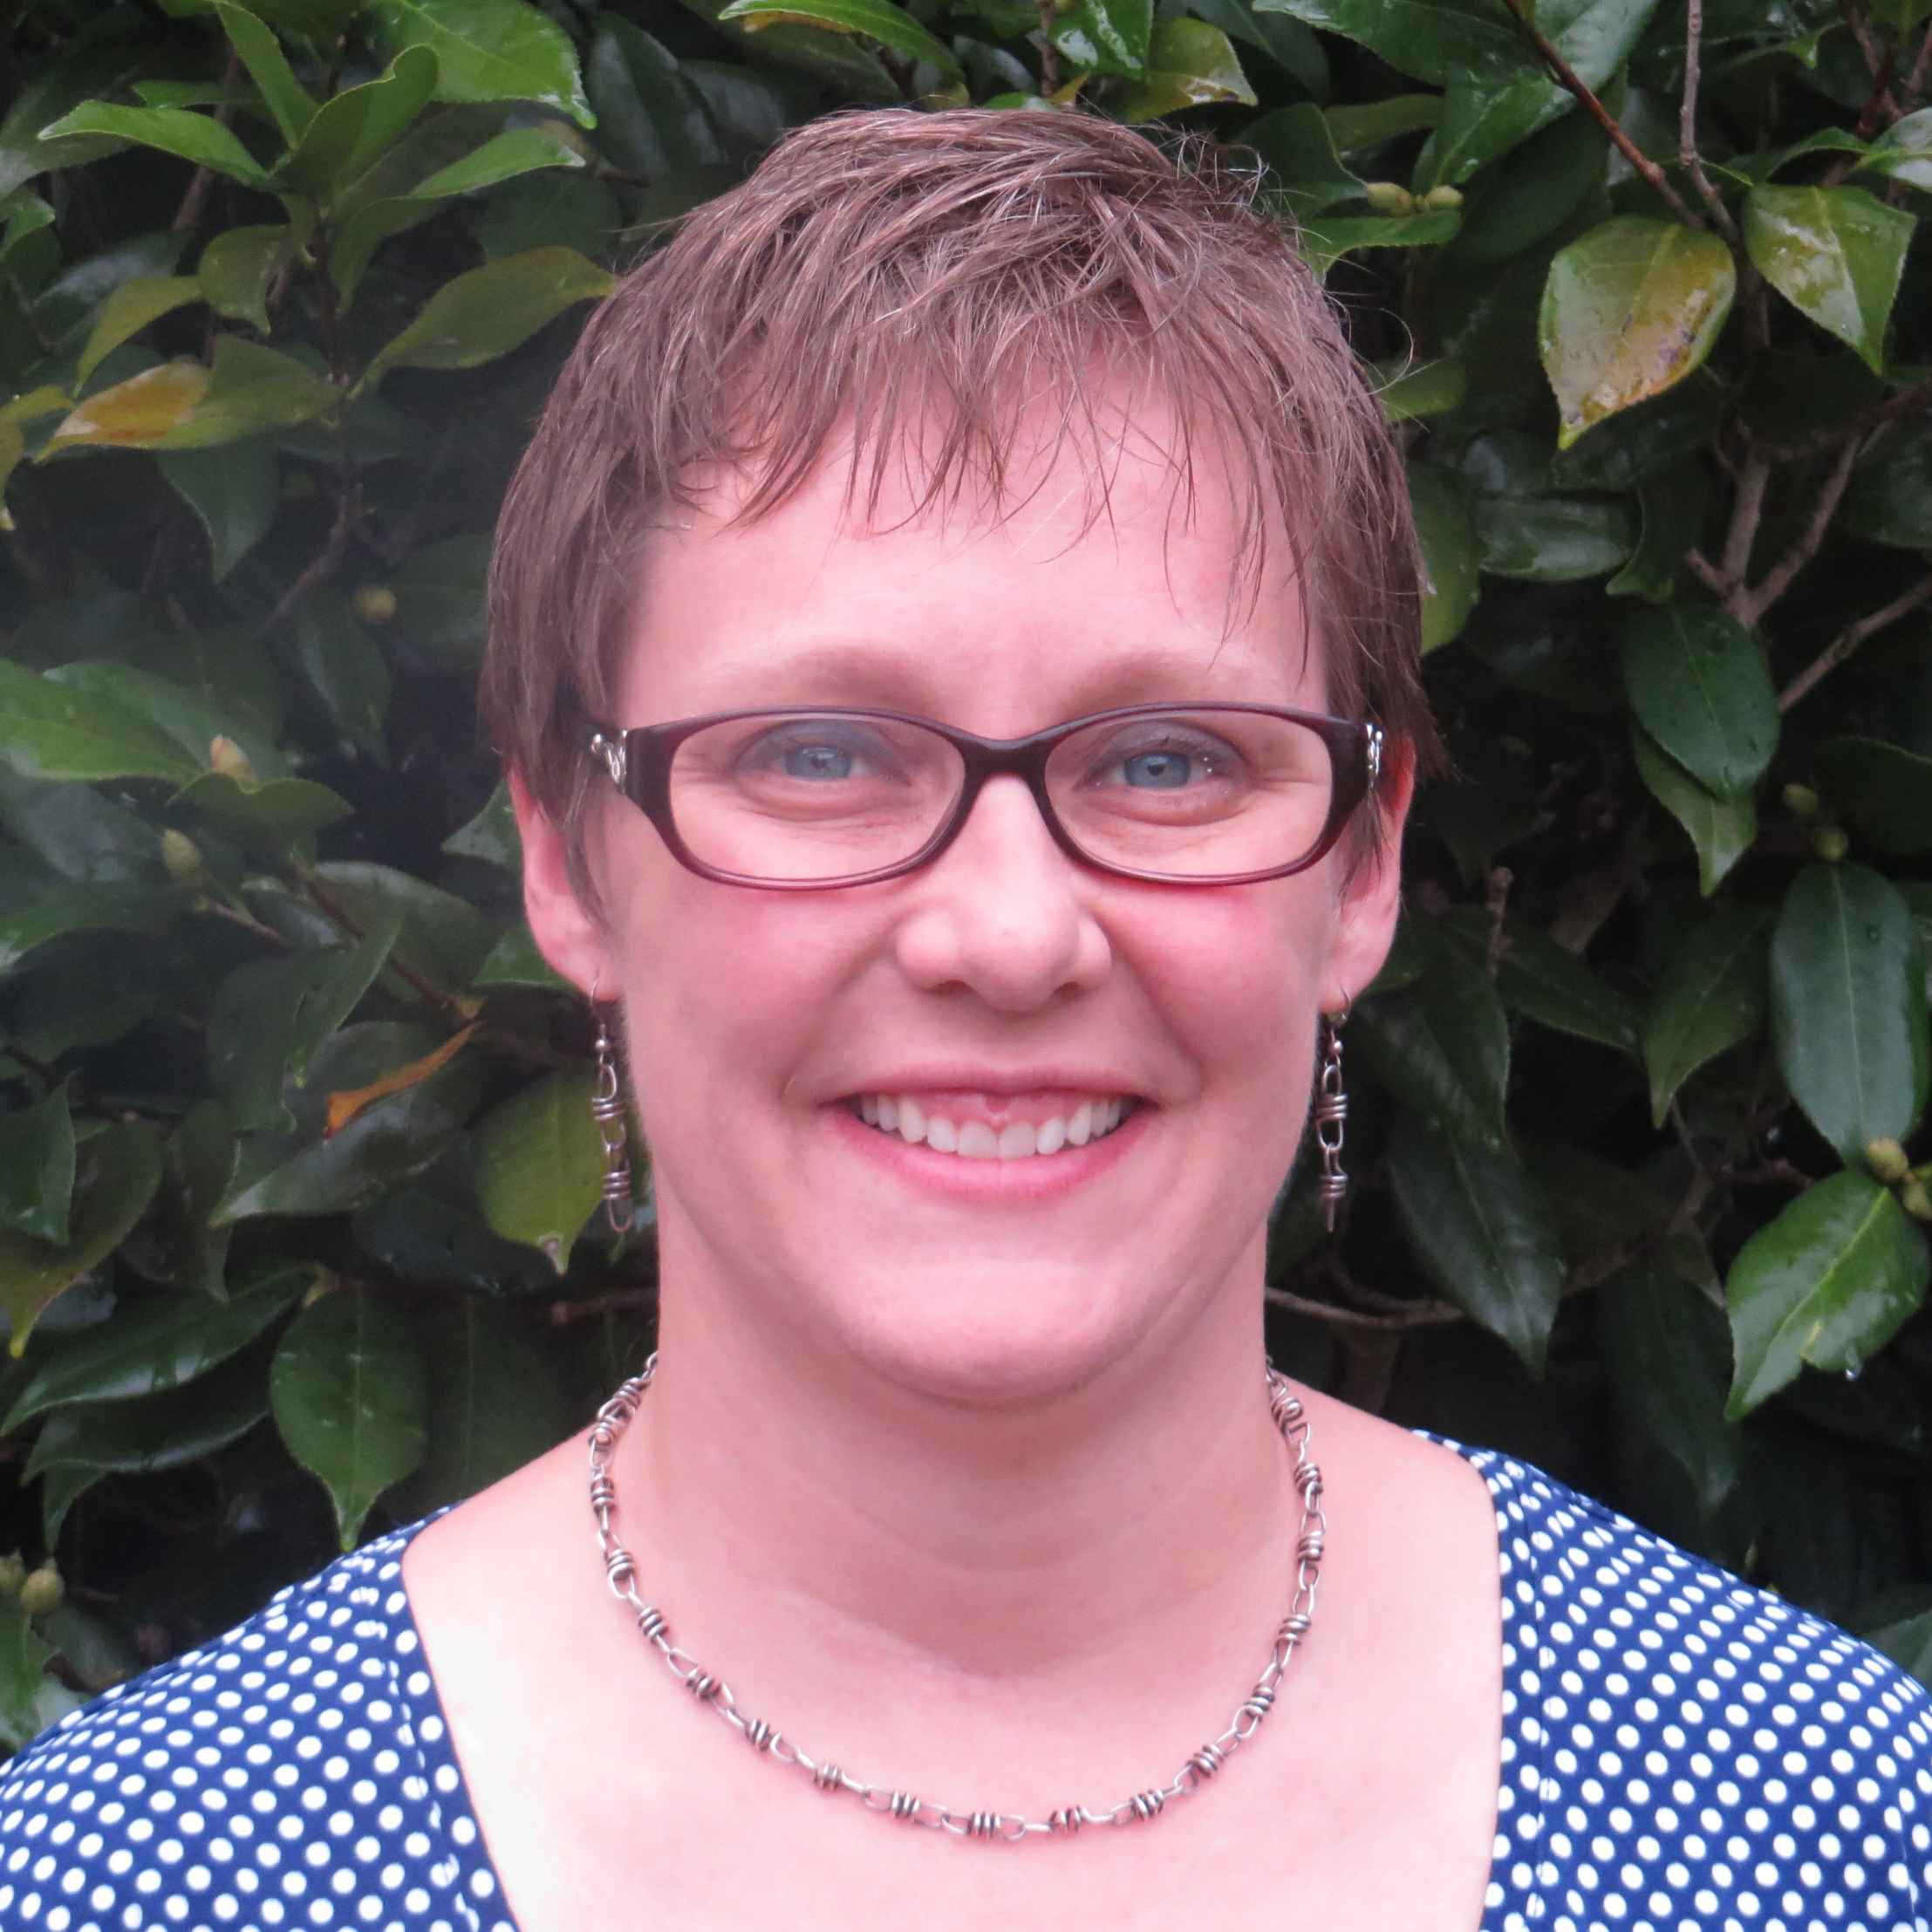
Lisa Schelbe
College of Social Work
lschelbe@fsu.edu
Evidence-Based Parenting Intervention for Youth Aging Out of the Child Welfare System. Funded by Florida Institute for Child Welfare
Evaluation of MEDS-AD and Medicaid Fraud Control Strategies. Qualitative Analysis of the MEDS-AD Waiver (MTM) Program Evaluation. (PI: Dr. Leslie Beitsch) Funded through Agency for Health Care Administration
Child welfare.
I can collaborate on research projects with a child welfare population examining various outcomes. Additionally, I offer my expertise in qualitative methods and work as part of a mixed-methods research team.

