Slide 1
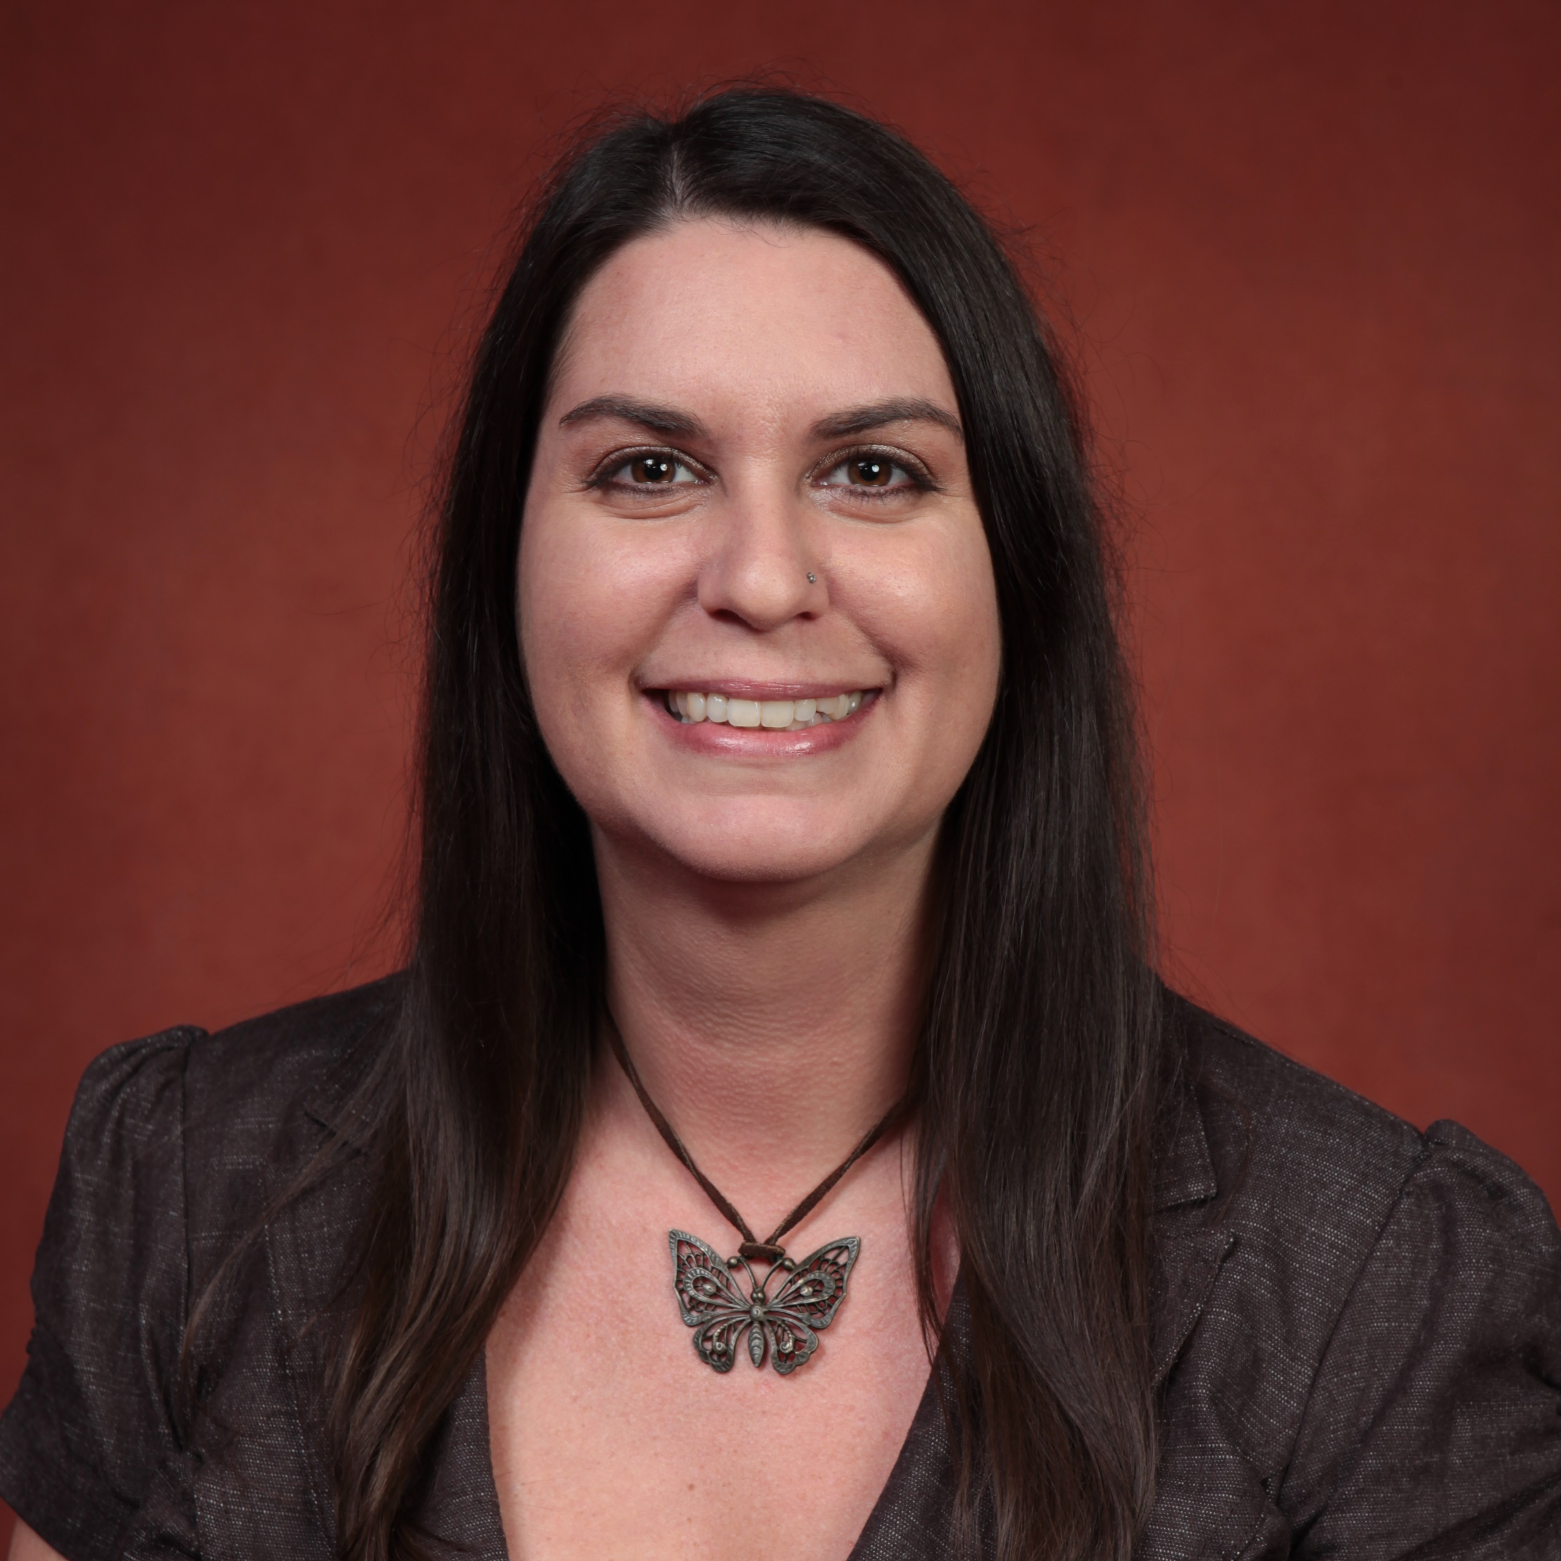
Lisa Rill
Claude Pepper Center
larill@fsu.edu
The Ideal Assisted Living: What It Should Be and Why?
  the revised ALF bill HB 1001
  affordability and availability of ALFs for lower-income individuals
  function-focused care in ALFs
  aging in place
Collaborative interdisciplinary research on Long-term care, Labor force crisis, Gerontechnology, Staff training/education, Quality of life, Social Policy, Quality standards in LTC, Aging in Place, Life Long Learning
My experience as a sociologist and social worker in nursing homes taught me that there are many different needs for the diverse aging population. My time as a researcher in the field of Gerontology has shown me that there is a dearth in the knowledge of the aging process across all disciplines. These encounters, both applied and academic, have given me a diverse and comprehensive perspective in my field of aging, which helped guide my research interests.

