Slide 1
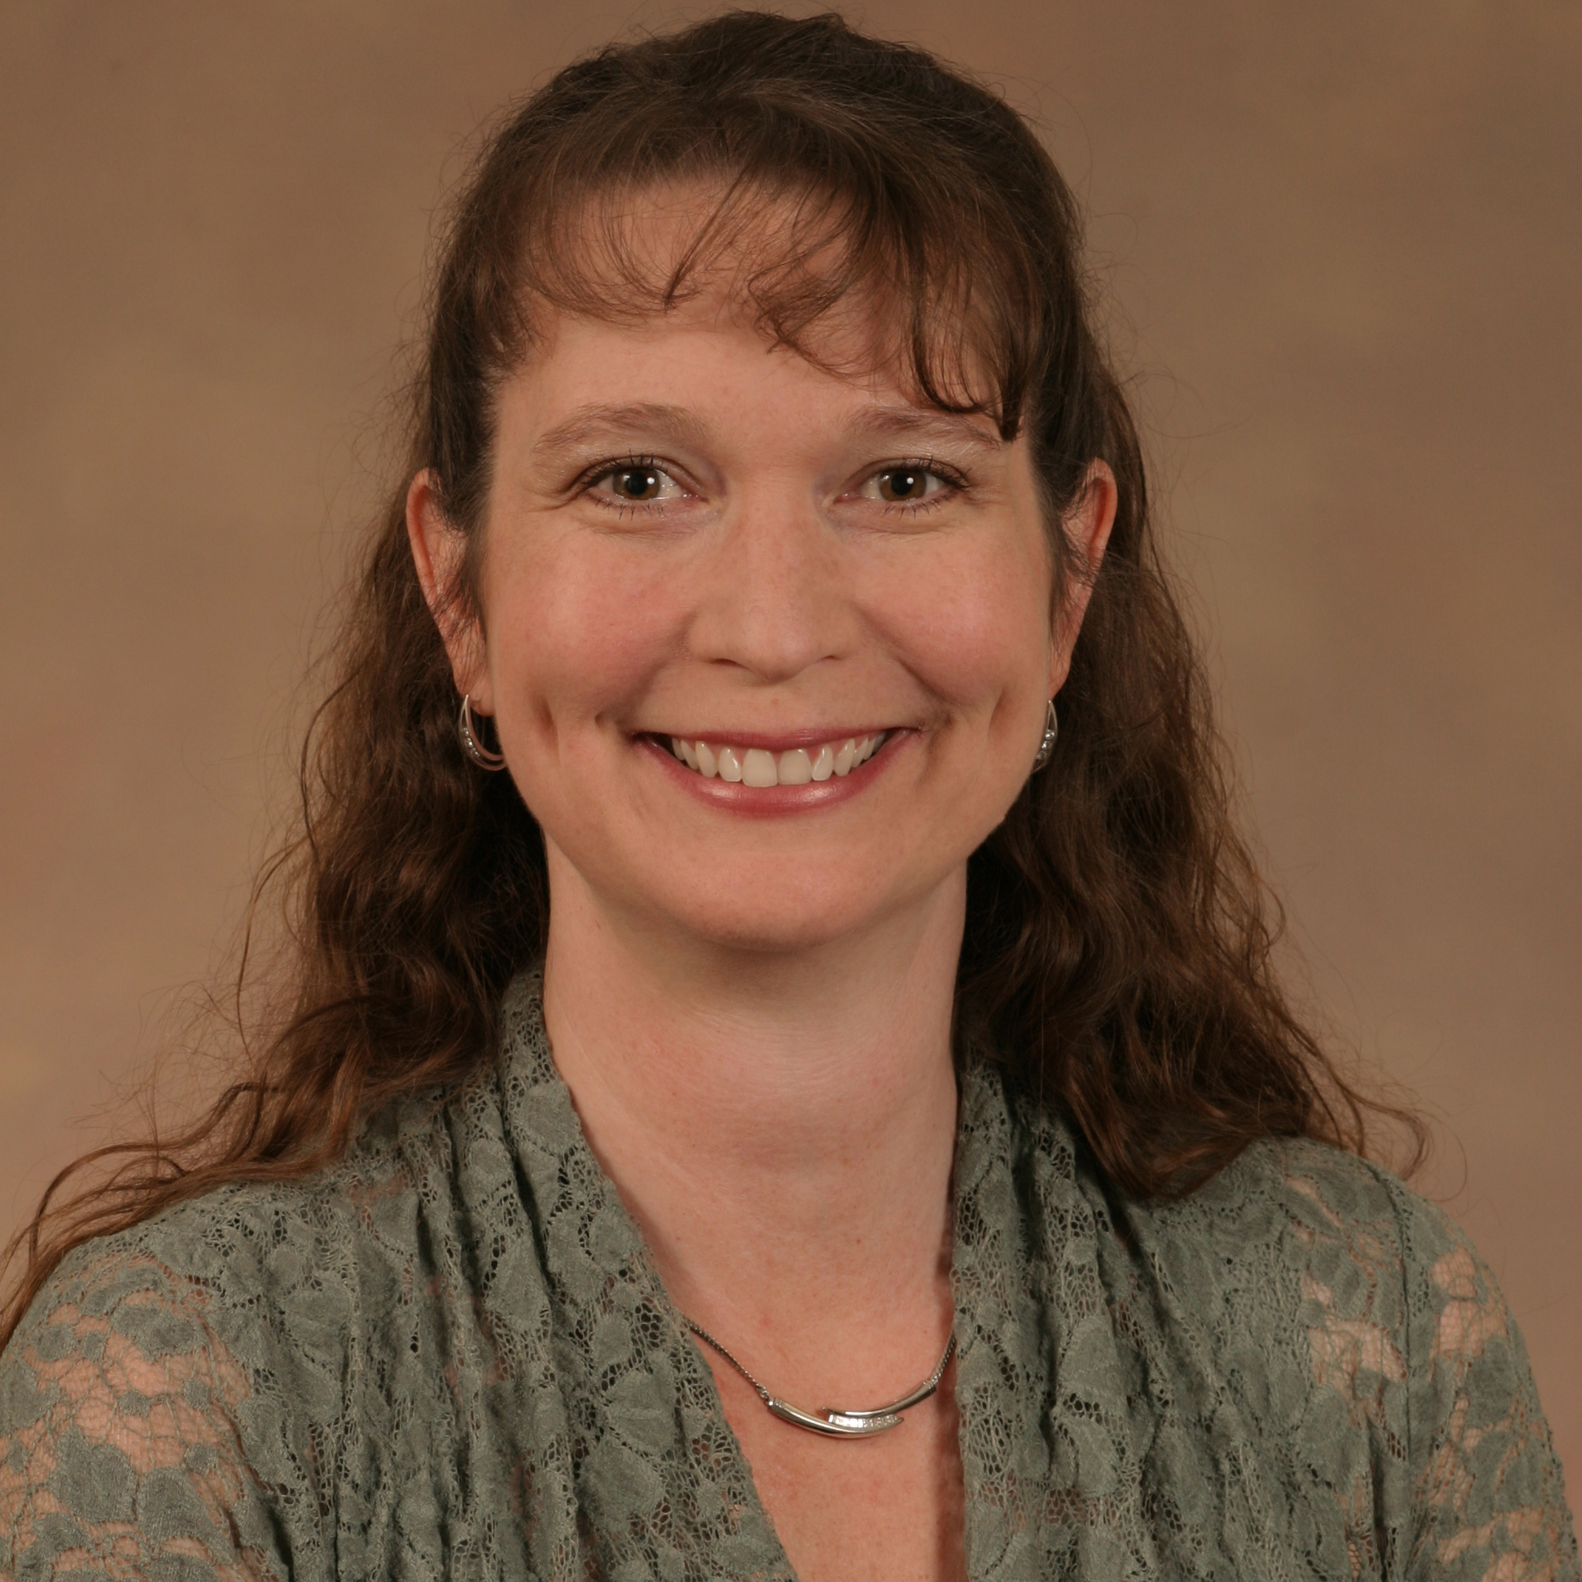
Lisa Lyons
Biological Science
lyons@bio.fsu.edu
Circadian regulation of alcohol induced tissue damage. Funded by NIAAA.
Sleep deprivation and memory formation. Funded by NINDS.
Mechanisms underlying long-term memory formation
Circadian modulation of memory
The mechanisms through which the circadian clock modulates synaptic plasticity in neurons, physiology and behavior.
My research utilizes in vivo behavioral approaches combined with cellular and molecular analysis. With our behavioral approaches, we have the ability to look at systems wide modulatory factors that affect health and physiology and then use molecular and genetic approaches to identify the underlying mechanisms. With twenty years of experience in chronobiology research, I can collaborate on proposals in which the circadian clock or sleep may be a factor.

