Slide 1
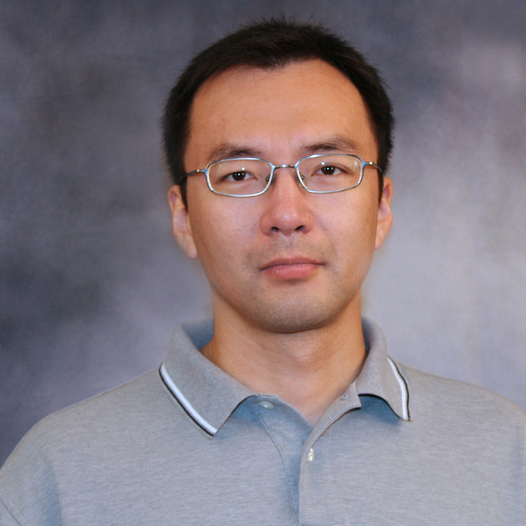
Jingjiao Guan
Chemical and Biomedical Engineering
guan@eng.fsu.edu
EAGER: Biomanufacturing: Development of a universal technique for functionalizing therapeutic cells with microdevices. Funded by NSF.
Integration of polyelectrolyte contact printing and aryldiazonium chemistry for nanopatterning. Funded by NSF.
Development of new tools for treating cancer, spinal cord injury, and brain diseases.
Design and fabrication of micrometer-sized structures for biomedical applications

