Slide 1
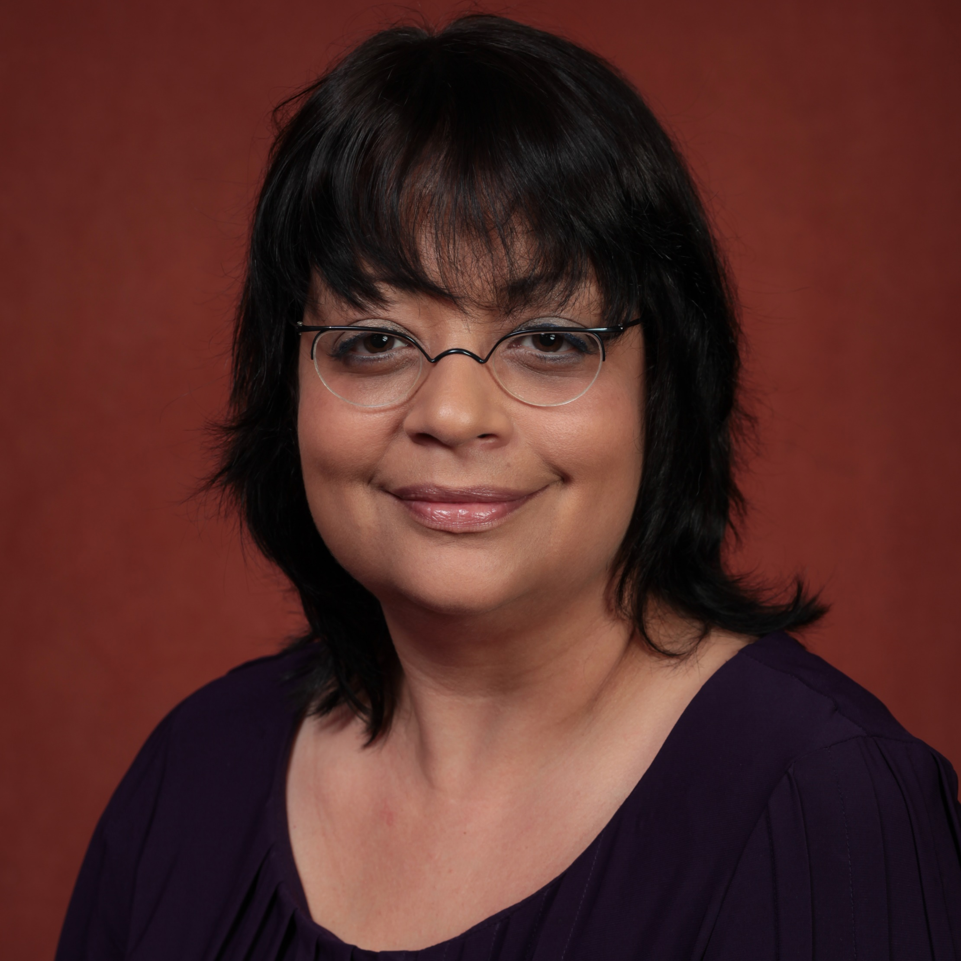
Jessica De Leon
Division of Research and the Department of Family Medicine and Rural Health
jessica.deleon@med.fsu.edu
African American Women’s Perception of Black Infant Mortality (J. Brown Speights, PI)
Pre and Post Assessment of Educational Videos on Sex Trafficking for Healthcare Professionals (S. Harrison, PI)
Optimizing Precision of Hypertension Care to Maximize Blood Pressure Control Pilot (R. Cooper-DeHoff, PI)
Community-based health research, minority health and health disparities, public health and cultural competence.
As a cultural and medical anthropologist, my research expertise includes using qualitative methods to explore health and medical issues, with a focus on community-based and public health research. I also possess knowledge and skills in grant writing, study design and implementation, and the administrative oversight and management of research projects.

