Slide 1
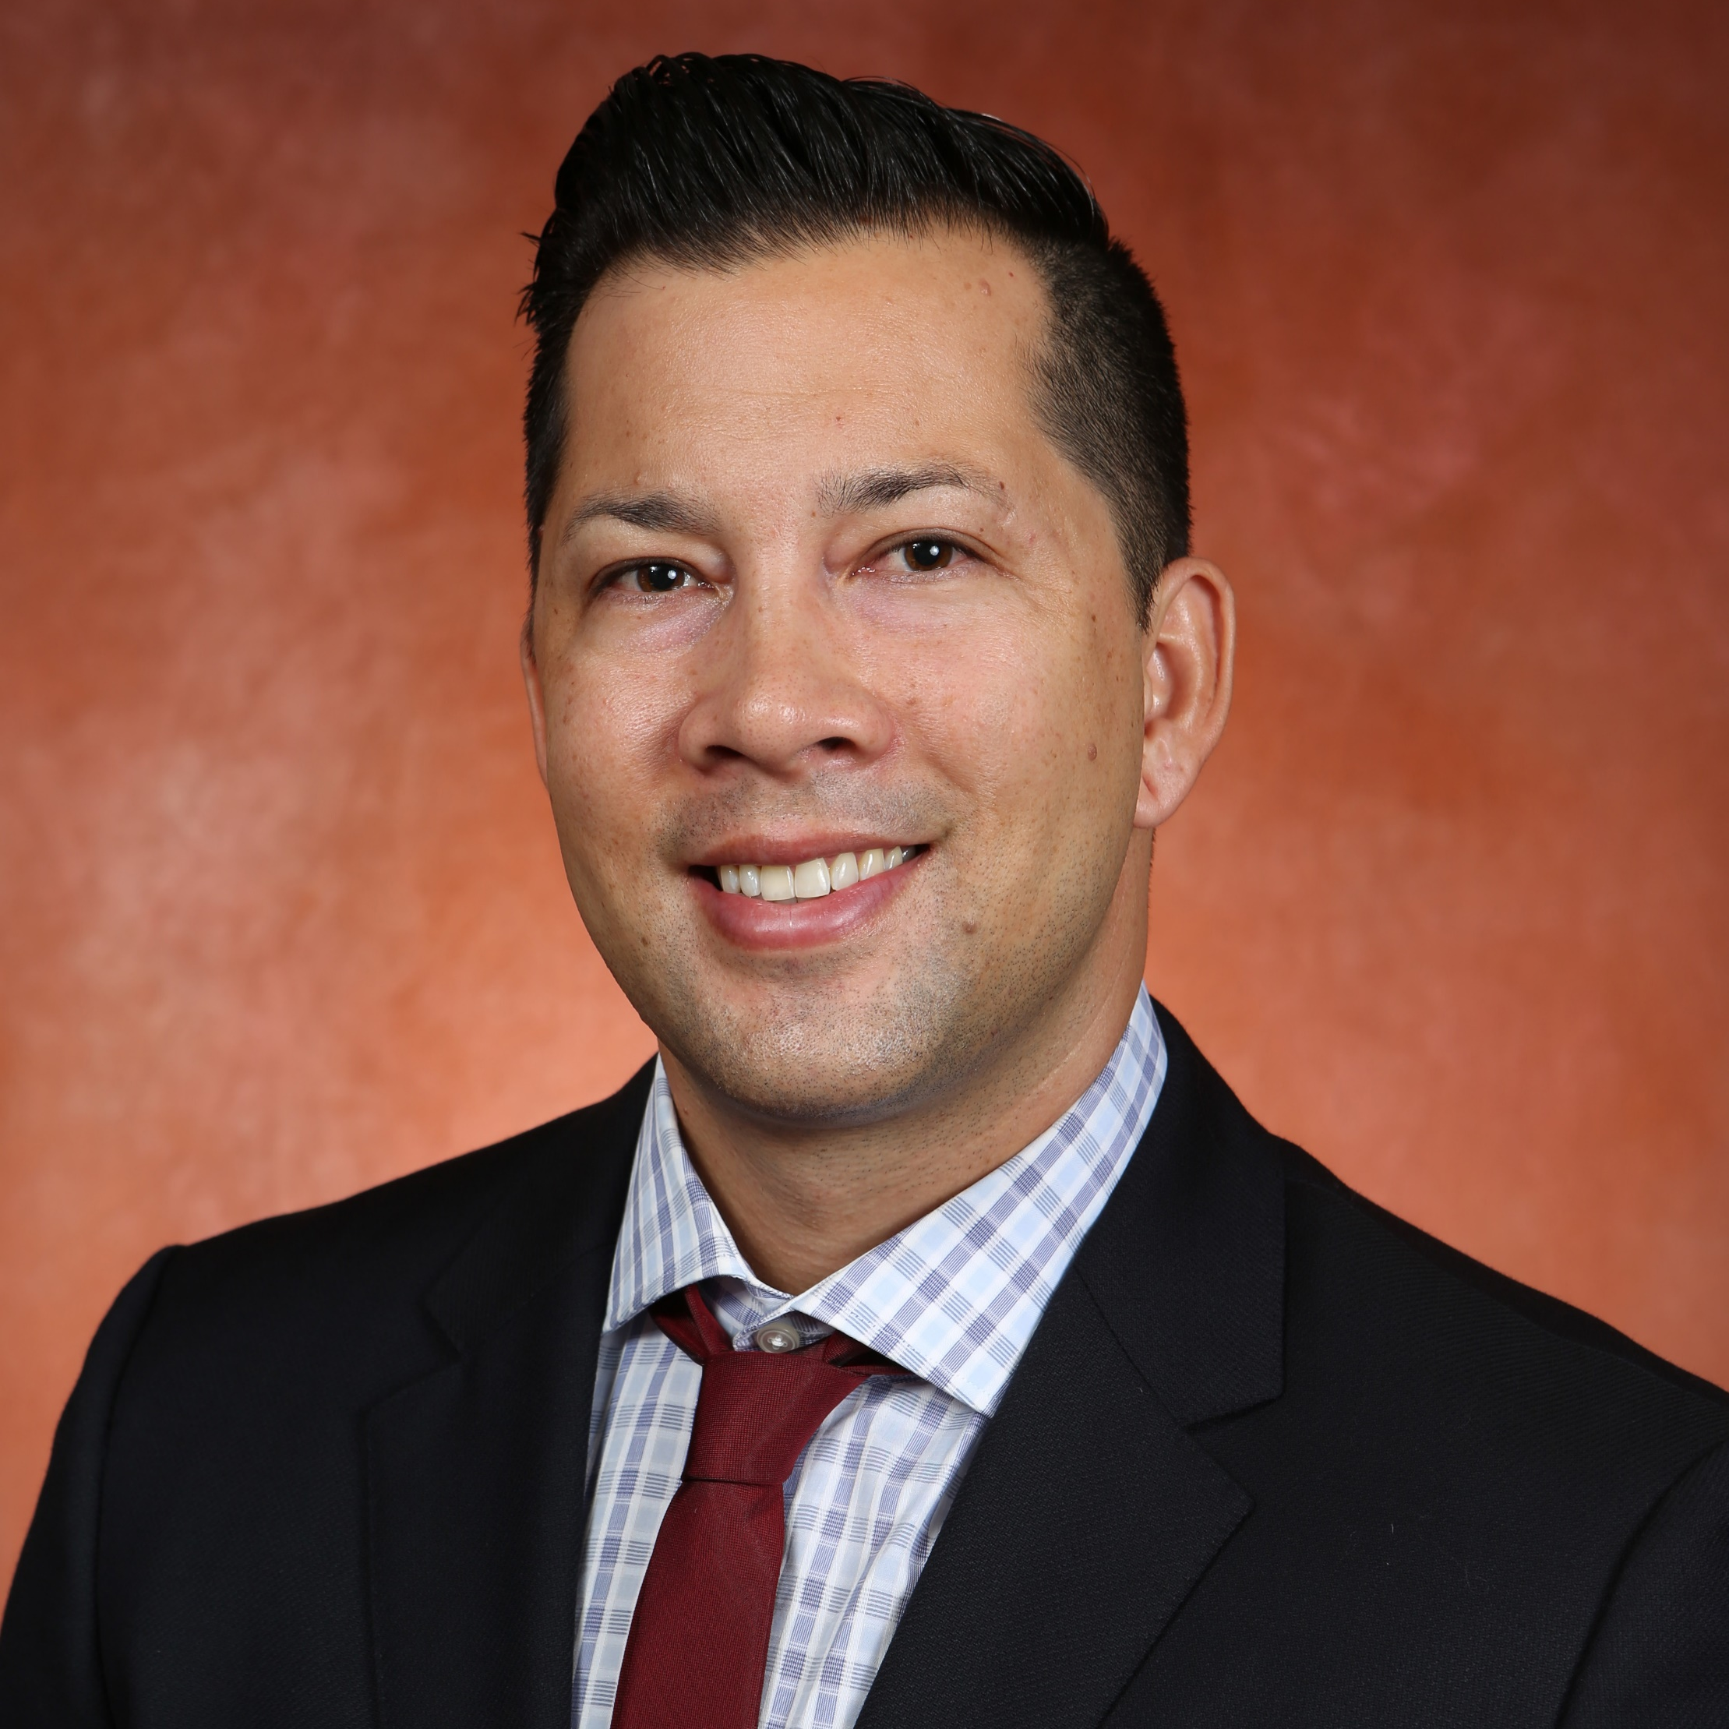
Graig Chow
Educational Psychology and Learning Systems
gchow@fsu.edu
Identifying Needs and Barriers to Promoting Sustainable Healthy Habits that are Culturally Relevant for Black Students. Funded by the COE.
The Role of Coaches in Preventing and Managing Alcohol Consumption of their Student-Athletes.
Student-Athletes’ and Student Non-Athletes’ Attitudes toward Seeking Online and Face-to-Face Counseling. Funded by the NCAA.
Mental health and well-being in athletes and coaches.
I have experience with developing, implementing, and evaluating interventions designed to address mental health, substance use, sexually transmitted infections, social relationships, performance, and psychological constructs. I am proficient in qualitative methods, scale development, and quantitative statistics such a multilevel modeling and structural equation modeling.

