Slide 1
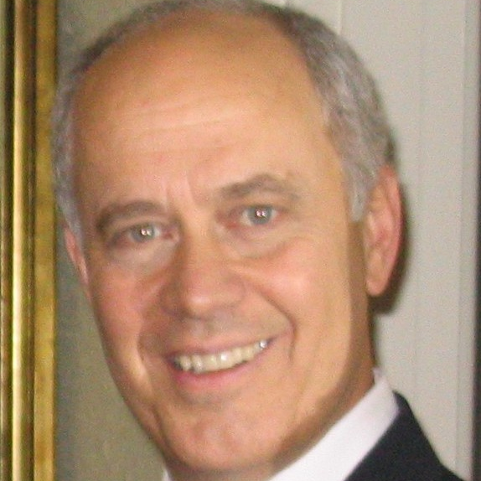
Elwood Carlson
Center for Demography
and Population Health
ecarlson@fsu.edu
Area #1 – Why has the gender balance of university students reversed from a male surplus a generation ago to a female surplus today? Research on family backgrounds of students and programs in schools to date has been inconclusive on this point.
Area #2 – Who has pioneered the trend toward later marriages, more informal unions and more childbearing outside marriage—people at the “high” or the “low” end of the social scale? The answer to this question likely varies from one country to another.
Analysis of demographic data (censuses, vital statistics, surveys)
to shed light on major changes in life course patterns
Experience with state, national and international databases from censuses, vital statistics, and surveys. Expertise in demographic analysis. Experience with research grants from National Institutes of Health.

