Slide 1
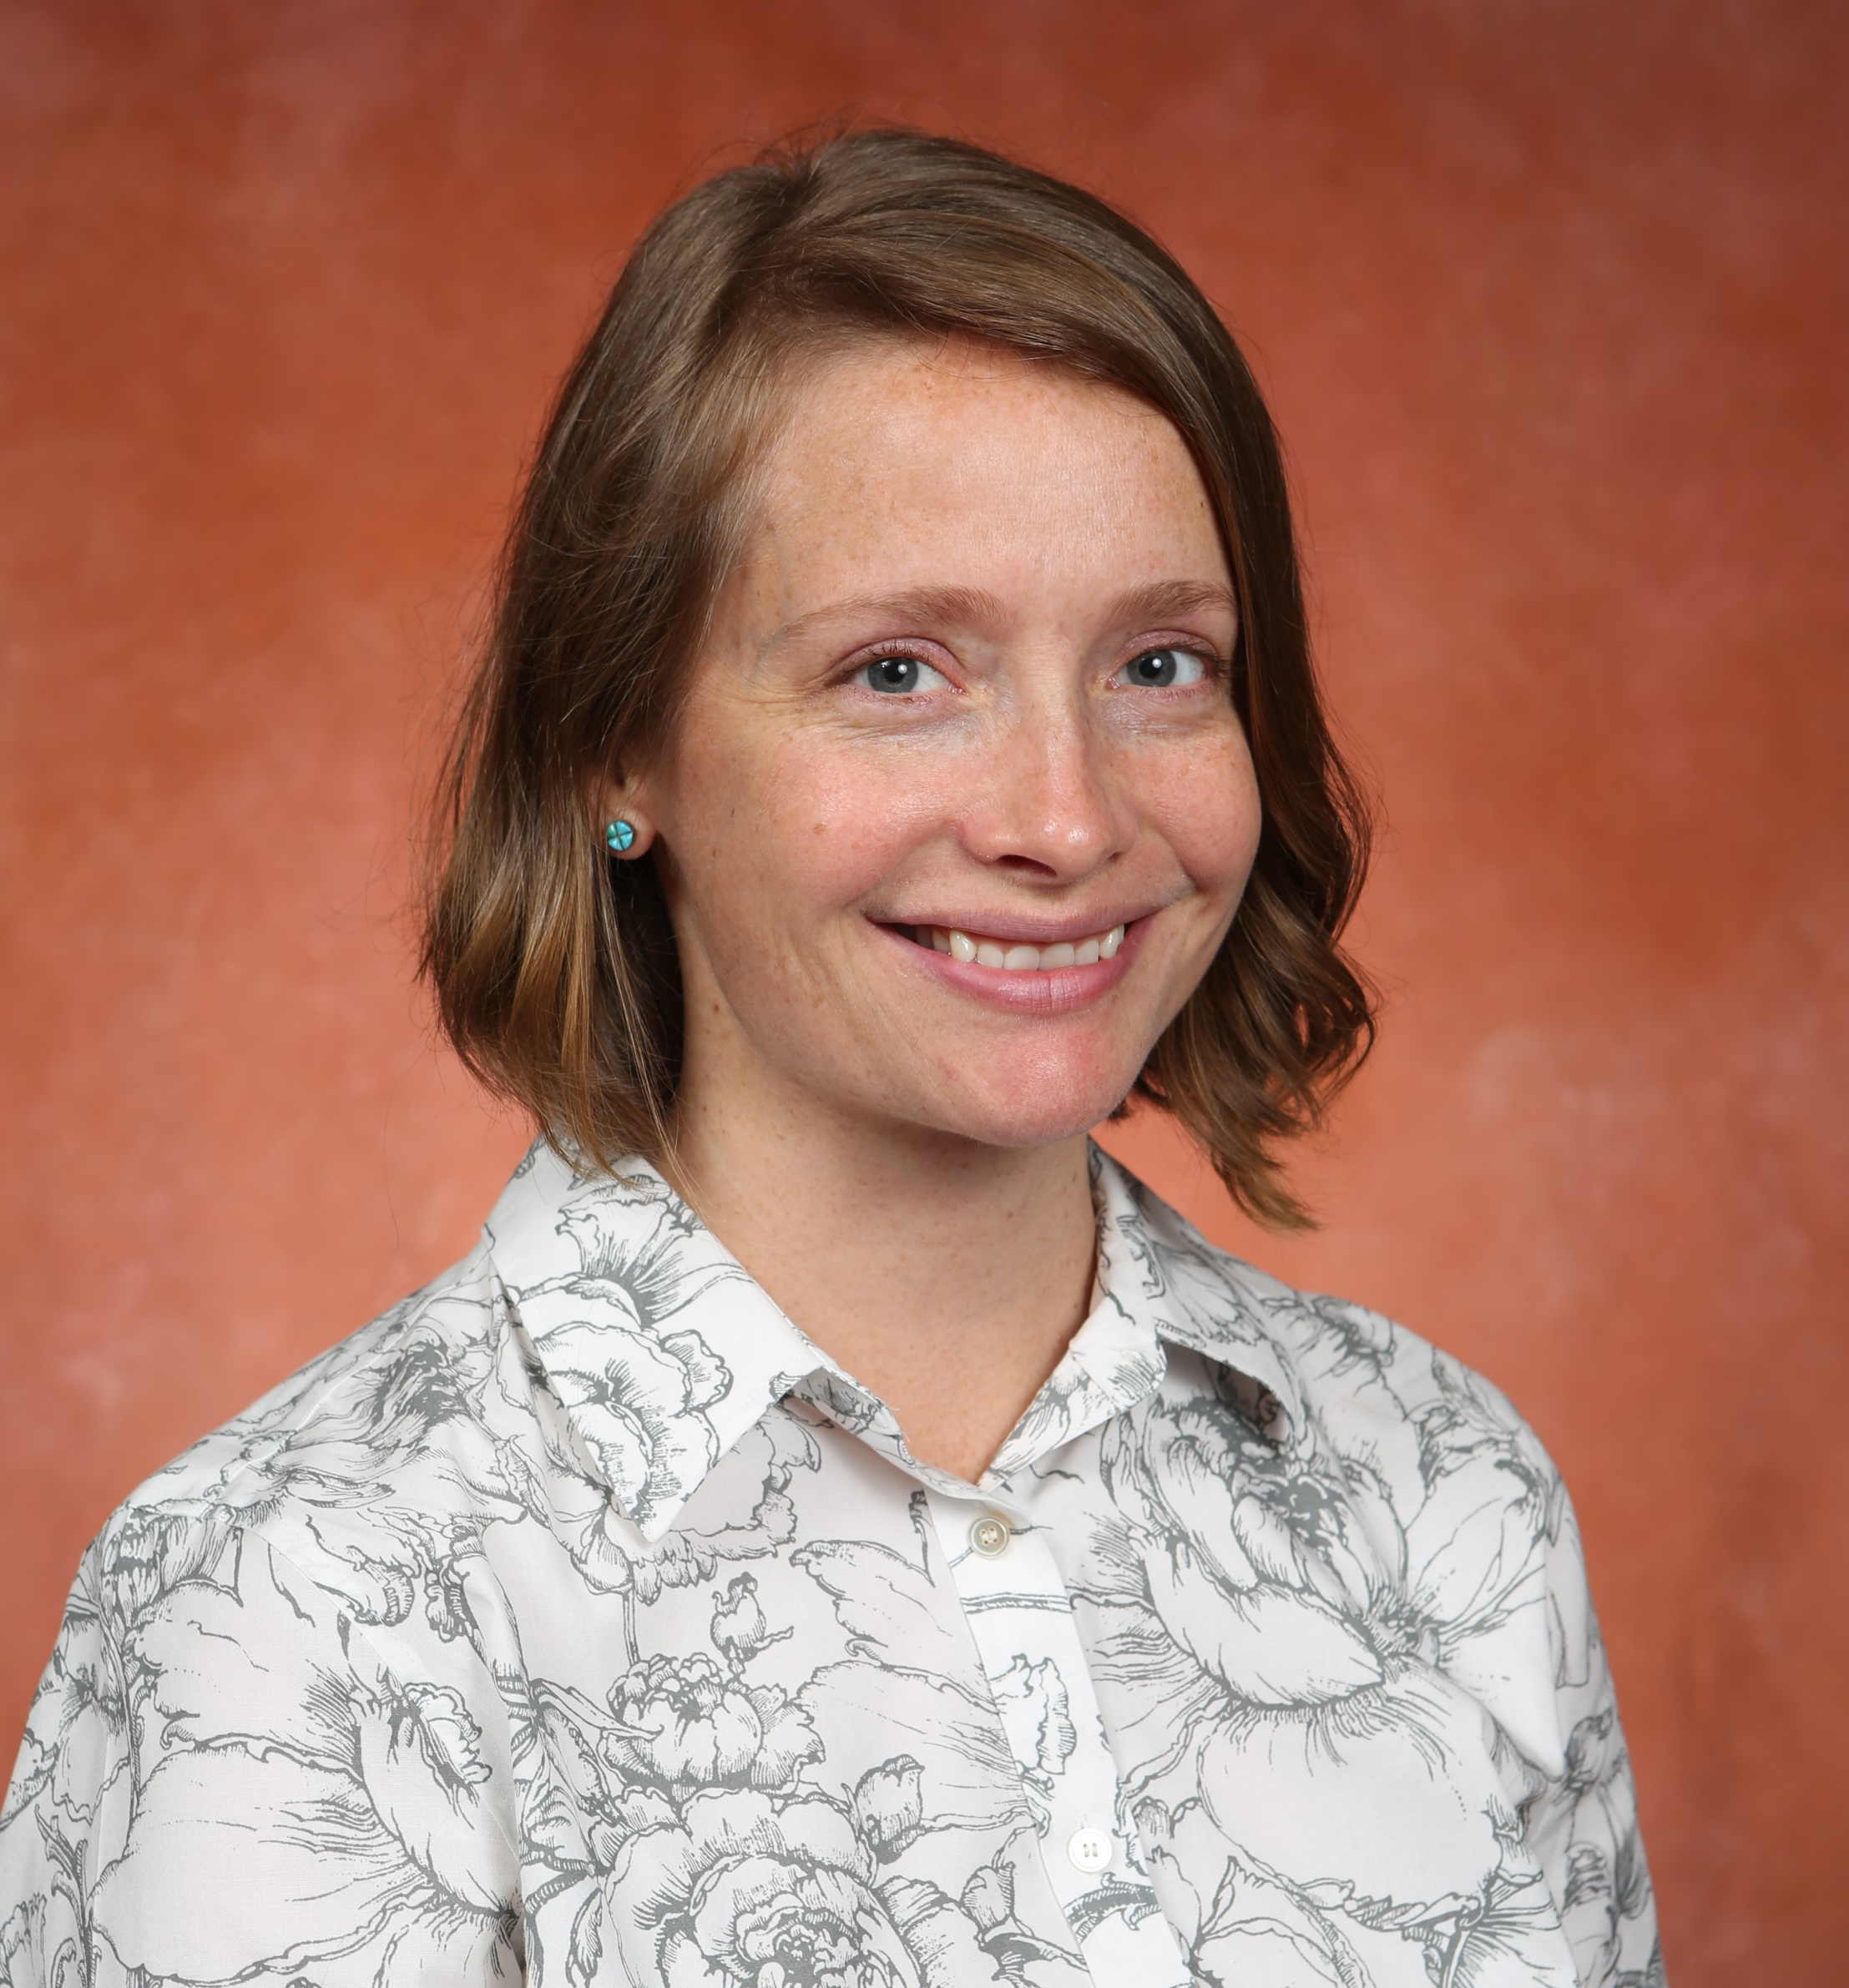
Elizabeth (Liz) Hammock
Psychology
ehammock@fsu.edu
Neural mechanisms of social support in infancy.
Intergenerational transmission of risk and resilience.
Biomarkers of adverse early life experiences.
3D printing applications in behavioral neuroscience.
Solving human problems with roots in social and emotional development.
e.g. Autism, Schizophrenia, Neglect
My research focuses on preclinical animal models to understand causal relationships and neural mechanisms of gene by environment interactions. I take a translational perspective.
Able to define problems and identify creative and practical solutions.

