Slide 1
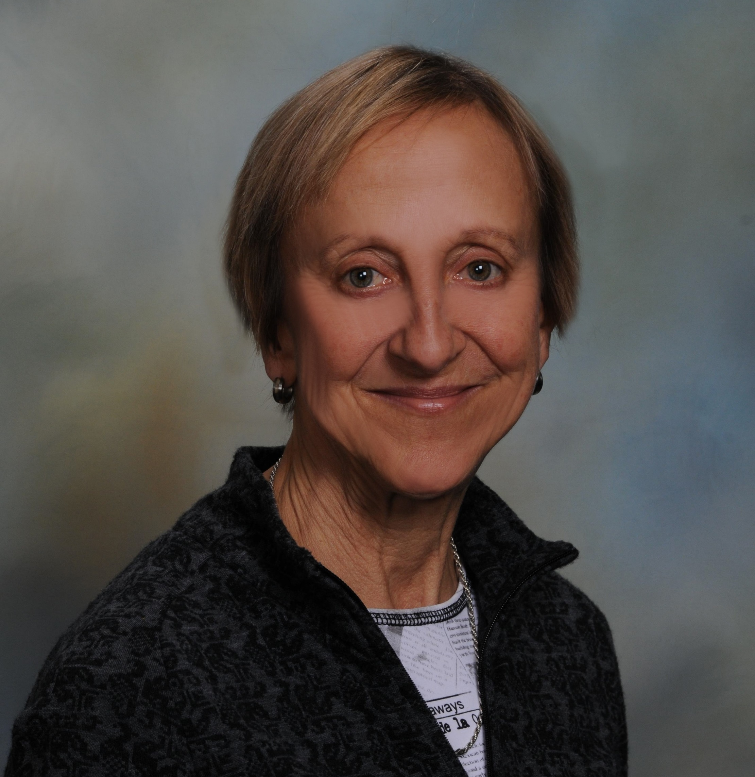
Eileen Cormier
College of Nursing
ecormier@fsu.edu
Efficacy of deliberate practice educational interventions designed to enhance clinical performance in novice nurses.
Understanding decision-making of nurses caring for patients with psychiatric comorbidities receiving treatment for medical conditions.
eHealth literacy of a general health consumer population.
Cognitions underlying decisional processes.
As a clinical nurse specialist in psychiatric/mental health nursing, I can work on problems related to parenting and managing symptoms of ADHD, cognitions underlying decision making processes, therapeutic communication skills, and eMental health literacy. I can collaborate on projects requiring knowledge of mental illness, educational interventions, and experience using qualitative and quantitative methods.

