Slide 1
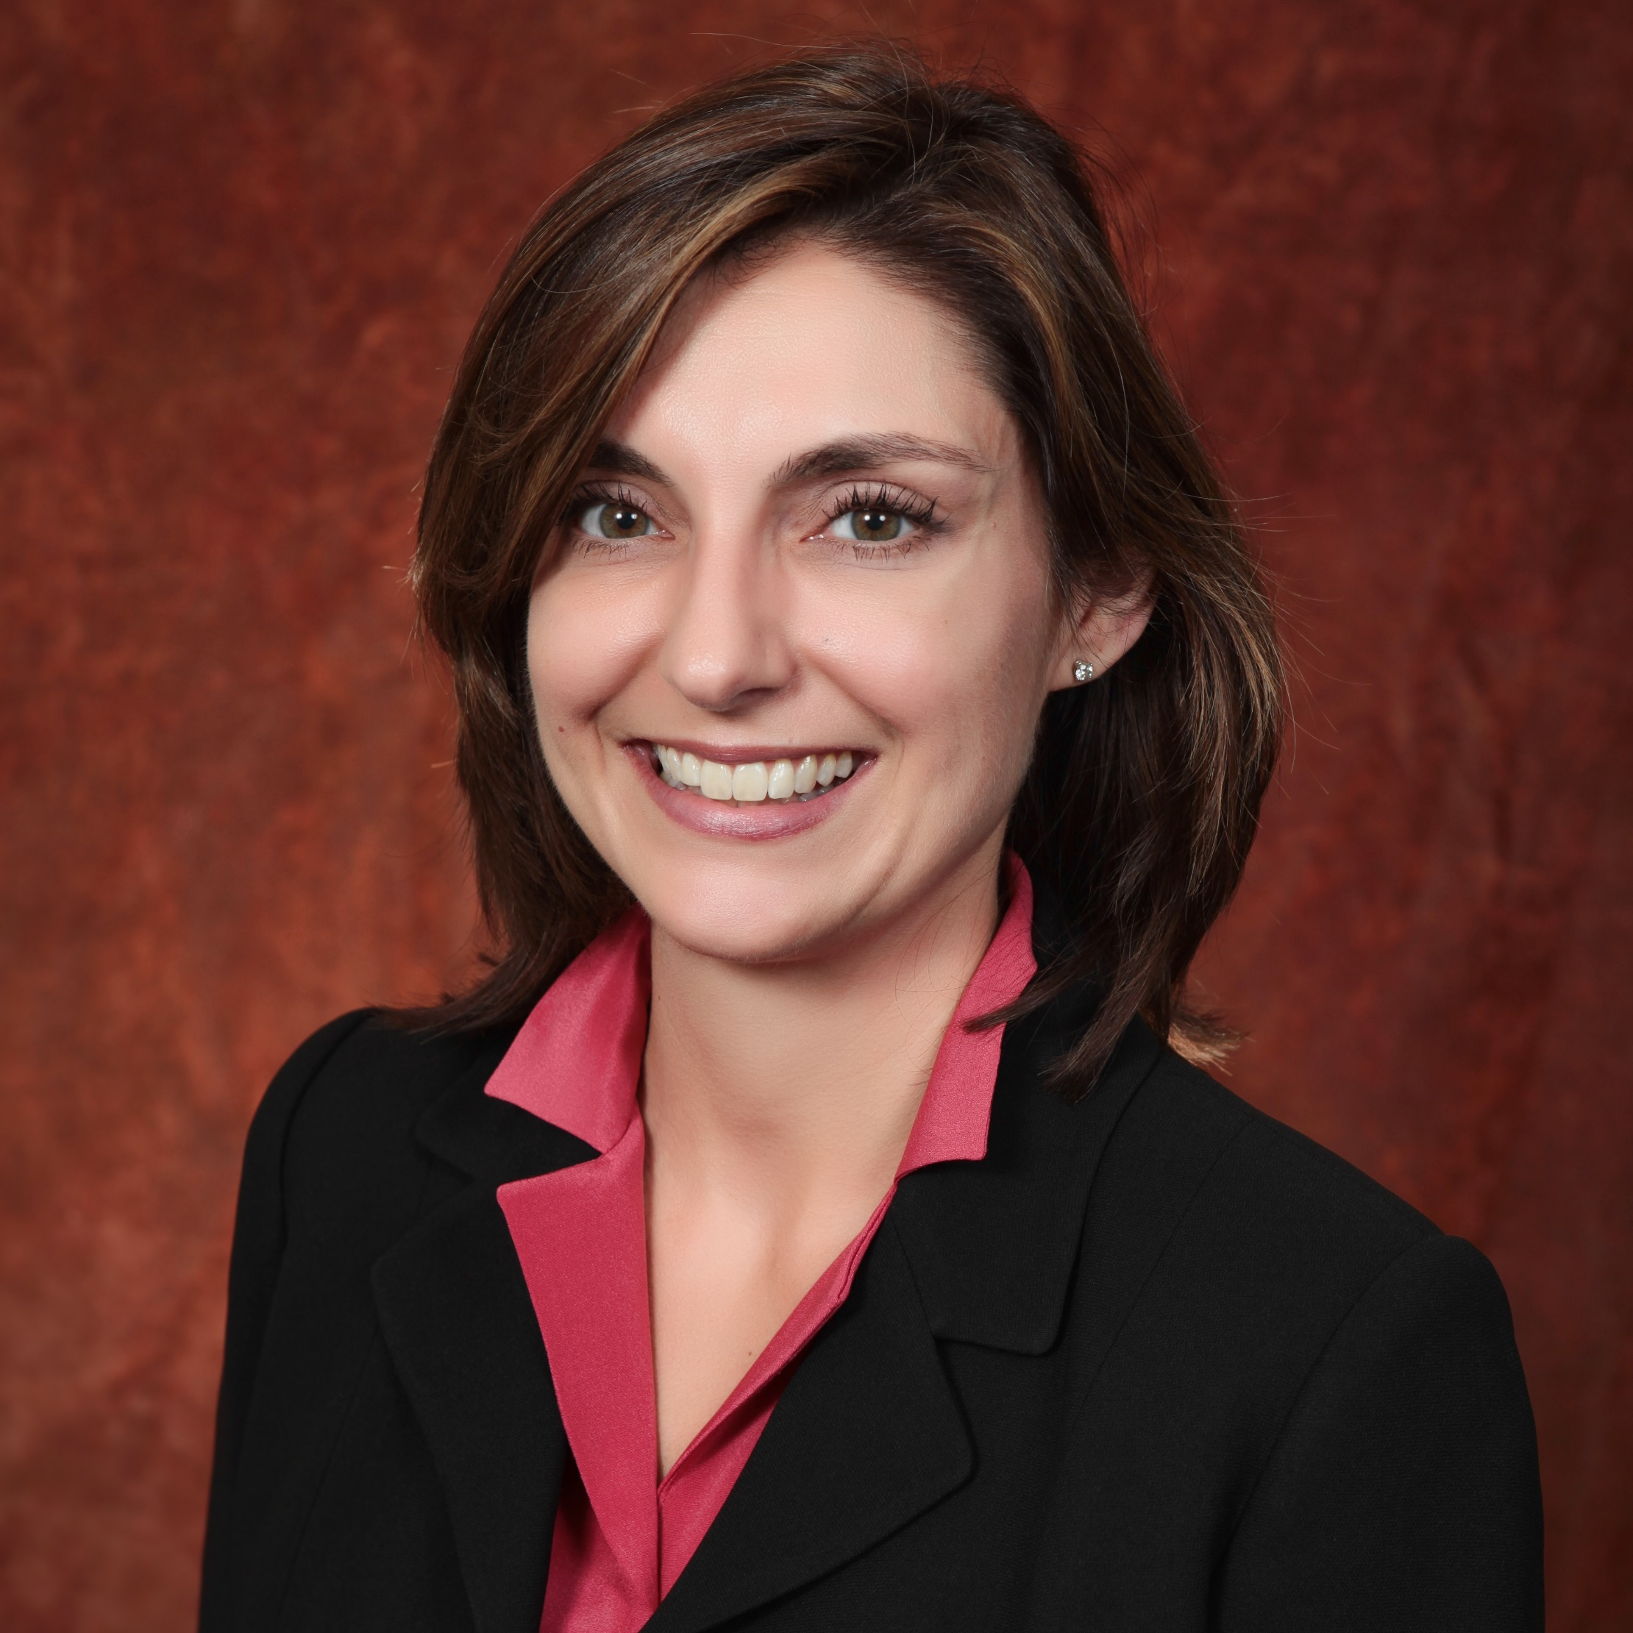
Christie Alexander, MD
Family Medicine and
Rural Health
christie.alexander@med.fsu.edu
Admissions Predictors of Students Selecting Careers in Primary Care and Rural Medicine
Improving Health Outcomes at Maryland Oaks Crossings Community (Funded by the Chapman Foundation)
Community medicine - the effects of sustainable care in low-income communities; Interdisciplinary education and practice and its effects on communities, patients, and students; Health policy
I am a family physician, so most of my expertise is clinical. I have been a part of the medical community since 1997 and part of the FSU College of Medicine since 2001 (graduated in 2005). I also sit on Board of the Florida Academy of Family Physicians and the Capital Medical Society and work with the Florida Medical Association. In doing do, I have fostered several relationships in the community that could help in putting people and projects together throughout Tallahassee and the State of Florida.

