Slide 1
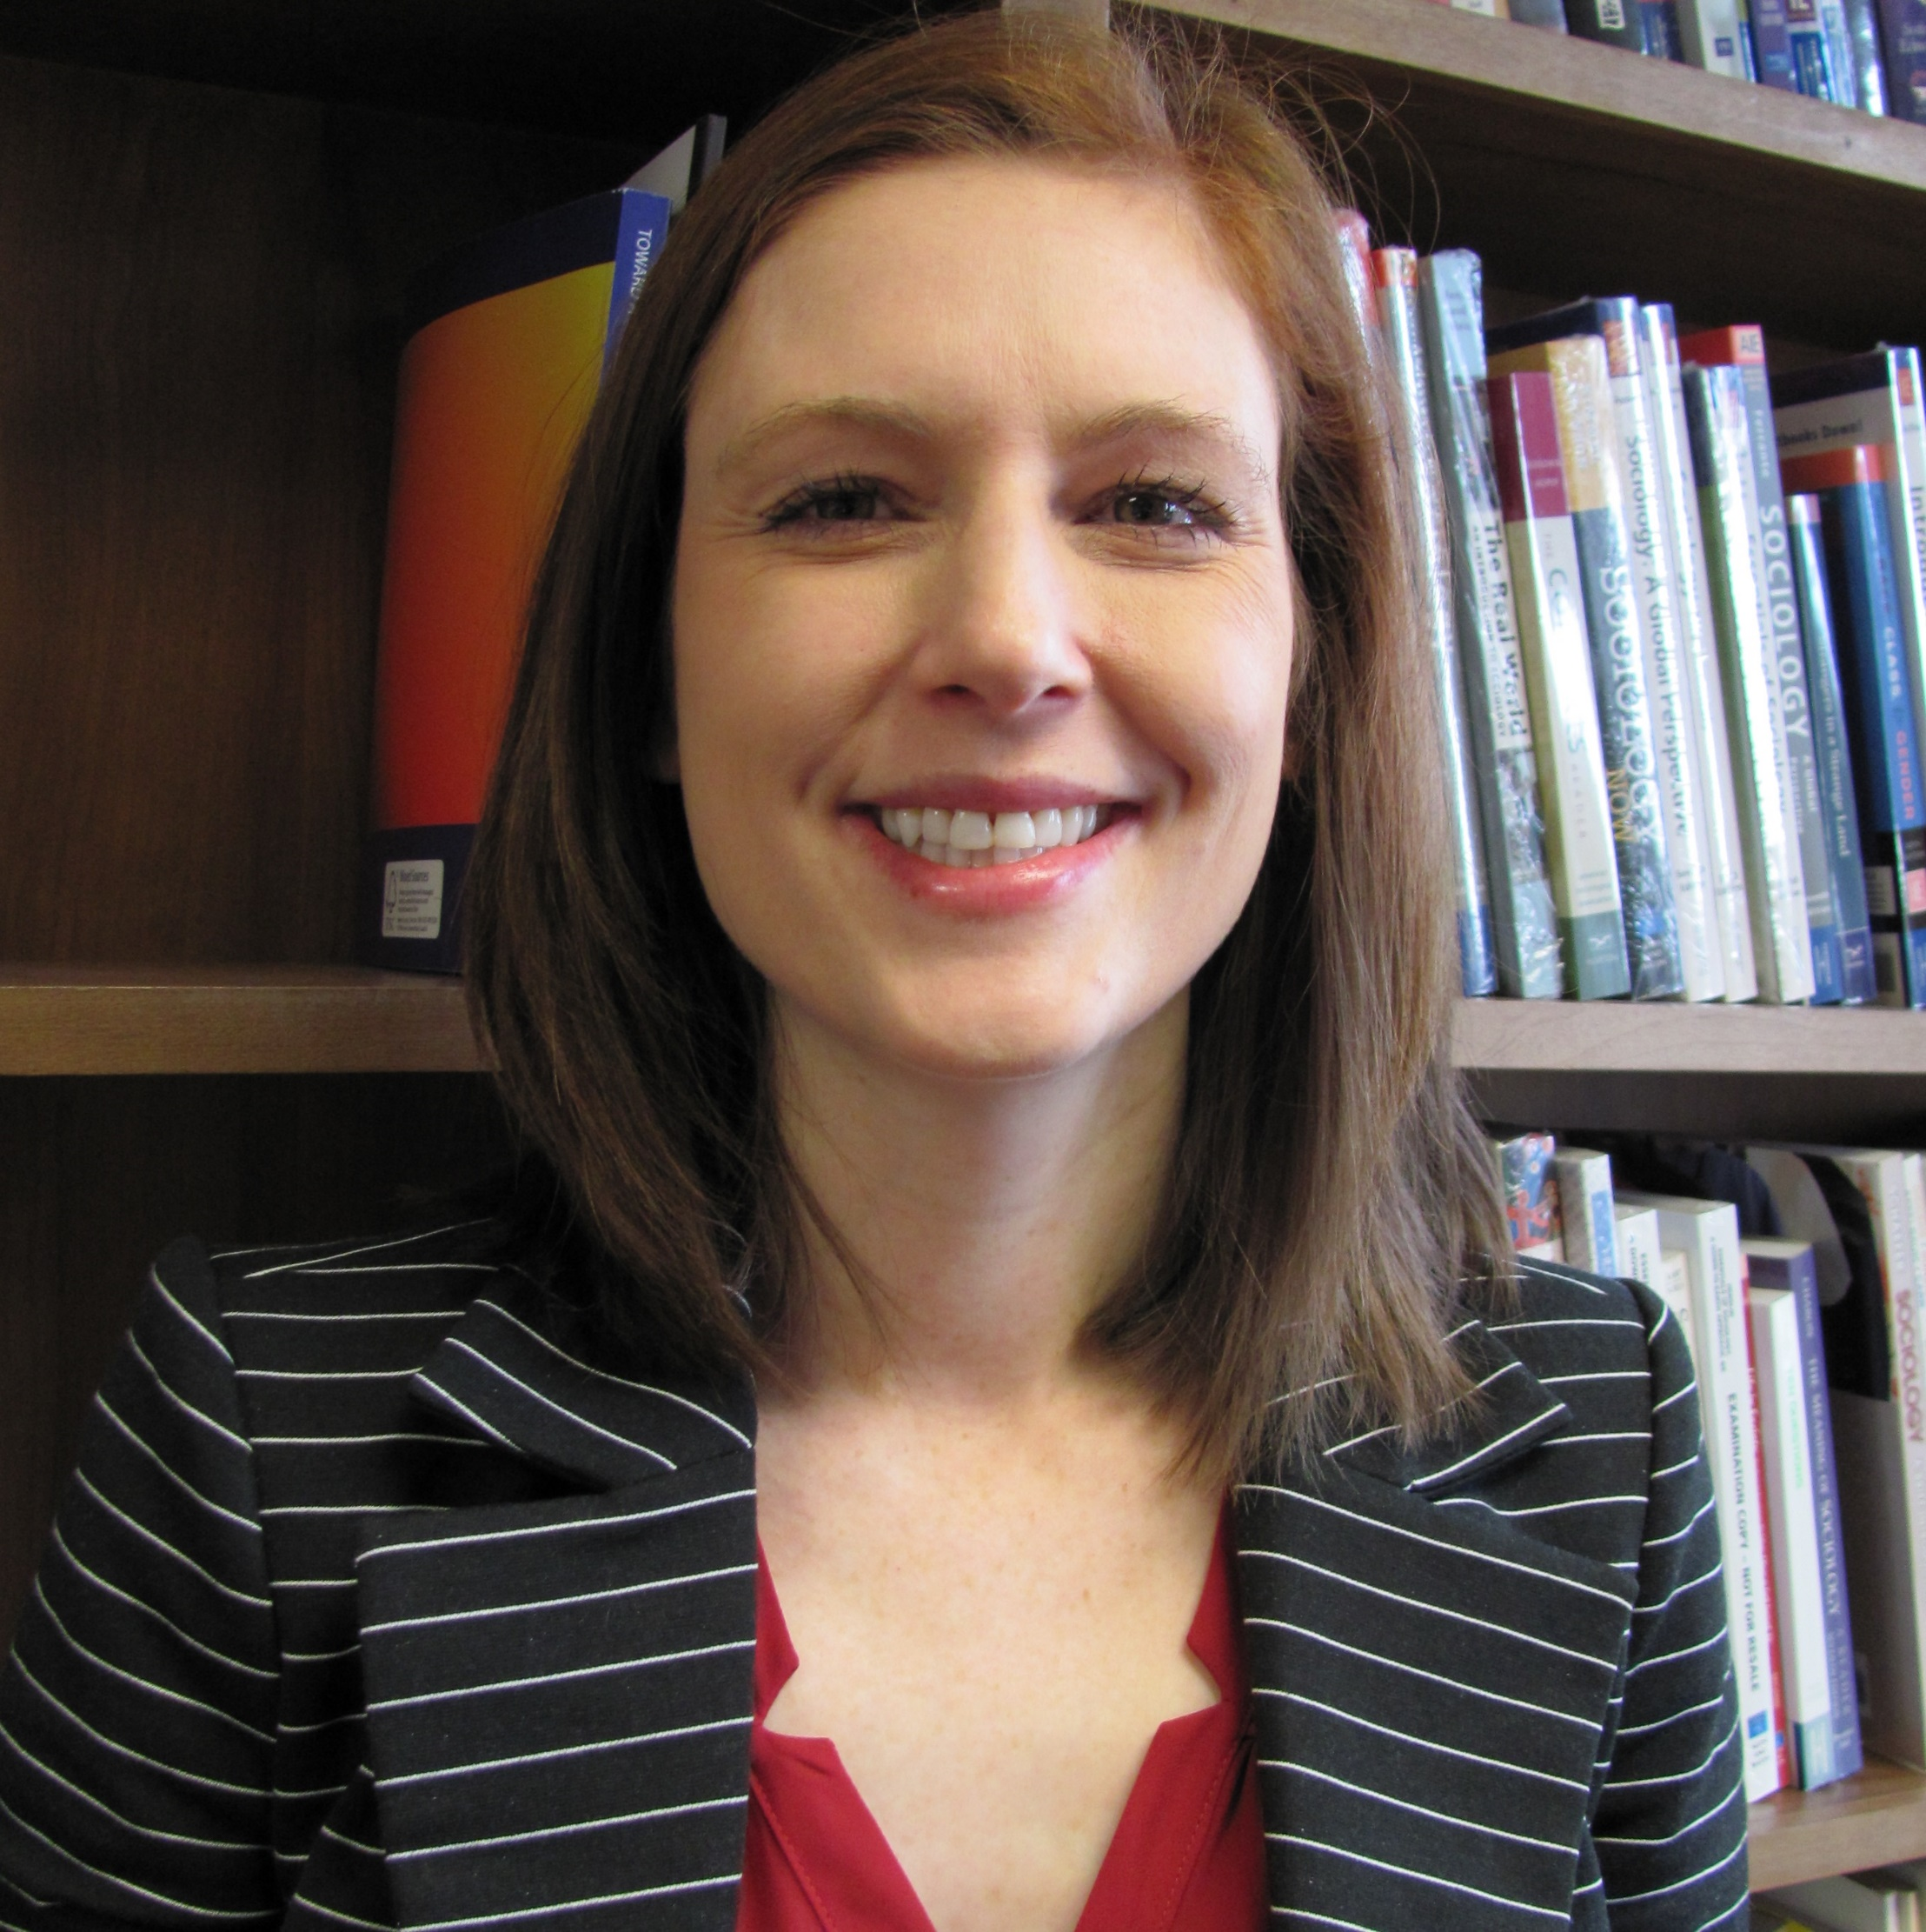
Amy Burdette
Sociology
aburdette@fsu.edu
My research focuses on sexual health, particularly variations by race and religious involvement. I also examine neighborhood disparities in health, particularly BMI.
A current proposal I am working on is focused on reducing health disparities among minority youth through athletic participation. The other is focused on sexual health among sexual minority young adults.
Aging, Disparities, Sexual Health
I am open to different collaboration options.

